Slide 1
Presentation Title
CampaignforAction.org
Title of Event/Audience
Presenter
Date

Slide 2
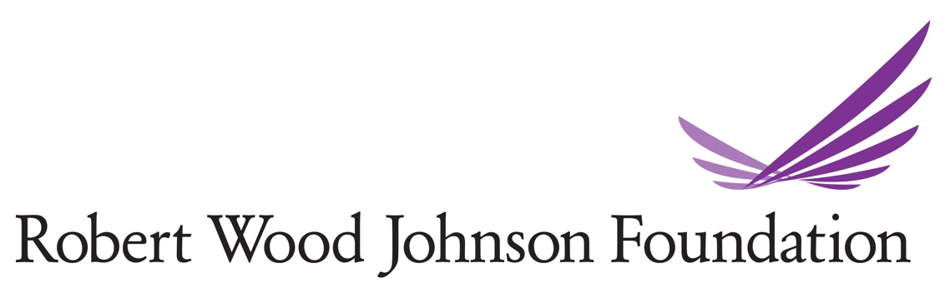


The Campaign Is…
and…
A network of multi-sector national and state coalitions working together to improve health and health equity through nursing so all people in the US can lead longer, healthier lives.
Notes:
The Campaign is an initiative of AARP Foundation, AARP’s charitable arm, AARP, the nation’s largest nonprofit, nonpartisan organization dedicated to helping people 50 and older live their healthiest lives, and the Robert Wood Johnson Foundation, the country’s largest philanthropy devoted to building a Culture of health. The fact that AARP serves nearly 38 million members made it an ideal organization to join with RWJF to fortify the nursing profession to build a healthier America. Today, the Campaign is a powerful network of state and national coalitions working with more than 2,000 organizations on a vision that everyone in America can live a healthier life, supported by nurses as essential partners in providing care and promoting health equity and well-being.

Slide 3

The Center to Champion
Nursing in America
The Center to Champion Nursing in America was created in 2007 to ensure all Americans have a highly skilled nurse when and where they need one.
Notes:
The Center to Champion Nursing in America (CCNA) runs the Campaign for Action. Like the Campaign, CCNA is an initiative of AARP Foundation, AARP and the Robert Wood Johnson Foundation. CCNA’s mission is to see that Americans have a highly skilled nurse when and where they need one.

Slide 4
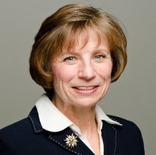
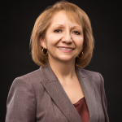
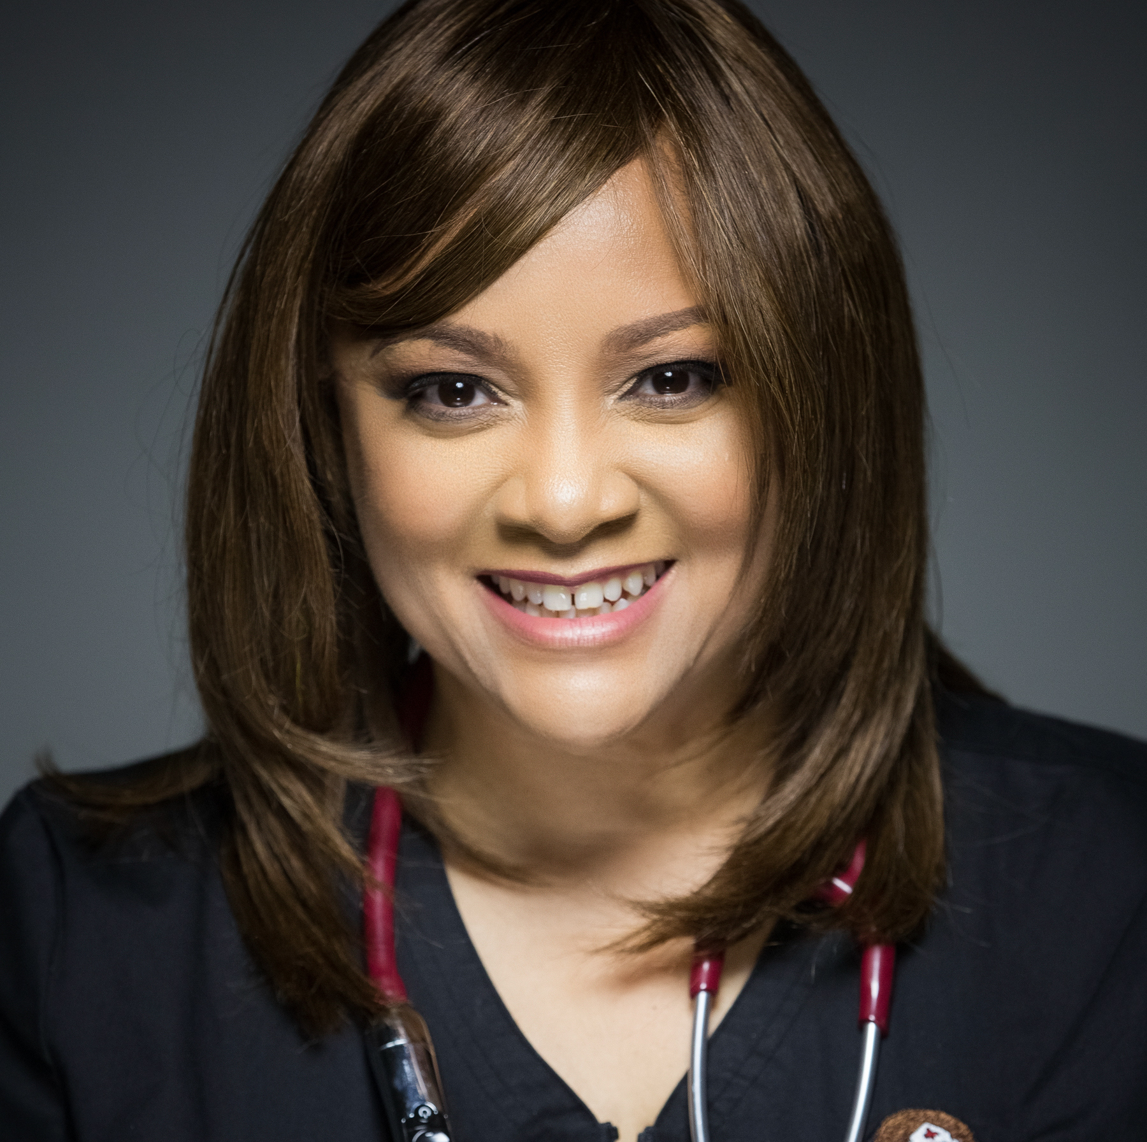
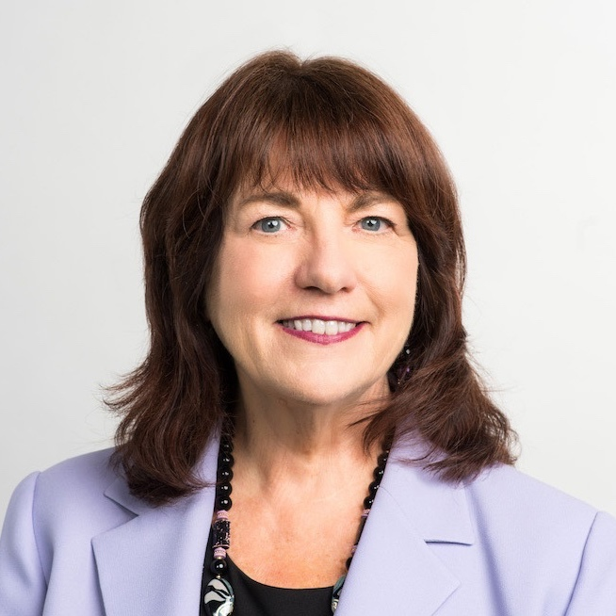
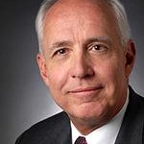
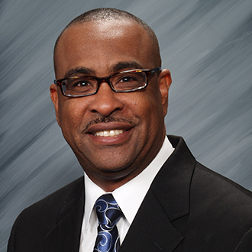
Campaign Leaders
Susan B. Hassmiller, PhD, RN, FAAN
Antonia M. Villarruel, PhD, RN, FAAN
Scharmaine Lawson, DNP, FNP
Susan C. Reinhard, PhD, RN, FAAN
Darrell Kirch, MD
Eric J. Williams, DNP, RN, FAAN
Notes:
The Campaign is led by Susan Hassmiller, senior adviser for nursing at RWJF and Chief Strategist Susan Reinhard, senior vice president and director of AARP Public Policy Institute. Antonia Villarruel and Darrell Kirch lead the Campaign’s Strategic Advisory Committee, which helps shape strategic vision. Scharmaine Lawson and Eric Williams lead the Equity, Diversity and Inclusion Steering Committee which supports the Campaign in the critical effort to diversify the nursing workforce so it reflects the communities it serves.

Slide 5



The Campaign Was Launched To …
Notes:
The Campaign was launched to implement recommendations in the Institute of Medicine’s 2010 report, The Future of Nursing: Leading Change, Advancing Health, which was focused on building a robust nursing profession. But not just for its own sake. We need a larger, more highly skilled nurse workforce to give more people more access to health care. Today, we are leading efforts to implement recommendations from the National Academy of Medicine’s latest report on nursing, The Future of Nursing 2020-2030: Charting a Path to Achieve Health Equity.

Slide 6

The Campaign’s Tools Empower Nurses and Stakeholders
Action Hub
https://campaignforaction.org/action-hub
Campaign for Action Dashboard
https://campaignforaction.org/campaign-dashboard
Health Equity Toolkit
https://campaignforaction.org/equity-toolkit/
Nursing Innovations Fund
https://campaignforaction.org/nursing-innovations
Learning Collaboratives
https://campaignforaction.org/learning-collaboratives/
Notes:
The Campaign functions as a convener, a facilitator, equipping a multi-sector network to advance a mission. We have invested in building tools and resources to put into the hands of partners and our state coalitions. Here are a few examples:
Our Action Hub is where we share ideas and resources about how to implement recommendations from the National Academy of Medicine’s Future of Nursing 2030 report.
The Campaign for Action Dashboard is updated twice a year and measures our progress by primary indicators that look at metrics around key areas, including nursing education, state practice environment, diversity and leadership. We also have a secondary dashboard with additional measures.
The Health Equity Toolkit helps nurses help their communities by tackling the social determinants of health—those conditions in which people are born, grow, live, work and age, including social and economic factors that have a great influence on people’s health.
The Nursing Innovations Fund awards creative, replicable and evidence-based solutions that highlight nurses leading in improving health equity. We have awarded over $850,000 to 23 state coalitions, and they have raised over $1 million in matching funds. In fact, our state coalitions have raised more than $93 million in the past decade.
Learning Collaboratives are opportunities to learn and share knowledge about priority issues with each other, subject matter experts and Campaign stakeholders.
Next up: A quick look at the Campaign’s accomplishments in the past decade

Slide 7

Fortifying Nursing Since 2011
Improved access to care
for millions of people
A nursing work force that
is becoming more diverse and inclusive
More nurses in
leadership positions
Nurses are more
highly educated
Notes:
The Campaign’s founding coincided with the passage of the Affordable Care Act, which gave so many more Americans access to health care. A major goal was to help meet the demand by building a workforce of highly skilled nurses. To do that, the Campaign focused early on transforming nursing education and nurse empowerment.
We have hit critical important milestones.
By modernizing state laws and regulations, 84 million Americans in 28 states have improved access to care.
A nursing work force should reflect the communities it serves. And while we still have a long way to go – the workforce is largely made up of white nurses -- data do that show that the number of pre-licensure registered nursing school graduates from underrepresented groups increased by almost 80 percent from 2009 to 2019. These groups include American Indian/Alaskan Native, Asian, Black, Hispanic, Native Hawaiian or other Pacific Islander, plus those who identify as having two or more races.
Knowing that nurses represent the voices of consumers, we have helped place more than 10,000 nurses on boards or decision-making bodies with strategic influence to improve the health of communities.
The number of RN-to-BSN graduates grew 252 percent from 2009 to 2020, while the number of doctorally prepared nurses jumped more than 300 percent.

Slide 8
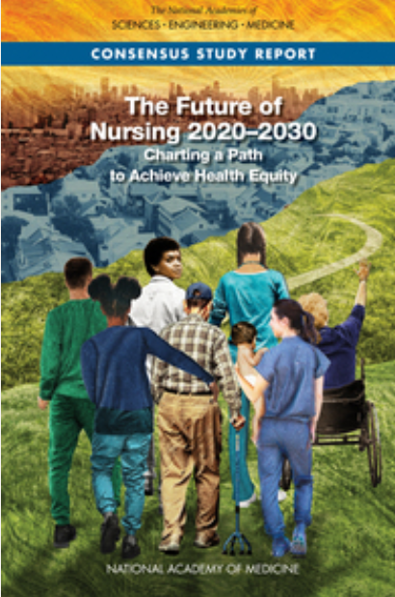
Future of Nursing 2020-2030:
Charting a Path to Achieve Health Equity
Committee Vision:
The achievement of health equity in the United States built on strengthened nursing capacity, diversity and expertise
Notes:
In 2018, RWJF asked the National Academy of Medicine to chart a path for the nursing profession to create a culture of health, reduce health inequities, and improve the health and well-being of the nation -- and the Academy went to work to work on this report.
Input was solicited from many sources, including three regional “town hall” meetings in 2019 – in Chicago, Philadelphia and Seattle.
While the report committee was in the midst of writing the report, the pandemic happened, followed by renewed calls for racial justice. The report was delayed and modified to incorporate the lessons of the pandemic, its devastating toll on nurses, and the imperative to confront structural inequities, including racism.
Over the next few slides, I will review terms such as health equity, which can mean different things to different people. After that, we’ll dig into four key takeaways from the NAM report and then go through its nine major recommendations for nursing to advance health equity.

Slide 9
Health Equity
“Health equity means increasing opportunities for everyone to live the healthiest life possible, no matter who we are, where we live, or how much money we make.”
–The Robert Wood Johnson Foundation
Notes:
As a country, we have long failed to give everyone a fair and just opportunity for health. We know that health is greatly influenced by non-medical factors that affect communities, such as safe and affordable housing, access to jobs that pay a living wage, reliable transportation, walkable neighborhoods, good schools, fresh food, and adequate green spaces. Factors like our race and ethnicity, income level, sexual orientation, disabilities, and the conditions where we live – including in rural and remote areas -- predict whether we are more likely to suffer from preventable, costly medical conditions, and live shorter lives.

Slide 10

Inequities and Structural Racism
Notes:
Health inequities mirror economic inequities mirror social inequities, and on and on.
Health disparities between different ethnic and racial groups have been documented for decades. They reflect longstanding structural and systemic inequities rooted in racism and discrimination.
The social determinants of health are real.
For example, Black and American Indian or Alaska Native (AIAN) people fare worse compared to White people across most indicators: birth risks; infant mortality rates; HIV and AIDS diagnosis and death rates; and death rates due to certain chronic conditions.
For example, nonelderly Hispanic people are nearly three times as likely as White people to lack health coverage, and nonelderly American Indian or Alaska Native people are over three times as likely to be uninsured.
These kinds of disparities occur across socioeconomic status, age, geography, language, gender, disability status, citizenship status, and sexual identity and orientation -- in intersecting ways.
The Campaign believes that our pathway to equity is to help build better health for all through nursing.

Slide 11
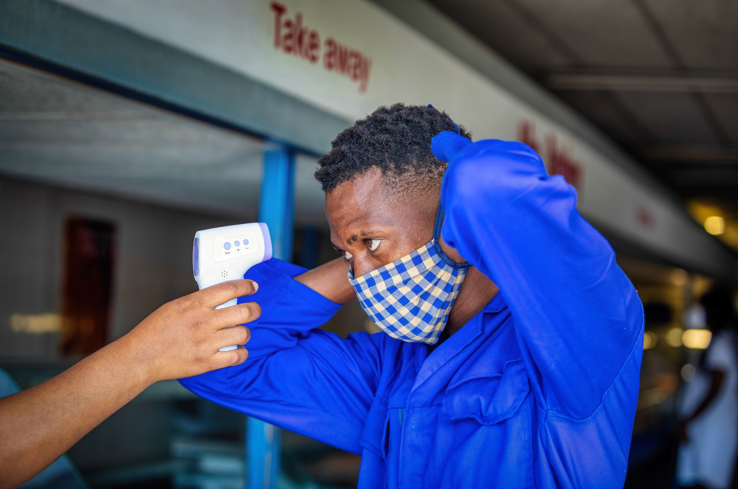
COVID-19 and Health Inequities
Notes:
The pandemic has laid bare these inequities and the correlating health disparities that have plagued us for generations. The effects of the pandemic on health were especially severe for people making low incomes and older Americans living in long-term care facilities.
Pandemic-related financial challenges have also disproportionately impacted those who were already struggling. People of color and those with low income are more likely to live in crowded housing, rely on public transportation, and be essential workers. They are also more likely to lack health insurance and less likely to be able to access care. In short, they are at higher risk of getting sick or dying from COVID.
One study after another bears all of this out.
*************************************************************************************
A presenter might opt to leave out some/all of the below examples for the sake of time
In mid-2021, a Centers for Disease Control and Prevention study, adjusting for population age differences, estimated that Native Americans, Latinos and Blacks are two to three times more likely than white people to die of COVID-19.
The Associated Press followed up those numbers and found that Latinos were dying at much younger ages than other groups. Hispanic people between 30 and 39 have died at five times the rate of white people in the same age group.
An October 2021 study published in the Annals of Internal Medicine found, and I am quoting: “Age-standardized excess deaths per 100 000 persons among Black, American Indian/Alaska Native (AI/AN), and Latino males and females were more than double those in White and Asian males and females. Non–COVID-19 excess deaths also disproportionately affected Black, AI/AN, and Latino persons. Compared with White males and females, non–COVID-19 excess deaths per 100 000 persons were 2 to 4 times higher in Black, AI/AN, and Latino males and females, including deaths due to diabetes, heart disease, cerebrovascular disease, and Alzheimer disease. Excess deaths in 2020 resulted in substantial widening of racial/ethnic disparities in all-cause mortality from 2019 to 2020.”
Income has also been a factor. One team of researchers trying to understand geographic variation in COVID death rates found that, quote “that preexisting inequality is a powerful force generating inequality in death.”
Another study focused on Social Determinants of Health and COVID concluded: “With respect to income, COVID-19 deaths are disproportionately among middle- and lower-income people. Those making below the median income, which is the $55,000–$64,999 category, make up 67.5% of deaths.…”
Lastly, nursing home residents and staff. Together they are less than 1% of the U.S. population, yet they make up about a third 40% of COVID-19 deaths. Older, often frail residents of these facilities are powerless to protect themselves and have become sick and died in heart wrenching numbers.
SOURCES:
https://apnews.com/article/baltimore-california-coronavirus-pandemic-race-and-ethnicity-health-341950a902affc651dc268dba6d83264
https://www.acpjournals.org/doi/10.7326/M21-2134
https://insight.kellogg.northwestern.edu/article/covid-19-death-rates-income-inequality
https://journals.plos.org/plosmedicine/article?id=10.1371/journal.pmed.1003490

Slide 12

Key Takeaways of the NAM Report
For our country to advance health equity for all, the systems that educate, pay, and employ nurses need to:
Prepare nurses to advance health equity
Permanently remove nurse practice barriers
Value nurses’ contributions
Fully support nurses
Notes:
A nation cannot fully thrive until everyone—no matter who they are, where they live, or how much money they make—can live their healthiest possible life, and helping people live their healthiest life is and has always been the essential role of nurses. Nurses have a critical role to play in achieving the goal of health equity, but they need robust education, supportive work environments, and autonomy, the National Academy of Medicine study found.
I will review four key takeaways from the NAM report and then move to the NAM’s nine detailed actionable recommendations for nursing to advance health equity.

Slide 13

Takeaway 1: Prepare Nurses to Advance Health Equity for All
Nursing schools should:
Cultivate an inclusive environment
Recruit and admit diverse students
Provide students with support and mentorship
Ensure that all nurses practice cultural humility and are aware of their biases
Notes:
To achieve these four “takeaway” goals, the National Academy of Medicine suggested actions for each, and I will go through them in the next several slides.
For the first -- preparing nurses to advance health equity for all -- the NAM urges nursing schools and nurse education leaders to commit to dismantling interpersonal and structural racism within their own institutions by:
Changing curricula, which have historically focused on the contributions of white and female nurses.
Having difficult conversations about privilege and power
Dismantling long-standing, exclusionary traditions that exclude some groups over others
Understanding how interpersonal and structural racism shapes the student experience
Reviewing and detecting biases in curricula routinely

Slide 14

Prepare Nurses to Advance Health Equity
Nursing schools should:
Integrate content about the drivers of health, health inequities, and population health concepts throughout
the curriculum.
Expand community learning opportunities
Increase number of nurses
with PhDs who focus on health equity and nurse well-being
Notes:
The pandemic has reinforced that all nurses regardless of where they practice should possess deep, empathetic, real-world knowledge and understanding of the social, economic, and environmental factors that affect health and well-being. But many nurses are still not taught about these issues in the classroom.
Most nursing schools cover health equity and the social determinants of health as a siloed topic, leaving nurses unprepared to work in a wide variety of settings and with people from diverse backgrounds.
A good example of a nursing education program that is effectively preparing students to address the social determinants of health and collaborate across disciplines is based in Topeka, Kansas at Washburn University. In 2017, the university partnered with the Topeka Housing Authority to open the Pine Ridge Family Health Center. A nurse practitioner is leading the effort and leads the center, which focuses on providing care to community members, many of whom have low incomes and limited access to care.
The university uses the community-based center as an educational forum for students, including those from the School of Nursing, with a curriculum that covers topics ranging from social justice to trauma-informed care. The center is also a dedicated training site for nurse practitioner students, giving them real-world training in addressing the social factors that affect health.

Slide 15

Takeaway 2: Permanently Remove
Nurse Practice Barriers
Modernize Scope of
Practice Laws and
Regulations
Remove Restrictions
Notes:
All organizations, including state and federal entities and employing organizations, should enable ALL nurses to practice to the full extent of their education and training by removing: Regulatory and public and private payment limitations and restrictive policies and practices.
Nurses face barriers every day in all settings.
Nurses currently face two types of barriers: those relating to scope of practice, which can be lifted through policy changes; and institutional ones, that affect where nurses are working, learning, and training.
One example rose to the forefront amid COVID-19. Before the pandemic, many APRNs were not allowed to bill for telehealth services.
But during the crisis, the Centers for Medicare & Medicaid Services temporarily broadened telehealth access for Medicare beneficiaries. Nurse practitioners and other healthcare professionals have used telehealth to screen people for COVID-19 and treat noncritical illnesses that can be managed at home.
To address these barriers, the report recommends that:
Policymakers support full practice authority for APRNs in all settings. Federal authority should be used to supersede restrictive state laws.
Employers and government agencies need to remove institutional barriers, such as telehealth restrictions and restrictive workplace policies.
All related changes in policies and state and federal laws adopted in response to COVID-19 should be made permanent. We’ve seen since the start of the pandemic these changes really do work.

Slide 16
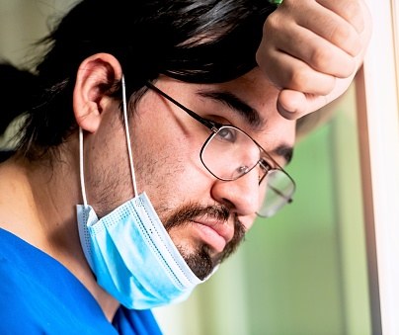
Takeaway 3: Fully Support All Nurses
To promote nurses’ health
and well-being, nursing organizations should initiate the implementation of structures, systems and evidence-based interventions.
Notes:
As the COVID-19 pandemic has starkly revealed, responding to crises takes a serious toll on nurses’ mental and physical health. Nurse well-being is a cycle that affects all aspects of their work.
The truth is that nurses were experiencing a well-being crisis long before this:
Estimated rates of burnout among nurses range from 35 to 45 percent.
Nurses are at higher risk than the general population for suicide.
There is an “expected culture” within nursing in which young or new nurses routinely encounter bullying, intimidation, hostility and even hazing from other staff nurses, supervisors and managers.
Nurses who work in long-term care settings face stressors such as physical or verbal abuse from residents with dementia and exposure to death and declining health.
Nurses of color experience discrimination and bias within the workplace and educational settings, compounded by the lack of diversity among the nursing workforce and faculty.
Not surprisingly, and tragically, more than half of the nurses who have died from COVID or COVID complications have been nurses of color.
Some universities have started to take steps to address this challenge.
Presenters can adjust length and detail below depending on preference
For example, the University of Virginia’s School of Nursing’s Compassionate Care Initiative serves students, faculty, and staff and promotes well-being through focused coursework, resiliency activities, workshops, retreats, and meditation and yoga classes. CCI conducts research on things like compassion, resilience and self care and has an ambassador program in which student-clinicians, faculty, and community members meet monthly to share successes and challenges.
Associations and other professional organizations are also taking steps to promote nurse well-being.
The Pathways to Excellence Program, an initiative of the ANCC, recognizes health care organizations that demonstrate a culture that fosters a work environment that promotes wellbeing.
Institutions that meet the 12 standards focusing on workplace excellence are seeing improved patient care, decreased emotional exhaustion, and higher job satisfaction.
In May 2020, the ANA Foundation, the philanthropic arm of the American Nurses Association, launched a national well-being initiative for nurses to address the increased stress due to COVID. This is a collaboration between ANA and other nursing groups, including the American Psychiatric Nurses Association. It includes peer-to-peer conversations, hotlines, cognitive processing techniques, and apps for stress reduction.
The National Black Nurses Association has an affirmations webpage in which nurses can share favorite quotes or positive affirmations; and the National Association of Hispanic Nurses conducts educational programming that includes webinars focused on stress and compassion fatigue.
SOURCE: https://www.nationalnursesunited.org/sites/default/files/nnu/documents/0920_Covid19_SinsOfOmission_Data_Report.pdf

Slide 17

Takeaway 4: Value Nurses’ Contributions
Establish sustainable and flexible payment mechanisms to support nurses in both health care and public health, including school nurses, in addressing social needs, social determinants of health, and health equity.
Notes:
The current payment systems are not designed to pay for services that address social needs and social determinants of health (SDOH), nor advance health equity.
By supporting team-based care, improved communication, and proven interventions and strategies that can reduce health disparities – including school and public health nursing – payment systems can enable nurses to make these essential contributions to improving care and outcomes for all patients.
Presenters should modify below for length and detail
What does that look like in practice?
One example would be to reform fee-for-service payment models by ensuring that the Current Procedure Terminology (CPT) code set includes codes to describe, and reimburse, for nurse- led services such as case management, care coordination, and team-based care to address behavioral health, addiction, SDOH, and health equity.
Another example would be to reform value-based payment by using clinical performance measures stratified by risk factors such as race, ethnicity, and socioeconomic status. That could include measures that incentivize reductions in health disparities between more and less advantaged populations, improvements in measures for at-risk populations, and attainment of absolute target levels of high-quality performance for at-risk populations.
Another example that’s very important is ensuring adequate funding for school and public health nursing. Allow school nurses to bill Medicaid. Reimburse school nursing services that include collaboration with clinical and community health care providers. Use competitive pay scales for public health nurses.
Federal, state, local and private payers all need to get together on payment systems that recognize the immense value that public health nursing has for addressing and intervening in health inequities.
PHOTO https://www.gettyimages.com/detail/photo/nurse-talking-to-girl-while-parents-listen-during-royalty-free-image/1309074902

Slide 18

Nine Recommendations
Notes:
What follows are the NAM’s nine recommendations for nurses, working with others, to lead in advancing health equity.
[NOTE: presenters can customize here: Go through them all, dive deeper on certain reccs, include subrecommendations, etc. ]

Slide 19
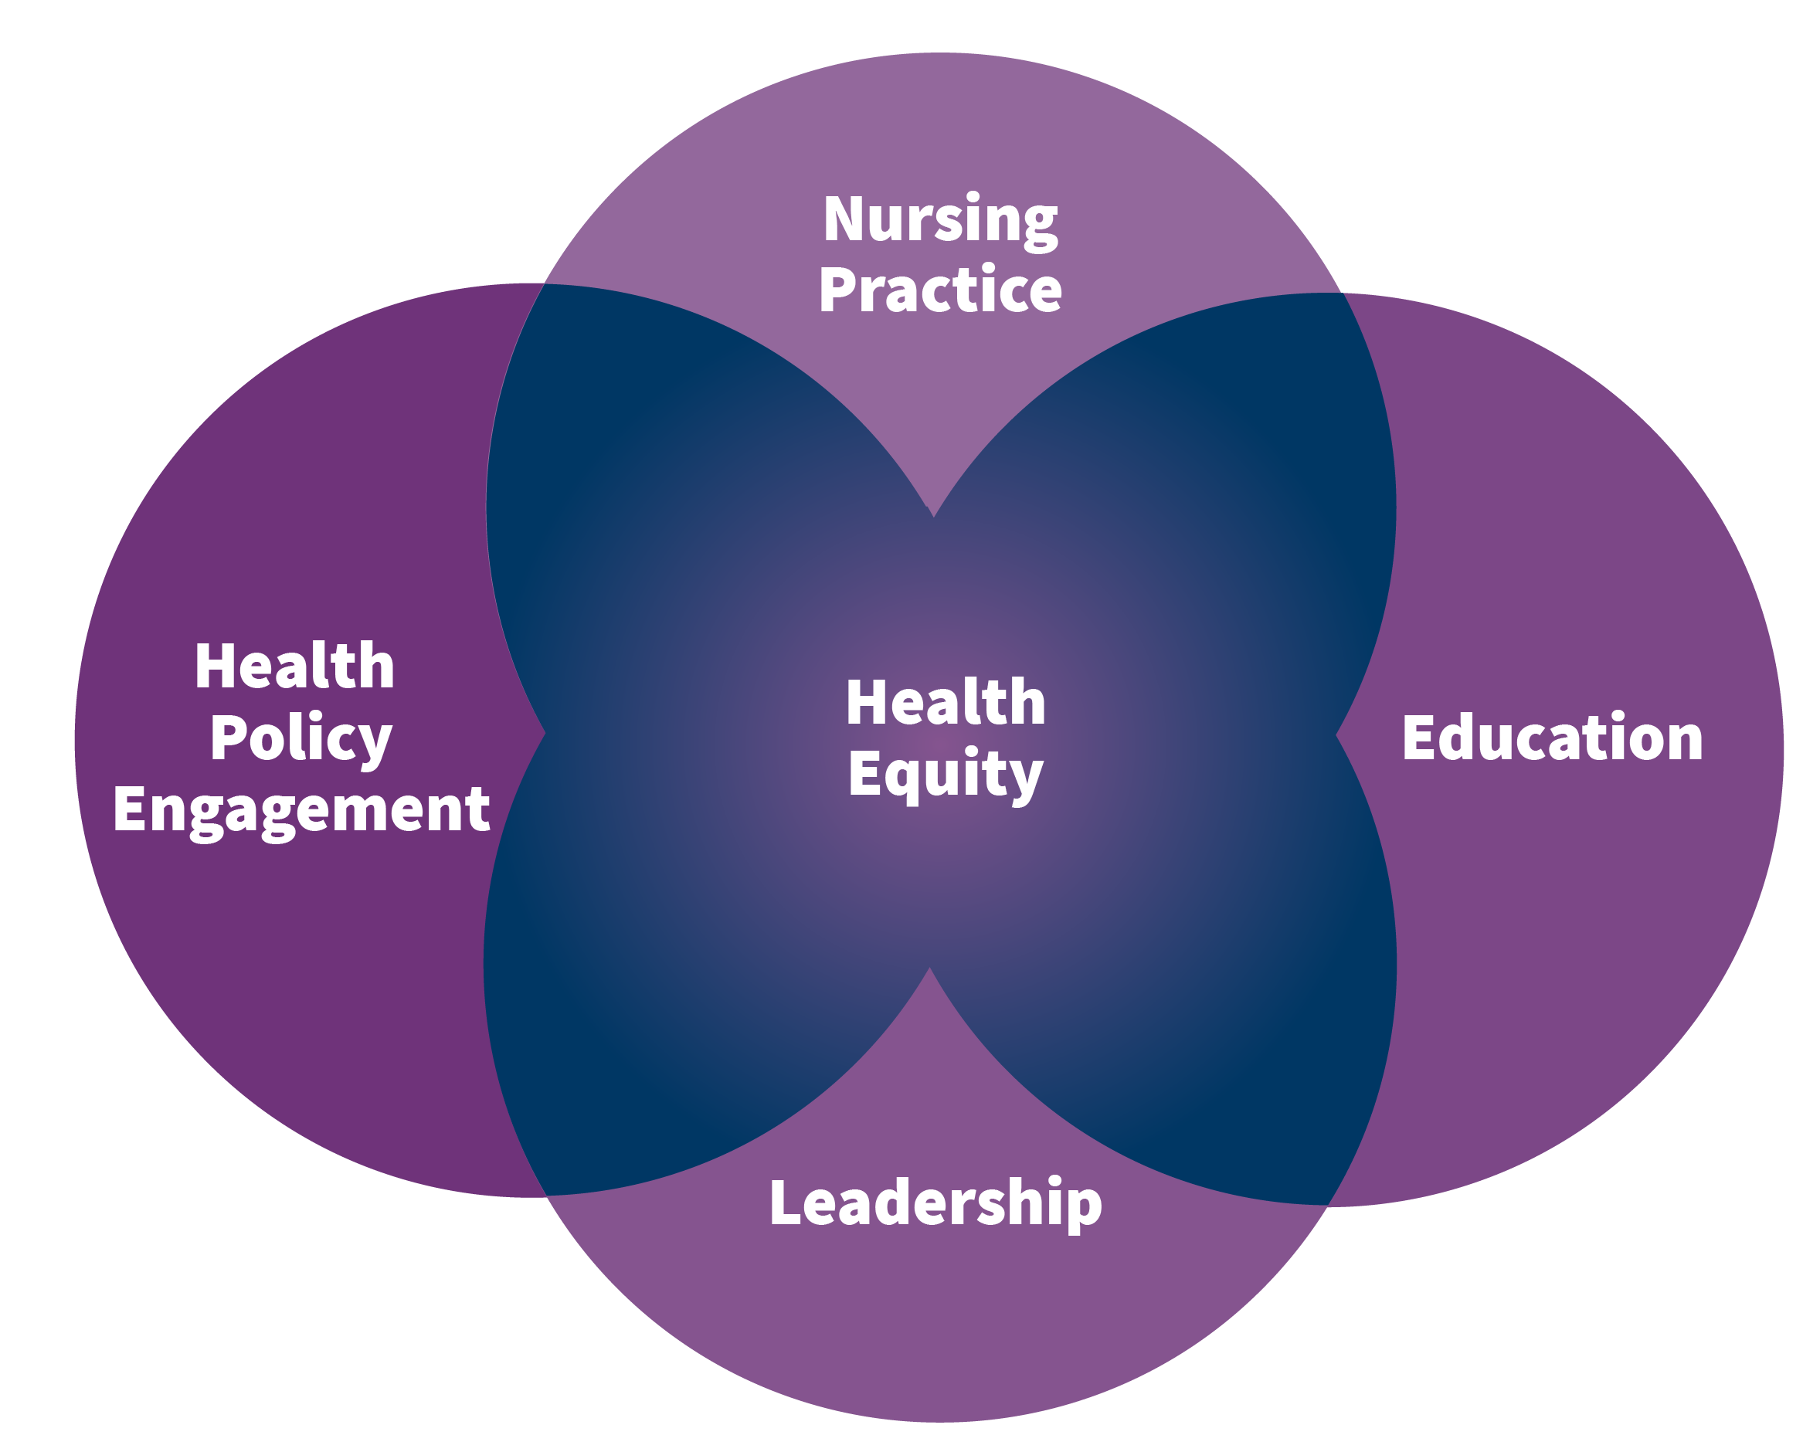
Recommendation 1:
CREATING A SHARED AGENDA
Notes:
All national nursing organizations should initiate work to develop a shared agenda for addressing social determinants of health and achieving health equity. This agenda should include explicit priorities across nursing practice, education, leadership, and health policy engagement.

Slide 20
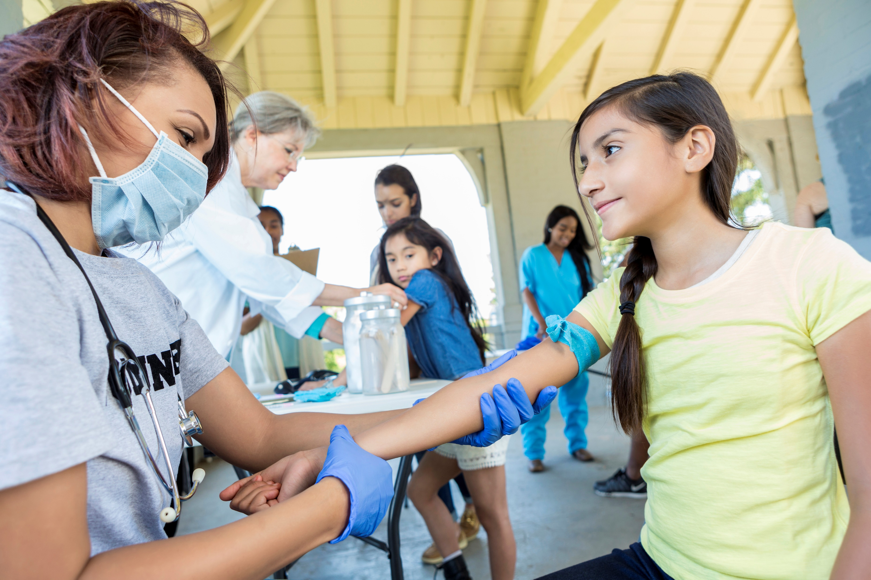
Recommendation 2:
SUPPORTING NURSES TO ADVANCE HEALTH EQUITY
Notes:
By 2023, state and federal government agencies, health care and public health organizations, payers, and foundations should initiate substantive actions to enable the nursing workforce to address social determinants of health and health equity more comprehensively, regardless of practice setting.

Slide 21

Recommendation 3:
PROMOTING NURSES’ HEALTH AND WELL-BEING
Notes:
Nursing education programs, employers, nursing leaders, licensing boards, and nursing organizations should initiate the implementation of structures, systems, and evidence-based interventions to promote nurses’ health and well-being, especially as they take on new roles to advance health equity.

Slide 22

Recommendation 4:
CAPITALIZING ON NURSES’ POTENTIAL
Notes:
All organizations, including state and federal entities and employing organizations, should enable nurses to practice to the full extent of their education and training by removing barriers that prevent them from more fully addressing social needs and social determinants of health and by improving health care access, quality, and value. These barriers include regulatory and public and private payment limitations; restrictive policies and practices; and other legal, professional, and commercial impediments.

Slide 23

Recommendation 5:
PAYING FOR NURSING CARE
Notes:
Federal, tribal, state, local, and private payers and public health agencies should establish sustainable and flexible payment mechanisms to support nurses in both health care and public health, including school nurses, in addressing social needs, social determinants of health, and health equity.

Slide 24

Recommendation 6:
USING TECHNOLOGY TO INTEGRATE DATA ON SOCIAL DETERMINANTS OF HEALTH INTO NURSING PRACTICE
Notes:
All public and private health care systems should incorporate nursing expertise in designing, generating, analyzing and applying data to support initiatives focused on social determinants of health and health equity using diverse digital platforms, artificial intelligence, and other innovative technologies.

Slide 25

Recommendation 7:
STRENGTHENING NURSING EDUCATION
Notes:
Nursing education programs, including continuing education, and accreditors and the National Council of State Boards of Nursing should ensure that nurses are prepared to address social determinants of health and achieve health equity.

Slide 26

Recommendation 8:
PREPARING NURSES TO RESPOND TO
DISASTERS AND PUBLIC HEALTH EMERGENCIES
Notes:
To enable nurses to address inequities within communities, federal agencies and other key stakeholders within and outside the nursing profession should strengthen and protect the nursing workforce during the response to such public health emergencies as the COVID-19 pandemic and natural disasters, including those related to climate change.

Slide 27

Recommendation 9:
BUILDING THE EVIDENCE BASE
Notes:
The National Institutes of Health, the Centers for Medicare & Medicaid Services, the Centers for Disease Control and Prevention, the Health Resources and Services Administration, the Agency for Healthcare Research and Quality, the Administration for Children and Families, the Administration for Community Living, and private associations and foundations should convene representatives from nursing, public health, and health care to develop and support a research agenda and evidence base describing the impact of nursing interventions, including multisector collaboration, on social determinants of health, environmental health, health equity, and nurses’ health and well-being.

Slide 28



Which Recommendation
Will You Take On?
Join your state coalition:
campaignforaction.org/state-action-coalitions/
Sign up for newsletter: campaignforaction.org/newsletter-sign-up/
Email us: campaignforaction@aarp.org
www.facebook.com/CampaignForAction/
twitter.com/Campaign4Action
The challenge is clear. Everyone needs to engage.
www.youtube.com/user/FutureofNursing
Notes:
Health systems, businesses, social justice movements, government, everyone and you … has an interest in working with nursing and supporting nursing to help move the nation toward health equity.
The report is a comprehensive roadmap for getting us as a profession where we want to be. No one group can get it all done. If there is a recommendation that resonates with your, your organization or your community, take it on. Take ownership. Develop an action plan for achieving that goal on whatever scale makes sense….

