Slide 1

Nurses Leading Change and
Building a Healthier America
Audience
Date
Speaker
Notes:
Thank you so much. I’m excited to talk to you about building a Culture of Health here in [insert community]– by that I mean enabling everyone to live the healthiest life possible. It’s something that we can do together.
I’m here on behalf of the [insert state Action Coalition]. We were established in [insert year] and are a voluntary organization that is part of the Future of Nursing: Campaign for Action, a joint initiative of the AARP Foundation, AARP, and the Robert Wood Johnson Foundation. I am also [insert professional affiliation].

Slide 2

Nurses Are Transforming Health
The Future of Nursing: Campaign for Action
Everyone in America can live a healthier life, supported by nurses as essential partners in providing care and promoting health, equity and well-being.
Notes:
Through the Campaign for Action, nurses are working to transform health and health care.
Our goal is to build a healthier America through nursing. We do this by working on seven major, interrelated issues based on recommendations from the Institute of Medicine.
We have Action Coalitions working in all 50 states, including here in [enter your state]. The Action Coalitions are made up of nurses and a broad spectrum of partners.
Action Coalitions have raised more than $20 million in funding. Members include a wide range of health care providers, consumer advocates, policymakers, and business, academic, and philanthropic leaders.
Together, we are working to implement our vision that everyone in America can live a healthier life, supported by nurses as essential partners in providing care and promoting health, equity and well-being.
We stand ready to work with you to build a healthier [enter your state].

Slide 3


Institute of Medicine* Reports
2010 report
2015 report
*The Institute of Medicine has been renamed the National Academy of Medicine.
Notes:
The Campaign launched on the heels of the release of a 2010 landmark Institute of Medicine Study, called The Future of Nursing: Leading Change, Advancing Health, which stated that nurses must help to lead and shape health system transformation.
The 2010 report, along with a follow up report released in 2015, offered specific recommendations to transform health and health care through nursing so all Americans have access to high-quality care, with nurses contributing to the full extent of their capabilities.
Using the IOM reports as our roadmap, the Campaign is building on the strengths of nursing to create a healthier America. Driving our work is a belief that everyone in America deserves to live the healthiest life possible and that nurses are vital to building a healthier nation.
*You may know the IOM was recently renamed the National Academy of Medicine.

Slide 4
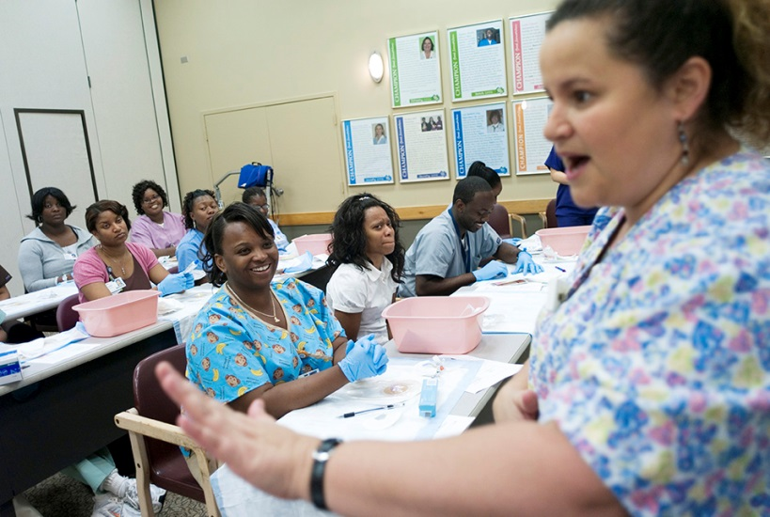


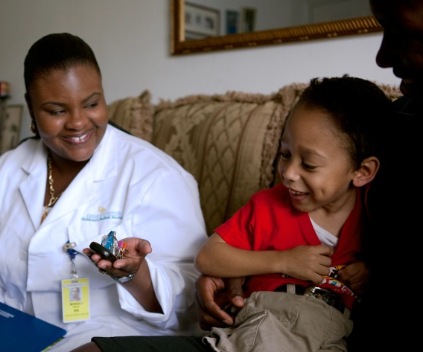


Areas of Focus
Education
Practice & Care
Leadership
Diversity
Interprofessional Collaboration
Data
Notes:
The Campaign focuses on six major areas, or pillars, based on the IOM’s recommendations. They are to:
Transform nursing education. We need to prepare our nursing workforce for the future by strengthening education and training.
Improve access to care. We need to expand access to care by maximizing the use of nurses and modernizing outdated policies that prevent nurses from practicing to the full level of their education and training.
Promote nursing leadership. We need to prepare the next generation of nurses to meet the health care needs of people, their families, and the communities where they live and to position nurses to lead system change.
Increase diversity in nursing. We need to recruit and prepare the nursing profession to provide culturally competent care in a variety of settings to an aging and more ethnically diverse population with more chronic illnesses.
Foster interprofessional collaboration. We need to promote a team-based approach to education and practice to improve the quality and coordination of health care.
Collect workforce data: We need accurate data to predict workforce needs and competencies, assess quality, and determine what’s working and what’s not. Data can inform all we do, so we are working on that across all pillars as well.
Through efforts in these areas, we are working to build healthier communities to help everyone live the healthiest life possible.

Slide 5
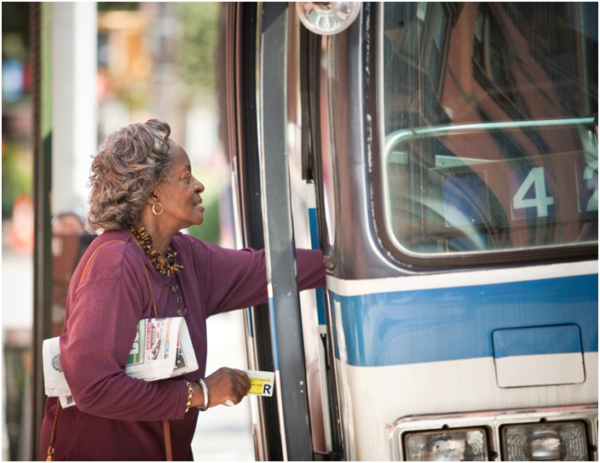
Address All Factors That Affect Health
Health tied to:
How much money people make
How much school they’ve completed
Neighborhoods they live in
Copyright <2009> Rodger Tully
The choices we make are based on the choices we have
Notes:
We know that there are many factors that affect health. In today’s America, too many people’s health is tied to how much money they make, how much school they’ve completed, and the neighborhoods they live in. People’s health has a lot to do with the individual decisions they make – that’s for sure. But the choices that we all make are based on the choices we have.

Slide 6
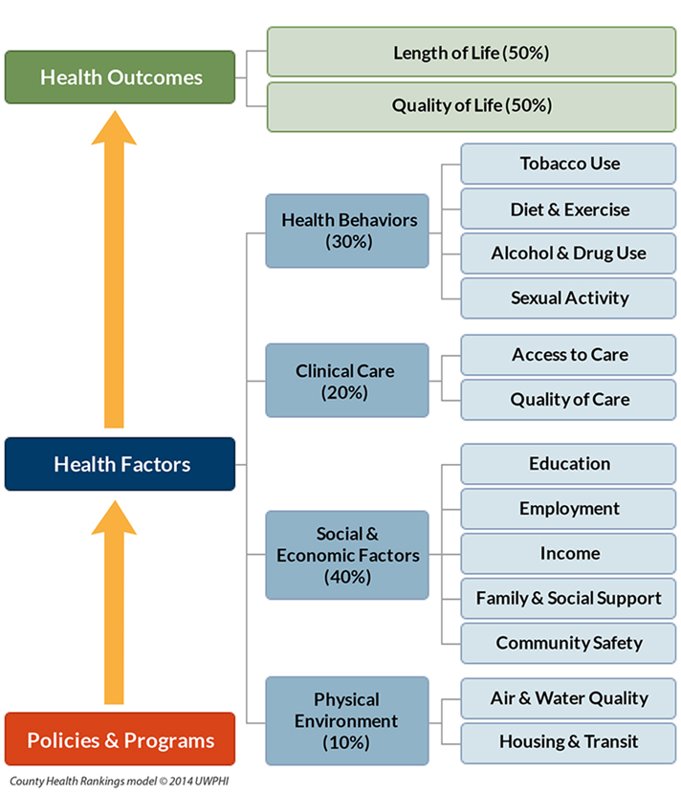
Many Factors Affect Health
Notes:
These social determinants of health, including poverty, inequity, violence, poor housing, lack of a good education, lack of jobs, lack of access to healthy food or safe places to play – are responsible for an estimated 80 percent of all illnesses; only 20 percent can be attributed to biological causes alone.
Source: Braveman, P., & Gottlieb, L. (2014). The social determinants of health: it's time to consider the causes of the causes. Public Health Reports, 129.

Slide 7

Disturbing Facts
1/3 of kids are either overweight or obese
75% of 17- to 24-year-olds are ineligible to serve in the military
One of every two deaths in America is linked to chronic disease
Copyright <2015> Tyrone Turner
Notes:
And as a nation, we’re not as healthy as we think we are. Too many of our children are still overweight or obese. And that means they’re facing the specter of a lifetime of chronic disease.
In fact, right now, a shocking 75 percent of America’s young adults are too fat, too poorly educated or too tied up in the criminal system to serve in the military.*
Research warns that if we don’t do something about our kids’ weight now, they will be the first generation in American history to live shorter and sicker lives than their parents.
One of every two deaths in this country is still linked to chronic diseases like diabetes, heart disease and stroke.**
Source: Mission Readiness. 2014. Retreat Is Not an Option. Washington, D.C. Available at: http://missionreadiness.s3.amazonaws.com/wp-content/uploads/MR-NAT-Retreat-Not-an-Option2.pdf
Source: Woolf SH and Laudan A, eds. U.S. Health in International Perspective: Shorter Lives, Poorer Health. Washington: National
Academies Press; 2013, www.ncbi.nlm.nih.gov/books/NBK154476/

Slide 8
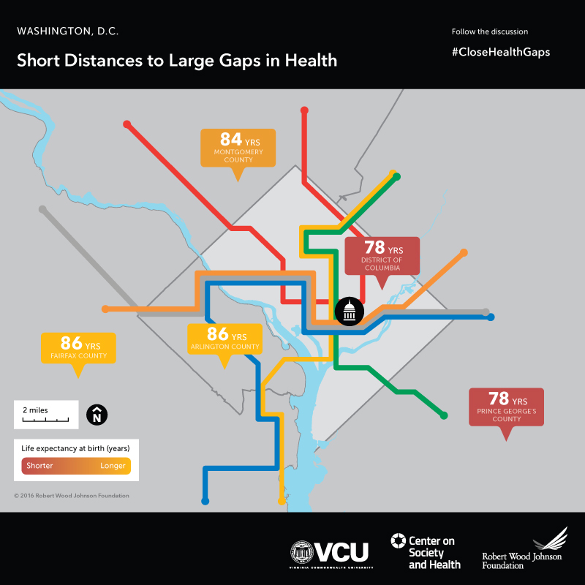
Where You Live Affects Your Health
Notes:
These problems are compounded if you are poor or a member of a minority group. Your zip code may be a better indicator of your health than your genetics. For example, babies born to mothers in Maryland's Montgomery County and Virginia's Arlington and Fairfax Counties can expect to live six to eight years longer than babies born to mothers in Washington, D.C.--just a few subway stops away.
Source: Arkin E, Braveman P, Egerter S, Williams D (eds.) Time to Act: Investing in the Health of Our Children and Communities. Princeton, N.J.: Robert Wood Johnson Foundation Commission to Build a Healthier America; 2014, p. 90.
[You can see maps for other metro areas here: http://www.societyhealth.vcu.edu/work/the-projects/mapping-life-expectancy.html]

Slide 9

RWJF Vision
We, as a nation, will strive together to build a Culture of Health enabling all in our diverse society to lead healthy lives, now and for generations to come
Copyright <2014> Paul Chouy
Notes:
That’s why we need to build a Culture of Health. Building a Culture of Health is a movement led by the Robert Wood Johnson Foundation and shared with others to take on one of the most pervasive challenges of our time: improving the health and well-being of everyone in America. A Culture of Health places well-being at the center of every aspect of life, so that all communities can flourish and all individuals thrive, regardless of race, creed, income, or location. It’s built on the premise that everyone deserves to live the healthiest life possible.

Slide 10
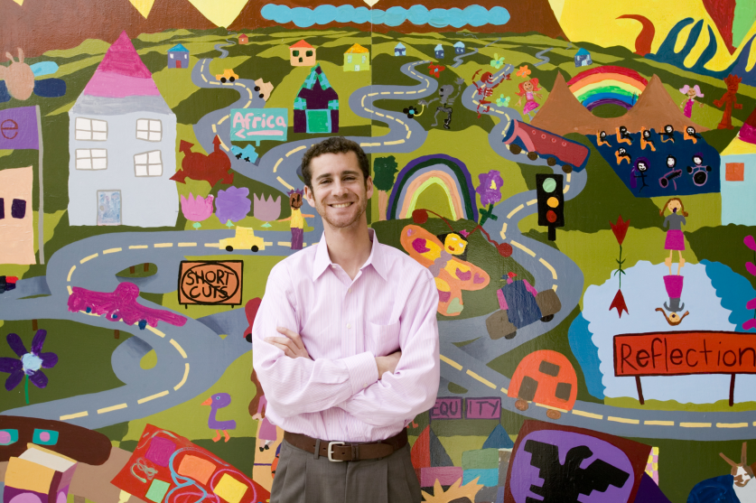
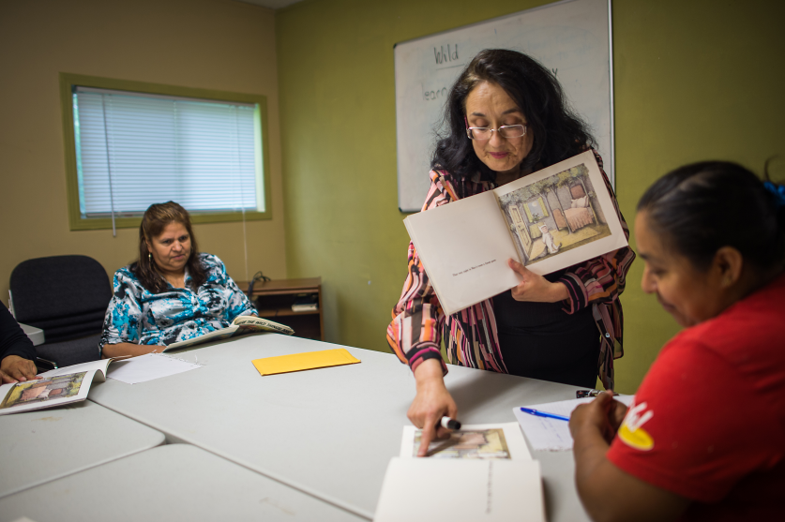
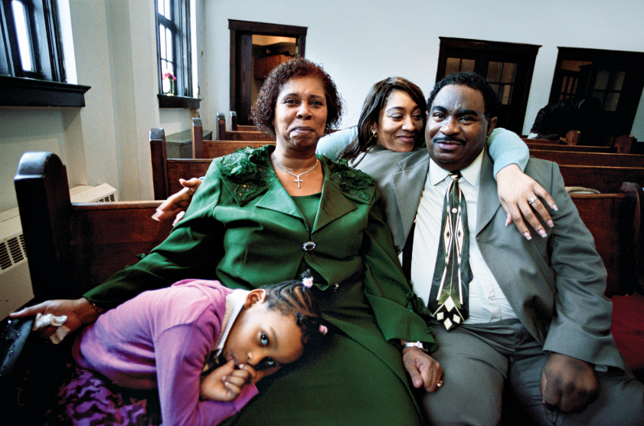
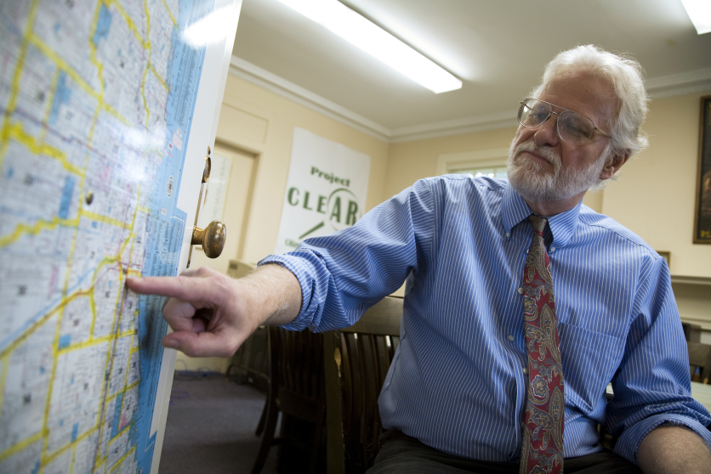
Many Partners…
Copyright <2006> Rodger Tully
Copyright <2014> Mike Belleme
Copyright <2008> Lynn Johnson
Copyright <2008> Ed Kashi
Notes:
If we want everyone in America to be able to lead a healthy life, we need to address all of the factors that affect health.
To do so, we must shift towards a society that places everyone's health and well-being at the center of every aspect of life - including in areas that we may not traditionally associate with healthy living, such as city and urban design, public transportation, and education. That means we need to partner groups like yours, and [give examples of local Action Coalition’s partnerships, or examples of local stakeholders/business that are important to the community]

Slide 11
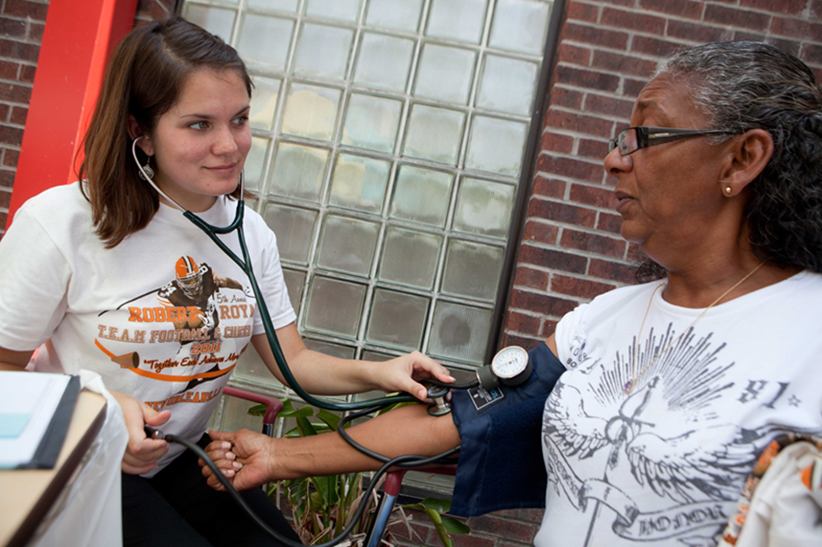
…Including Nurses
Copyright <2011> Tyrone Turner
Notes:
As nurses, we recognize the key role we can play in this movement. Nurses are repeatedly ranked the most trusted health professional, and they make up the largest segment of the health and health care workforce. They spend the most time with people, families and communities. Nurses promote prevention and wellness and provide population-focused services to entire communities.
Here in [insert state], nurses in our Action Coalition are [give examples of what nurses are doing. Here it doesn’t have to be specific to Culture of Health].

Slide 12
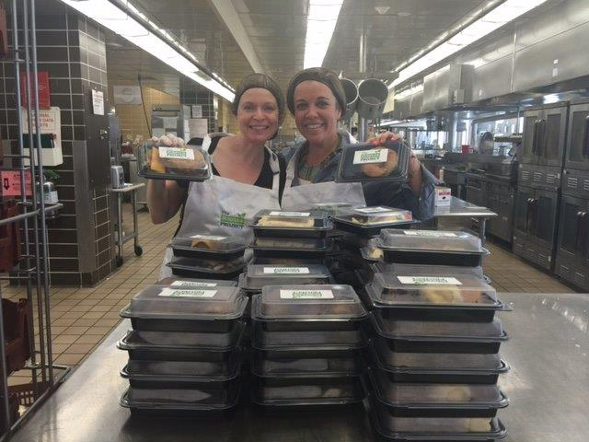
Example: Surplus Food Project
Nurses and other volunteers repackage hospital food bound for landfill to local food pantries
Nurses provide health screenings when meals are served
Copyright <2016> Jennifer Grenier
Notes:
There are some great examples of how nurses are partnering to build healthier communities. For example, Jennifer Grenier, a nurse in Chicago, started the Surplus Project with community partners to reduce food waste at her hospital, and to make sure the hungry get health screenings as well as meals.
In 2016 alone, 6,000 pounds of food bound for landfills has been turned into 5,600 meals served at food pantries.
Grenier worked with the director of a local food pantry and with volunteer staff at her hospital to repackage sandwiches, vegetables and lasagna for the food pantry. She and other nurse volunteers decided to start delivering, along with the meals, blood pressure screenings, nutritional assessments, and body-mass index calculations. When food is served, RNs on The Surplus Project team stand by, literally, to answer health care questions.
The program was so successful that a local grocery store and a high school also began repackaging food for the food pantry.

Slide 13
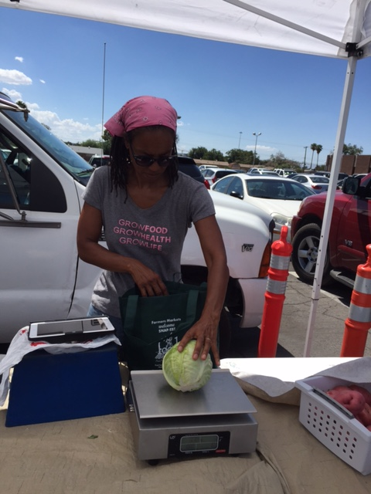
Example: Community Gardens
Garden offers produce to low-income community
Goal: create neighborhood connections and promote healthy bodies and minds
Nurses provide fundraising support and volunteers
Copyright <2016> Vegas Roots
Notes:
In Las Vegas, nurse leaders from the Nevada Action Coalition have partnered with the city’s only urban farm, Vegas Roots Community garden. The garden is located in a low-income part of the city. The garden already offers much now, including a Buck Truck – a farmer’s market on wheels that visits low-income neighborhoods.
The nurses are helping the garden to expand the fresh produce in an area with no large grocery stores and few options for healthy food.
They are visiting local churches to get congregations involved in the garden and pitching the cause to local businesses. They are also organizing a competitive fundraiser with the region’s nursing schools to raise money to build a larger chicken coop and purchase 24 hens. The eggs will be donated to needy families.
[More information is available here: http://campaignforaction.org/roots-success-take-hold-nevada/]

Slide 14
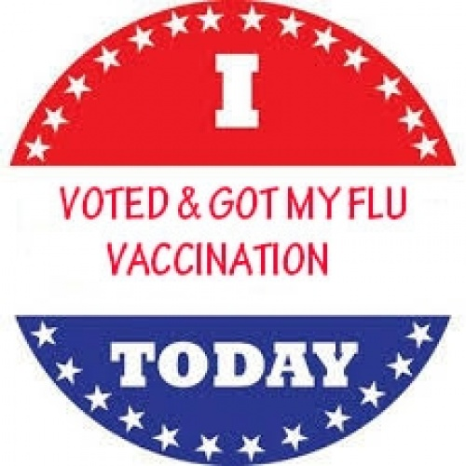
Example: Vote & Vax
Nurses part of Vote & Vax:
Voters are offered a flu shot in neighborhoods that experience health disparities
Many partners involved
Source: Vote & Vax
Notes:
And other nurse leaders are part in Vote & Vax, a program that provides flu vaccine on Election Day. For example, nurses in Omaha will offer people who come to vote a flu shot near four polling places in areas that experience health disparities. Other partners include two Federally Qualified Health Centers, Nebraskans for Civic Reform led by State Senator Adam Morefeld, and the Nebraska Immunization Taskforce.
Vote & Vax is a national program. From the 2004 election through election 2010, close to 40,000 flu shots were administered in 44 states and in DC. About half of those shots went to those who didn’t usually get them.
[More info available here: http://voteandvax.org/]

Slide 15

Example: Family Participation in Rounds
Inviting families to participate in rounds:
  Supports their involvement in decision-making
  Gives them an opportunity to ask questions and share information
  Engages them as partners in the care of their family member
Notes:
Nurses play an important role in helping patients and their families to have a voice in their care.
One strategy that can promote consumer engagement is inviting families to participate in rounds. This supports family involvement in decision-making, gives family members an opportunity to ask questions and share information, and engages them as partners in care. It can also contribute to improved communication, reduced family stress, and better outcomes.
The IOM also suggests that family involvement in care should be part of both collaborative teams and in clinical-decision making.
By offering patients and families the opportunity to meaningfully engage in bedside rounding, nurses support a patient- and family-centered approach to care.
Source: http://www.naqc.org/Main/Resources/FamilyParticipation-Rounds.pdf

Slide 16
Your Example Goes Here
Feel free to insert your own example here and delete one or more of the template examples.
What is the project?
Who did it benefit in the community?
Who were the health and non-health stakeholders involved?
What role did nurses or your Action Coalition play?

Slide 17
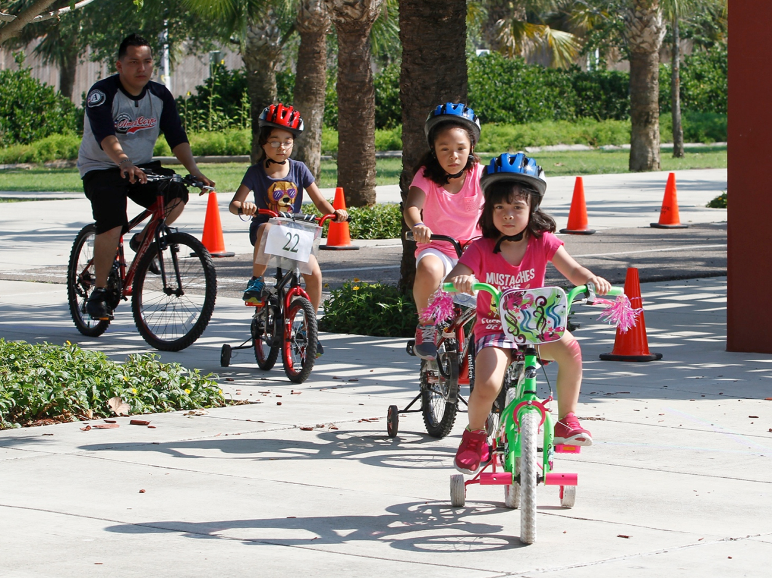
Partnering to Create a Healthier America
Copyright <2015> Flynn Larson
www.cultureofhealth.org
www.campaignforaction.org
Notes:
And we’d love to talk to you and hear your ideas of how we can work together and leverage the strength of nursing to build a Culture of Health. By working together, we can create a healthier place for everyone and leave a lasting legacy to our children and grandchildren. Thank you.
Flynn Larsen 2015

Slide 18
Contact Information
Enter your AC website here
Enter your email address here
Add your Twitter and Facebook info here
Notes:
Action Coalitions can give their website, email address and perhaps Twitter and Facebook

