Slide 1
[Venue/Audience]
[Date]
[Speaker name and title]

Slide 2
Health System Challenges
Notes:
Our health care system faces enormous challenges: an aging and sicker population, millions more insured, a primary care provider shortage, lack of preventive care, and rising costs. Meanwhile, those who work in health care face budget cuts, limited resources, fragmentation, and an emphasis on quantity of tests versus quality of diagnosis and treatment and prevention. We hear constantly from nurses about the pressure to do more with less.

Slide 3
A New Era in Health Care
Person- and Family-Centered Care
Notes:
We know we need to make many changes to improve the overall quality of health care and make sure that everyone has the opportunity to live the healthiest life possible. For example, we need to move our health care system away from the hospital and into the home and community—toward person- and family-centered care.
We need to expand our system’s focus and capacity, increase access to care, and contain costs. We need to make sure that coordinated health services are consistently provided in all settings, when and where people need them.

Slide 4
A Culture of Health
RWJF Goal: We, as a nation, will strive to create a culture of health enabling all in our society to lead healthy lives, now and for generations to come.
Notes:
As we rethink our health care system, it may be helpful to consider an ambitious and worthy goal of the Robert Wood Johnson Foundation and others to achieve a culture of health. That means a nation in which being as well as you can and staying well are shared values—and where everyone—regardless of their geographic, demographic, ethnic, racial, or socioeconomic circumstances—has access to high-quality, cost-effective, and affordable health care.
It means encouraging wellness is as high a priority as treating illness:
Where we pay more attention to the social determinants of health, such as food, exercise, and housing.
Where getting healthy and staying healthy are as fundamental values right up there with life, liberty, and the pursuit of happiness.
The Future of Nursing: Campaign for Action, which I am going to discuss in a minute, is a joint initiative of AARP Foundation, AARP, and the Robert Wood Johnson Foundation that is working to help make this happen.

Slide 5
How Nurses Can Help
Nurses are the largest segment of the health care workforce and spend most time with individuals and families.
Manage influx of older, sicker, patients, more chronic illness.
Develop and implement new models of care.
Provide transitional and coordinated care.
Reduce medical errors and rehospitalizations.
Improve prevention, wellness, population health outcomes.
Notes:
As the largest segment of the health care workforce, and the ones who spend the most time with patients and their families across the continuum of care, nurses are vital to the successful transformation of health care.
Nurses are at the center of many of the innovations we rely on to expand access, improve quality of care, and contain costs. And nurses with strong clinical and leadership skills can help to promote wellness, develop new models of care, manage care coordination, and improve population health outcomes.

Slide 6
Institute of Medicine* Reports
2010 report
2015 report
*The Institute of Medicine has been renamed the Health and Medicine Division of the National Academies.
Notes:
The Robert Wood Johnson Foundation has long invested in nursing and believes that strengthening the nursing field is crucial to improving health in our country. But the Foundation needed evidence. So, in 2008, it partnered with the Institute of Medicine (IOM) to produce a report on the future of nursing. In 2010, the IOM released The Future of Nursing: Leading Change, Advancing Health, a landmark report that stated that nursing must be prepared for health system transformation—and that nurses must help to lead and shape this change. The 2010 report, along with a follow up report released in 2015, offered specific recommendations to transform health and health care through nursing so all Americans have access to high-quality care, with nurses contributing to the full extent of their capabilities.
Few reports have received as much attention – or been as influential – as this. It remains one of the most downloaded reports the IOM has produced, and is used as a teaching tool in nursing schools throughout the nation.
Today, the IOM is known as the National Academy of Medicine and it recently launched another study on the future of nursing 2020-2030. This new report, again sponsored by RWJF, will build on the previous reports and extend the vision for a nursing profession that can play an even more powerful role in building a Culture of Health.
*The Institute of Medicine has been renamed the Health and Medicine Division of the National Academies.

Slide 7
Campaign Vision
Everyone in America can live a healthier life, supported by nurses as essential partners in providing care and promoting health equity and well-being.
Notes:
In 2010, the Robert Wood Johnson Foundation, the nation’s largest philanthropy devoted to health, joined AARP Foundation and AARP, the nation’s largest nonprofit, nonpartisan organization dedicated to empowering Americans 50 and older, to create The Future of Nursing: Campaign for Action to improve America’s health through nursing. The Campaign is working both on the national level and in the states, engaging with consumers, nurses, other clinicians, insurers, health care systems, employers, educators, funders, and policymakers—all the stakeholders who need to be involved in system change—to advance the IOM’s recommendations.
The Campaign has launched Action Coalitions in all 50 states and the District of Columbia to pave the way for needed changes at the state level. To date, these Action Coalitions have collected more than $54* million in funding from hundreds of organizations and individuals. Their members include a wide range of health care providers, consumer advocates, policymakers, and business, academic, and philanthropic leaders.
Together, we are working to implement our vision that everyone in America can live a healthier life, supported by nurses as essential partners in providing care and promoting health equity and well-being.
*Source: Action Coalition reporting to CCNA. Includes Health Services Cost Review Commission/Nurse Support Program II funds.

Slide 8
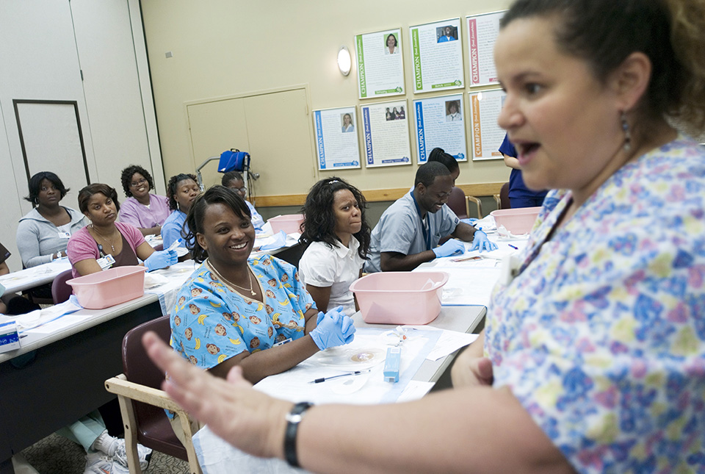
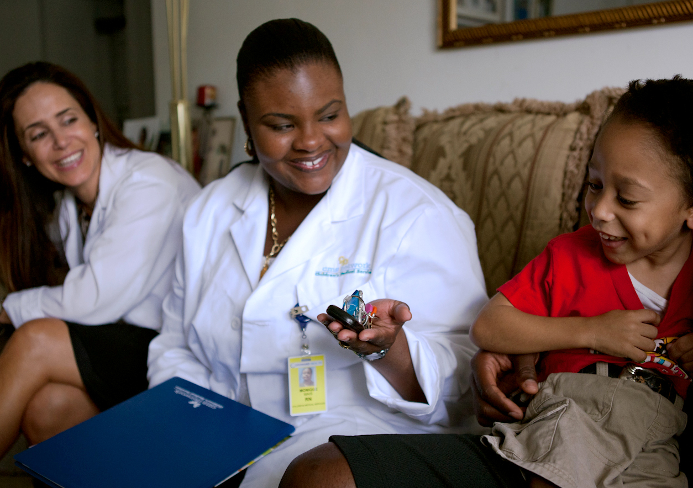
Areas of Focus
Education
Access to Care
Leadership
Diversity
Interprofessional Collaboration
Notes:
The Campaign focuses on five major areas, or pillars. They are to:
Transform nursing education. We need to prepare our nursing workforce for the future by strengthening education and training.
Improve access to care. We need to expand access to care by maximizing the use of nurses and modernizing outdated policies that prevent nurses from practicing to the full level of their education and training.
Promote nursing leadership. We need to prepare the next generation of nurses to meet the health care needs of people, their families, and the communities where they live and to position nurses to lead system change.
Increase diversity in nursing. We need to recruit and prepare the nursing profession to provide culturally competent care in a variety of settings to an aging and more ethnically diverse population with more chronic illnesses.
Foster interprofessional collaboration. We need to promote a team-based approach to education and practice to improve the quality and coordination of health care.
In addition to these areas, we need accurate data to predict workforce needs and competencies, assess quality, and determine what’s working and what’s not. Data can inform all we do, so we are working on data collection across all pillars as well.

Slide 9
Strengthen Nursing Education
IOM: Increase the proportion of nurses with BSN degrees and higher so that nurses can be:
Better prepared and educated and more adept with complex care and technology
Prepared to lead and replace retiring leaders and to reduce primary care and faculty shortages
Able to develop and implement new models of interdisciplinary care
Able to promote wellness and reduce chronic disease
Higher educated nurses are linked to lower patient mortality and improved outcomes.
Notes:
We need to make sure that nurses have the competencies required to practice in the community, home, and public health settings. Nurses will need to be more adept with technology to care for an aging population with multiple chronic conditions. They’ll need to work in teams with other health care professionals to coordinate care and manage disease. And they’ll need to assume leadership roles to help transform our health care system to ensure that it delivers integrated, equitable, and cost-effective services for everyone. In addition, nurses are needed to address the primary care shortage and the faculty shortage.
We also need more nurses with doctorates to teach the next generation and design health care delivery innovations. According to AACN, in 2018 nursing schools turned away more than 75,000 qualified candidates due to insufficient faculty, clinical sites, classroom space, clinical preceptors, and budget constraints. Most nursing schools pointed to faculty shortages as a reason for not accepting all qualified applicants into baccalaureate programs.
Sources:
American Association of Colleges of Nursing. http://www.aacnnursing.org/News-Information/Fact-Sheets/Nursing-Faculty-Shortage.
Kutney-Lee A, Sloane DM, & Aiken LH. 2013. An increase in the number of nurses with baccalaureate degrees is linked to lower rates of postsurgery mortality. Health Affairs, 32(3):579-586.
Aiken LH, Clarke SP, Cheung RB, et al. 2003. Education levels of hospital nurses and surgical patient mortality. Journal of the American Medical Association, 290(12):1617-1623.

Slide 10
Remove Barriers to Practice and Care
Nurses provide an immediate and cost-effective solution to care shortages.
All clinicians should be able to practice to the full extent of their education and training.
Barriers that limit nurses from expanding access to care must be removed.
Patients deserve the right care by the right clinician, at the right time, in the right place.
APRNs improve care on a wide range of indicators.
Notes:
Primary care in the United States is struggling to meet demand. Staffing shortages are expected to get worse as the population continues to age and people grapple with more chronic disease. This is particularly true in underserved, rural, and minority communities. Nurse practitioners provide an immediate and cost-effective solution to this problem, enabling physicians to direct their energy to caring for people with complex medical conditions.
But outdated barriers are blocking the ability of APRNs and other providers to expand access to care. We need to remove these barriers and use clinicians more efficiently and effectively so that consumers can get the care they need, when and where they need it. We need to ensure that people receive the right care by the right clinician at the right time and the right place.
Source: National Governor’s Association. 2012. The role of nurse practitioners in meeting increased demand for primary care. NGA Paper, www.nga.org/cms/home/nga-center-for-best-practices/center-publications/page-health-publications/col2-content/main-content-list/the-role-of-nurse-practitioners.html.

Slide 11
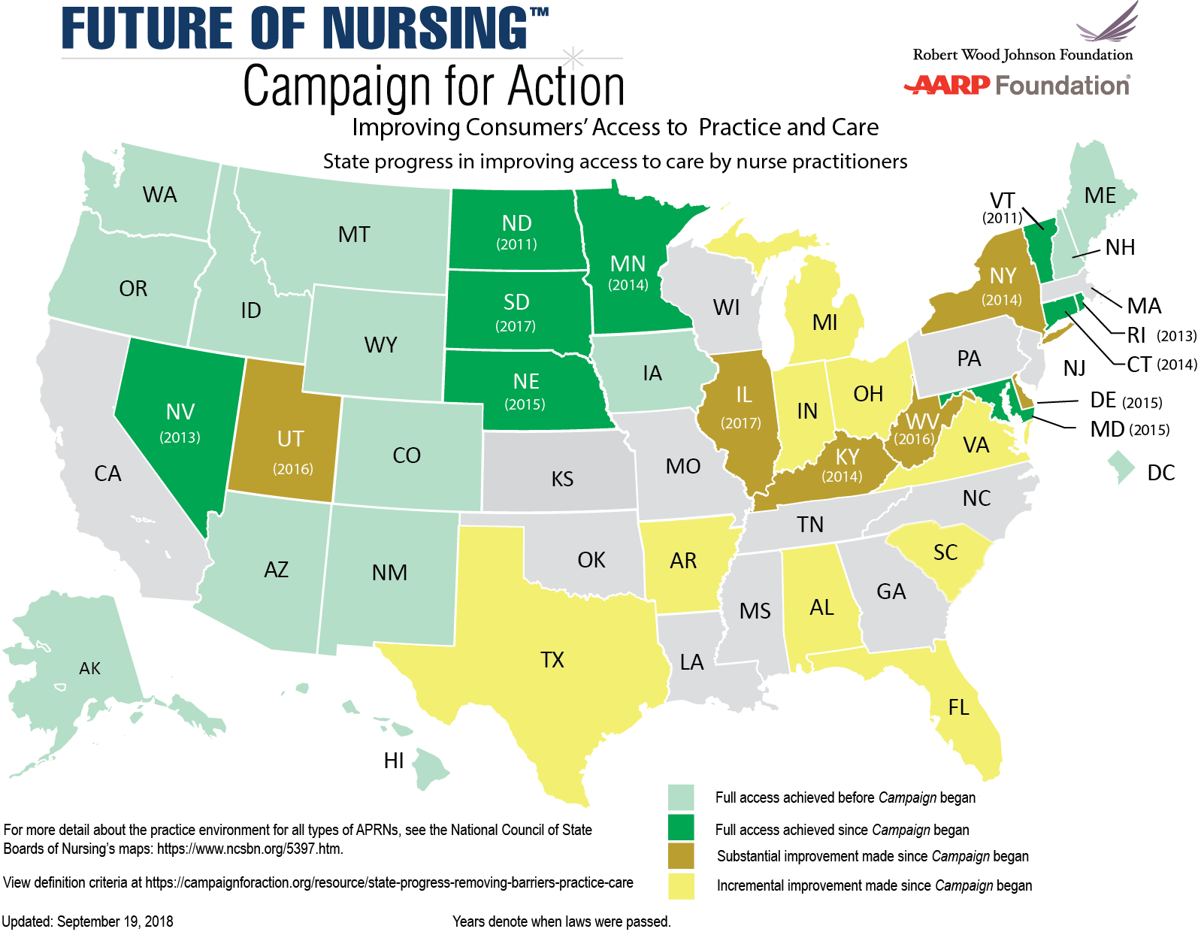
State Progress in Removing Barriers
Notes:
Right now, nurse practitioners in 22 states and the District of Columbia have full practice authority. This is significantly improved from a few years ago, as you can see by this map, which shows the progress made in removing barriers to practice and care.
The Campaign is working to expand access to care by maximizing the use of nurses and removing outdated laws, regulations, and policies that prevent nurses from practicing to the full extent of their education and training—and we are making steady progress. Public opinion is also shifting to support removing barriers to practice.
Since the launch of the Campaign, nine states* have fully modernized their practice laws for nurse practitioners to increase consumer’s access to care and six states** have made substantial improvements helping to increase consumers’ access to care. Many states have made incremental progress.
For more information about practice restrictions for other types of APRNs, visit the National Council of State Boards of Nursing’s website.
Sources:
American Association of Nurse Practitioners. AANP Practice Map. www.aanp.org/legislation-regulation/state-legislation-regulation/state-practice-environment.
Note*: The nine states are—South Dakota (2017), Maryland (2015), Nebraska (2015), Minnesota (2014), Connecticut (2014), Nevada (2013), Rhode Island (2013), North Dakota (2011), and Vermont (2011).
**Since the Campaign began, 6 states have passed legislation that substantially improves APRN scope of practice, and have direct access to APRN care:
Kentucky (2014): SB 7 allowed for APRNs with 4+ years’ experience to prescribe routine medications w/o a written agreement with a physician (written agreement still required for prescribing controlled substances).
New York (2014): SB S4611A, called The Nurse Practitioners Modernization Act eliminates the need for a signed written practice agreement for NPs with >3,600 practice hours. Written practice agreement between NP with less hours and a physician is still required. NPs maintain collaborative relationships with physicians.
Delaware (2015): SB 57, APRNs could apply for independent practice once they completed at least 2 years of practice and 4,000 practice hours. (Utah (2016): SB 58 allowed APRNs to prescribe schedule II medications without a consultation and referral plan
West Virginia (2016): HB 4334 removed the restrictive requirement for a collaborative agreement with a physician after 3 years of APRN practice, expanded the prescribing formulary for APRNs, but does not allow APRNs to prescribe Schedule II controlled substances.
Illinois (2017): HB 313 signed in 2017, went into effect 2018. Enables APRNS who work outside of hospital settings and meet certain conditions to practice without a written agreement with a physician, but their ability to prescribe certain medications remains limited. APRNs who have completed 4,000 hours of clinical experience with a physician and 250 hours of CE will be able to practice without a written agreement (except a written agreement remains for substances that have a high abuse potential, such as opioids).

Slide 12
Promote Nurse Leadership
Nurses bring a unique perspective to management and policy discussions.
Nurses are the largest segment of the health care work force and spend the most time with people receiving health services.
When nurses are positioned to influence system practice, it leads to improved quality of care and reduced medical errors.
Yet nurses account for only 5 percent of hospital board positions.
Source: American Hospital Association 2011
Notes:
Nurses provide an important and unique point of view in decision-making, from the boardroom to our communities. They are vital to improving quality by supporting the transition of patients from hospital to home or community and reducing re-hospitalizations and medical errors. When nurses are positioned to influence system practice and policies, it leads to improvements in quality of care, wellness, and reduced medical errors.
Yet we know nurses are woefully underrepresented on clinical and other boards.
That’s why AARP and RWJF created the Nurses on Boards Coalition to improve the health of communities and the nation through the service of nurses on boards and other bodies. That coalition has a goal of registering 10,000 nurses who serve on boards by 2020. The coalition is more than halfway to its goal.
Source: American Hospital Association. 2014. 2014 National Health Care Governance Survey Report. http://www.americangovernance.com/resources/reports/governance-reports/2014/

Slide 13
Improve Workforce Diversity
Nurses should reflect the population in terms of gender, race, and ethnicity.
All nurses should provide culturally competent services and care.
Greater workforce diversity may help to reduce health disparities and improve health outcomes in diverse communities.
Notes:
The Campaign and our partners also are working to recruit and prepare the nursing profession to provide culturally competent care in a variety of settings to an aging and more ethnically diverse population with more chronic illnesses.
According to 2018 Census estimates, almost 40% of the U.S. population is part of a racial or ethnic minority.
Nurses from minority backgrounds represent 30% of the registered nurse workforce (Dashboard indicator - American Community Survey).
Men comprise only 9.1 percent of all RNs (2017 National Nursing Workforce Study)
We see more progress in schools of nursing.
According to AACN's report on 2018-2019 Enrollment and Graduations in Baccalaureate and Graduate Programs in Nursing, nursing students from minority backgrounds represented 34.2% of students in entry-level baccalaureate programs, 34.7% of master’s students, 33.0% of students in research-focused doctoral programs, and 34.6% of Doctor of Nursing Practice (DNP) students
When it comes to college faculty, these percentages are even lower. Only about 16% percent (15.9%) of full-time nursing school faculty come from minority backgrounds.
By 2043, minority populations will make up a majority of our population. We need to make sure that our profession reflects the people we serve and that all nurses deliver culturally competent services in all settings.
Sources:
US Census Quick Facts. 2018 July. https://www.census.gov/quickfacts/fact/table/US/PST045218
Racial/ethnic composition of the RN workforce in the U.S. 2020 January 19. https://campaignforaction.org/resource/racialethnic-composition-rn-workforce-us/
National Nursing Workforce Study 2017 https://www.ncsbn.org/workforce.htm
U.S. Census Bureau. March 24, 2011. 2010 Census Shows America's Diversity (press release), www.census.gov/newsroom/ releases/archives/2010_census/cb11-cn125.html.
American Association of Colleges of Nursing. 2019 April. Fact sheet: Enhancing diversity in the nursing workforce, https://www.aacnnursing.org/Portals/42/News/Factsheets/Enhancing-Diversity-Factsheet.pdf
American Association of Colleges of Nursing. 2017 March. Nursing Faculty: A Spotlight on Diversity https://www.aacnnursing.org/Portals/42/Policy/PDF/Diversity-Spotlight.pdf

Slide 14
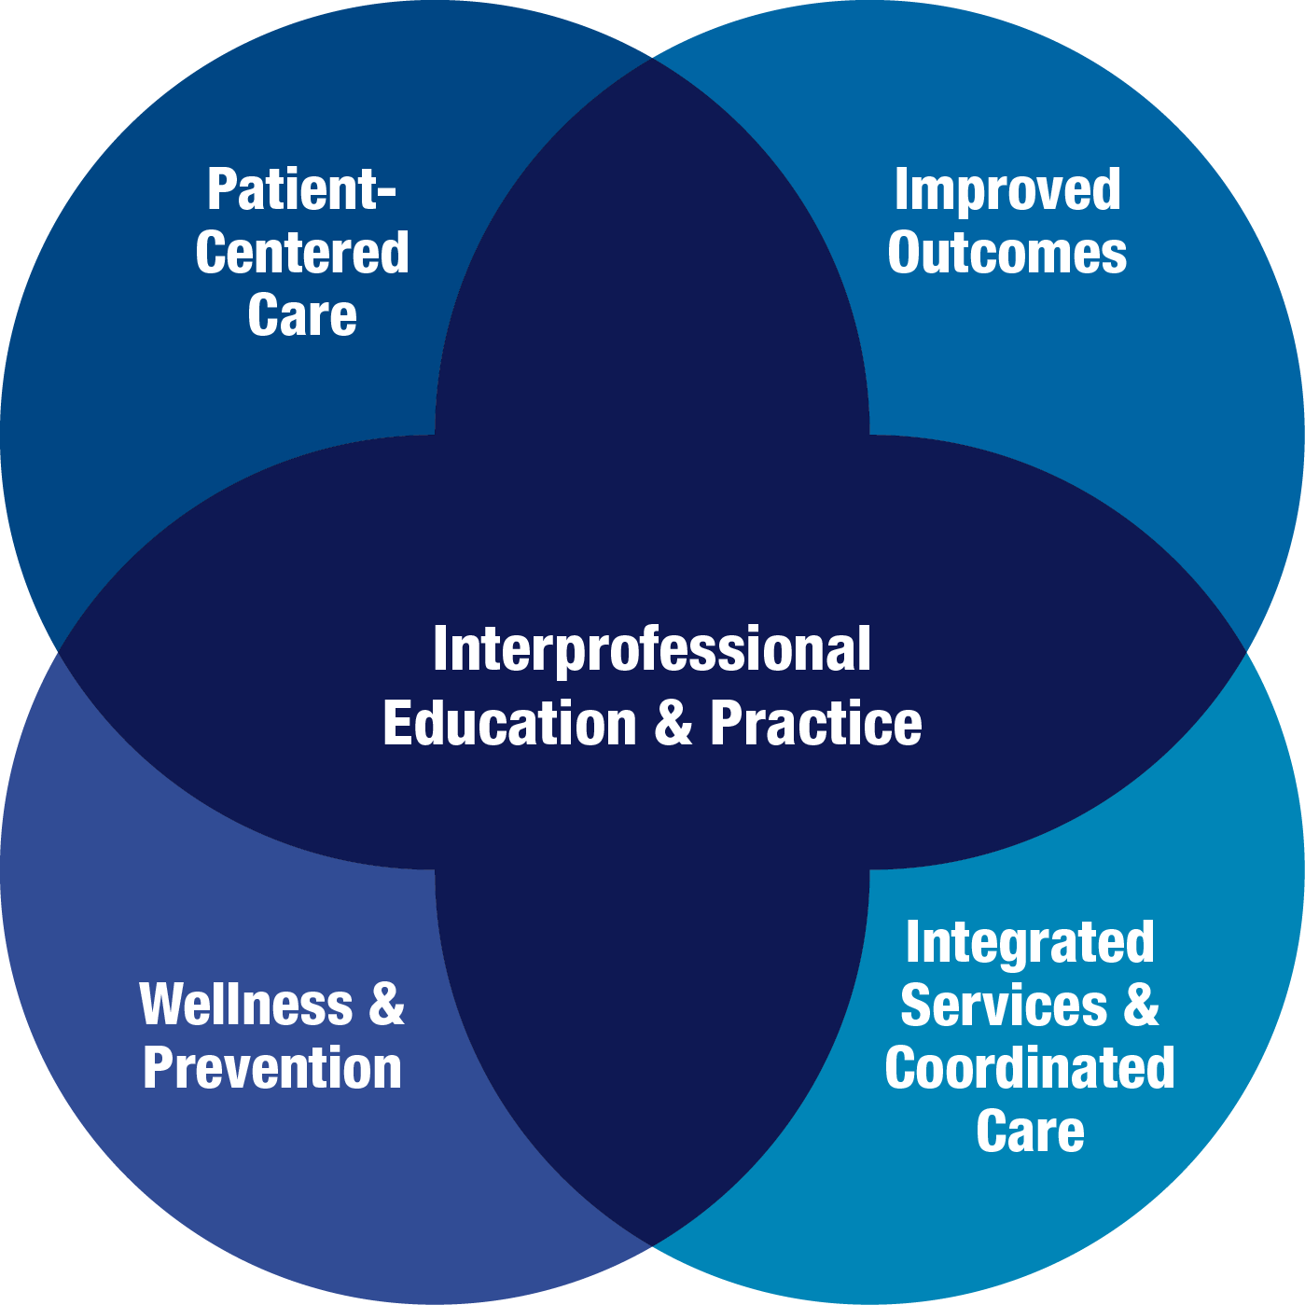
Interprofessional Collaboration
Notes:
Finally, the Campaign also is working on interprofessional collaboration to promote a team-based approach to education and practice to improve the quality and coordination of health care. Studies have demonstrated that effective coordination and communication among health professionals can enhance the quality and safety of patient care.
When health professionals work collaboratively as integrated teams, they draw on individual and collective skills and experience across disciplines. This integration of health service delivery better leverages the assets of health care and public health professionals, allowing each person to practice at a higher level. This results in better health outcomes, including higher levels of satisfaction with services received and improved wellness and preventive care.

Slide 15
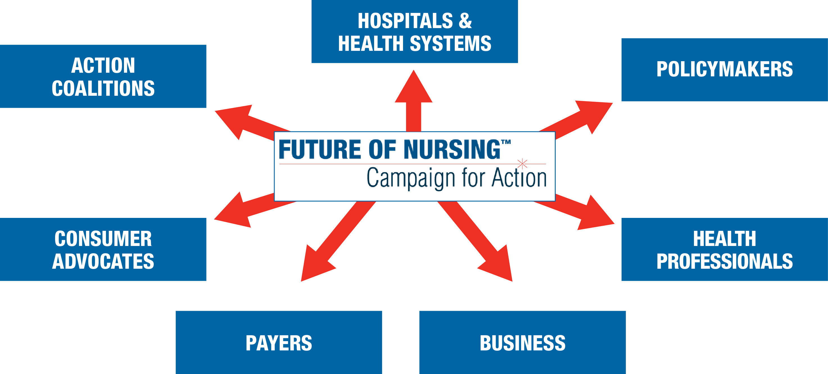
We Need Your Support
Notes:
The Future of Nursing: Campaign for Action is working to build healthier communities through nursing, and we need your help to succeed. It will take all of us—health professionals, hospitals and health systems, policymakers, consumer advocates, payers, consumers, businesses, think tanks, long-term care, foundations, and everyone who cares about health care—to make this work.

Slide 16
Help Shape the Future of Health Care
Join or support an Action Coalition.
Sign up for our email alerts and newsletters.
Visit our website.
Educate your organization about the Campaign.
www.campaignforaction.org
http://facebook.com/campaignforaction www.twitter.com/campaign4action
Notes:
Health care transformation is under way, and the future of nursing is now. We can’t build healthier communities without transforming nursing. Our nation’s health can improve only if nurses are better prepared and able to lead and practice to the full extent of their education and training. A few things you can do:
Join or support an Action Coalition.
Sign up for our email alerts and newsletters.
Visit our website and participate in our online community.
Educate your organization about the Campaign.
Together, we can build a healthier America. Thank you.

