Slide 1
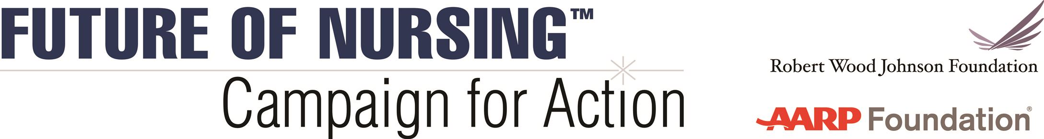
[Venue/Audience]
[Date]
[Speaker name and title]

Slide 2
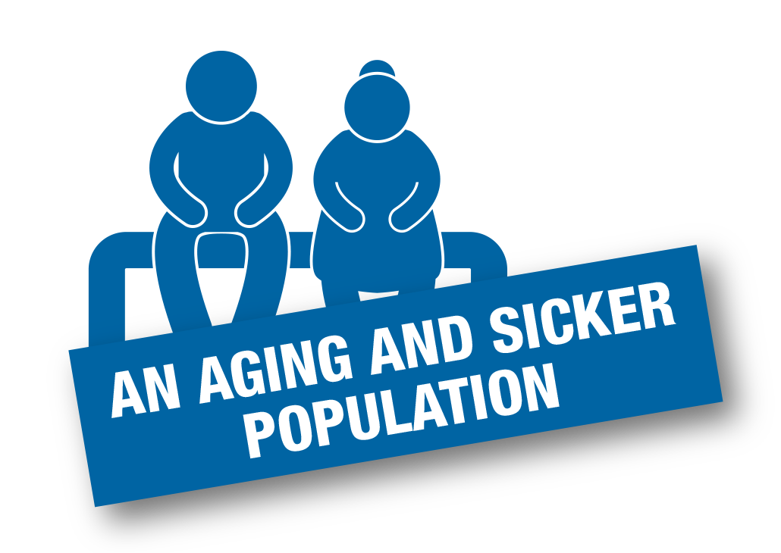
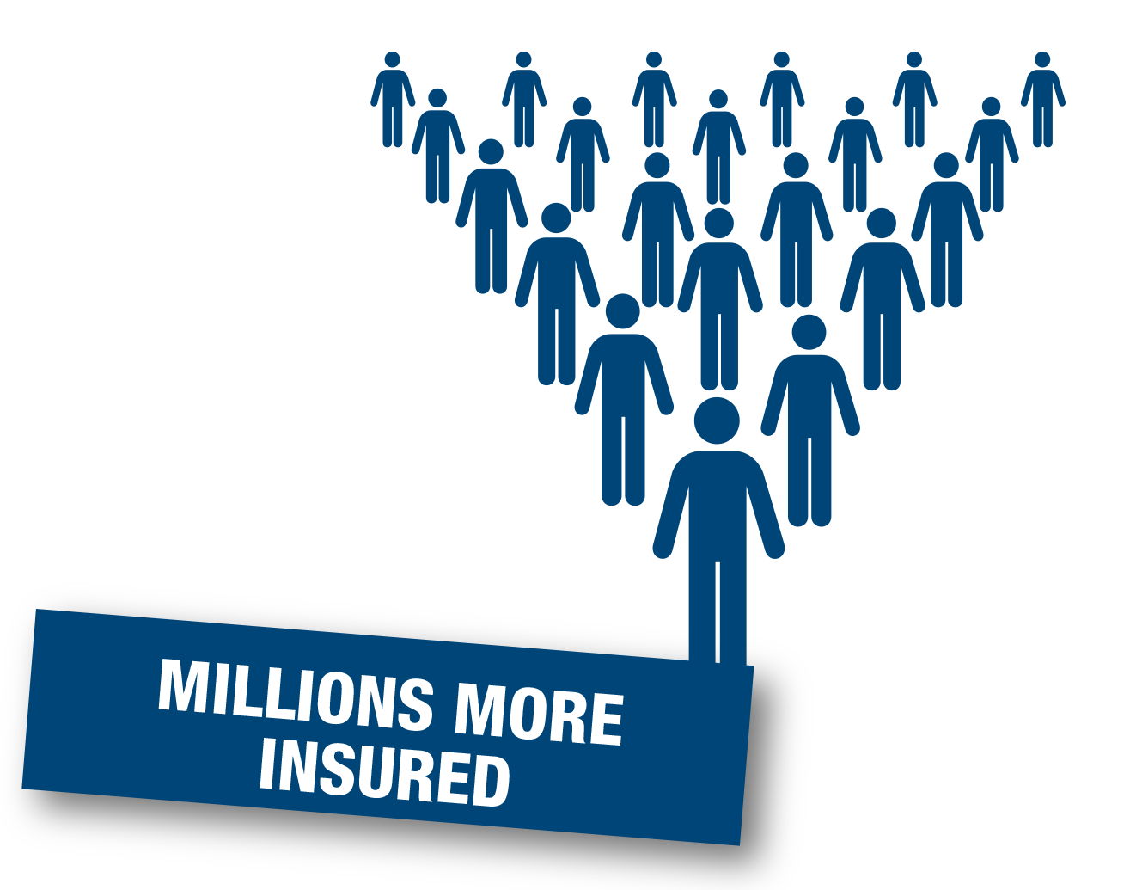

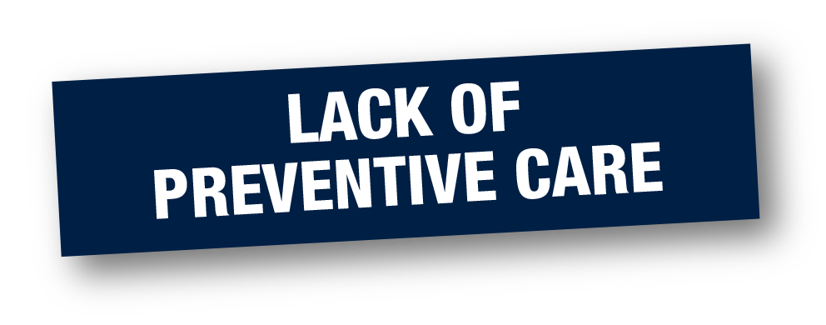

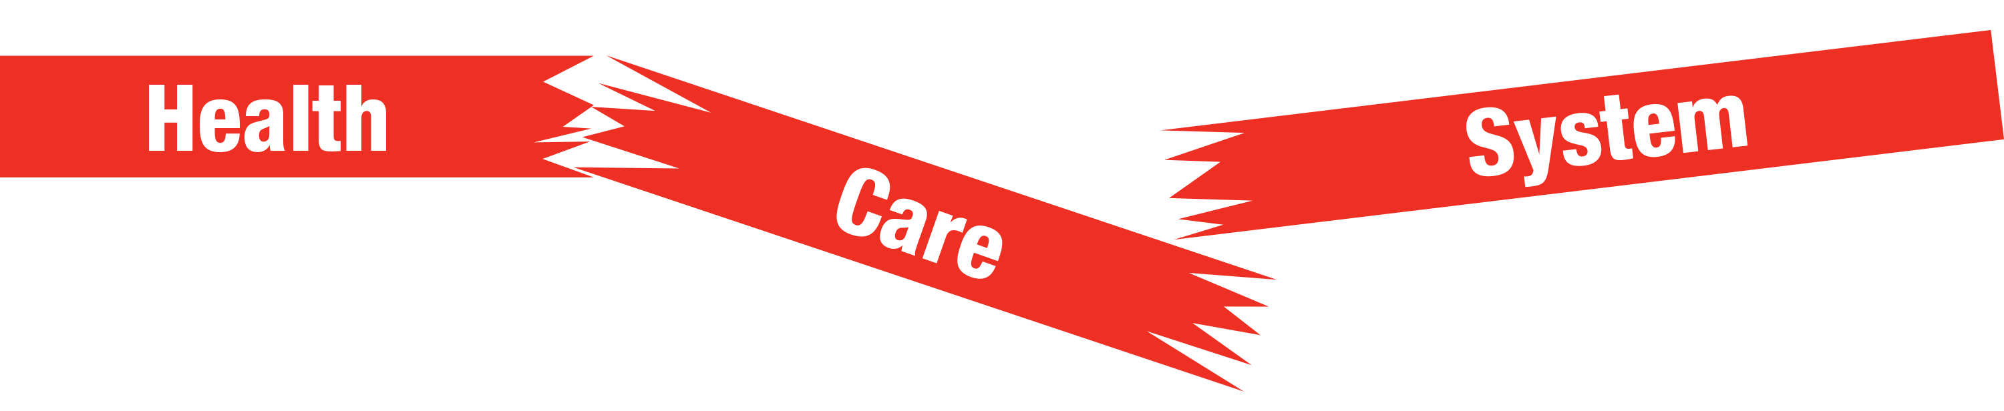
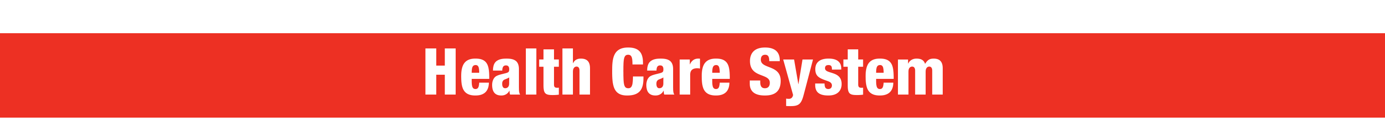
Health System Challenges
Notes:
Our health care system faces enormous challenges: an aging and sicker population, millions more insured, a primary care provider shortage, lack of preventive care, and rising costs. Meanwhile, those of us who work in health care face budget cuts, limited resources, fragmentation, and an emphasis on quantity of tests versus quality of diagnosis and treatment and prevention. We hear constantly from nurses about the pressure to do more with less.

Slide 3



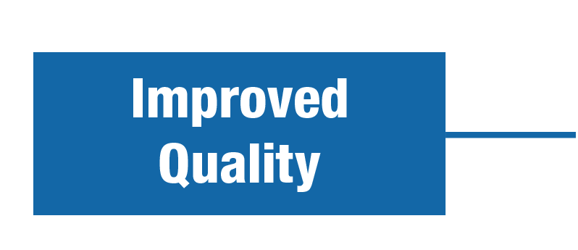


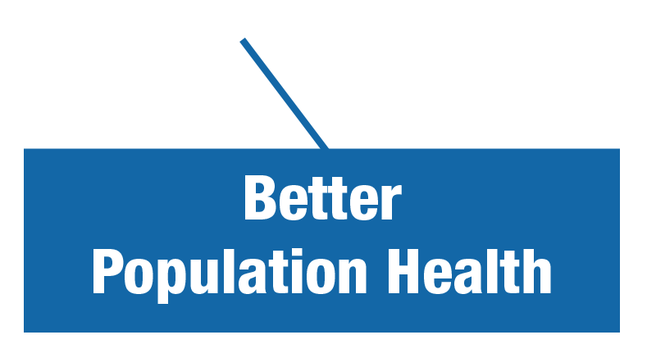
A New Era in Health Care
Person- and Family-Centered Care
Notes:
The good news is that decision-makers are open to change like never before. We need to make many changes to improve the overall quality of health care. For example, we need to move our health care system away from the hospital and into the home and community—toward person- and family-centered care.
We need to expand our system’s focus and capacity, increase access to care, and contain costs. And we need to make sure that coordinated health services are consistently provided in all settings, when and where people need them.

Slide 4



A Culture of Health
RWJF Goal: We, as a nation, will strive to create a culture of health enabling all in our society to lead healthy lives, now and for generations to come.
Notes:
As we rethink our health care system, it may be helpful to consider the Robert Wood Johnson Foundation’s ambitious and worthy goal to achieve a culture of health. It means a nation in which being healthier and staying healthier are shared values—and where everyone—regardless of their geographic, demographic, ethnic, racial, or socioeconomic circumstances—has access to high-quality, cost-effective, and affordable health care.
It means encouraging wellness is as high a priority as treating illness:
Where we pay more attention to the social determinants of health, such as food, exercise, and housing.
And where getting healthy and staying healthy are as fundamental values right up there with life, liberty, and the pursuit of happiness.
The Future of Nursing: Campaign for Action, which I am going to discuss in a minute, is a joint initiative of the AARP Foundation, AARP, and the Robert Wood Johnson Foundation that is working to help make this happen.

Slide 5

How Nurses Can Help
Nurses are the largest segment of the health care workforce and spend most time with individuals and families.
Manage influx of older, sicker, patients, more chronic illness.
Develop and implement new models of care.
Provide transitional and coordinated care.
Reduce medical errors and rehospitalizations.
Improve prevention, wellness, population health outcomes.
Notes:
As the largest segment of the health care workforce, and the ones who spend the most time with patients and their families across the continuum of care, nurses are vital to the successful transformation of health care.
Nurses are at the center of many of the innovations we rely on to expand access, improve quality of care, and contain costs. And nurses with strong clinical and leadership skills can help to promote wellness, develop new models of care, manage care coordination, and improve population health outcomes.

Slide 6
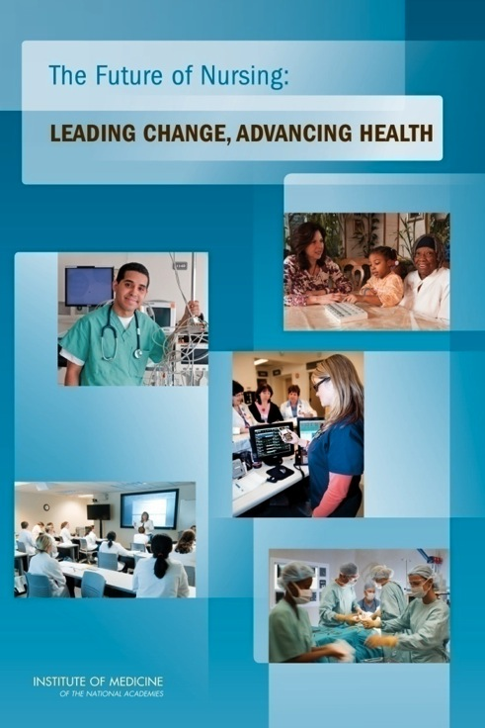

Institute of Medicine* Reports
2010 report
2015 report
*The Institute of Medicine has been renamed the Health and Medicine Division of the National Academies.
Notes:
The Robert Wood Johnson Foundation has long invested in nursing and believes that strengthening the nursing field is crucial to improving health in our country. But the Foundation needed evidence. So, in 2008, they partnered with the Institute of Medicine (IOM) to produce a report on the future of nursing. In 2010, the IOM released The Future of Nursing: Leading Change, Advancing Health, a landmark report that stated that nursing must be prepared for health system transformation—and that nurses must help to lead and shape this change. The 2010 report, along with a follow up report released in 2015, offered specific recommendations to transform health and health care through nursing so all Americans have access to high-quality care, with nurses contributing to the full extent of their capabilities.
Few reports have received as much attention as this original report. It is one of the most viewed online reports in the IOM’s history, ranking “most read” in 2011, 2012, 2013, 2014, 2015, 2016, and 2017.
*The Institute of Medicine has been renamed the Health and Medicine Division of the National Academies.

Slide 7

Campaign Vision
Everyone in America can live a healthier life, supported by a system in which nurses are essential partners in providing care and promoting health.
Notes:
In 2010, the Robert Wood Johnson Foundation, the nation’s largest philanthropy devoted to health, joined AARP Foundation and AARP, the nation’s largest nonprofit, nonpartisan organization dedicated to empowering Americans 50 and older, to create The Future of Nursing: Campaign for Action to improve America’s health through nursing. The Campaign is working both on the national level and in the states, engaging with consumers, nurses, other clinicians, insurers, health care systems, employers, educators, funders, and policymakers—all the stakeholders who need to be involved in system change—to advance the IOM’s recommendations.
We have launched Action Coalitions in all 50 states and the District of Columbia to pave the way for needed changes at the state level. To date, these Action Coalitions have collected more than $36 million in funding from hundreds of organizations and individuals. Their members include a wide range of health care providers, consumer advocates, policymakers, and business, academic, and philanthropic leaders.
Together, we are working to implement our vision that everyone in America can live a healthier life, supported by a system in which nurses are essential partners in providing care and promoting health.

Slide 8
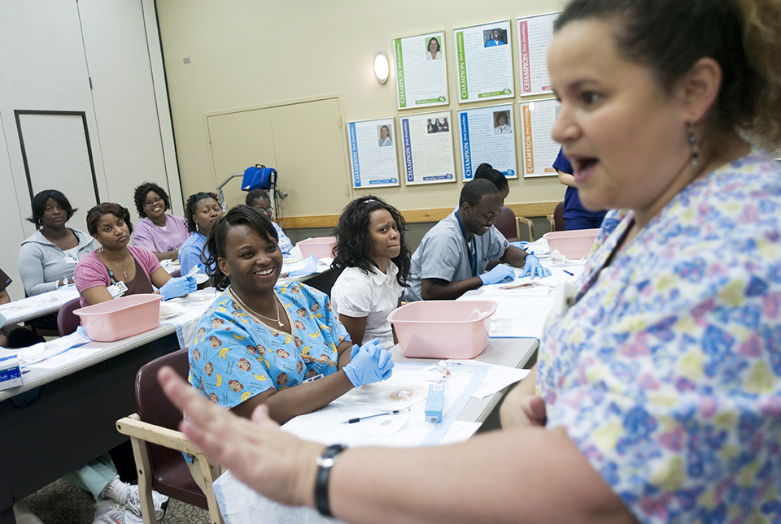


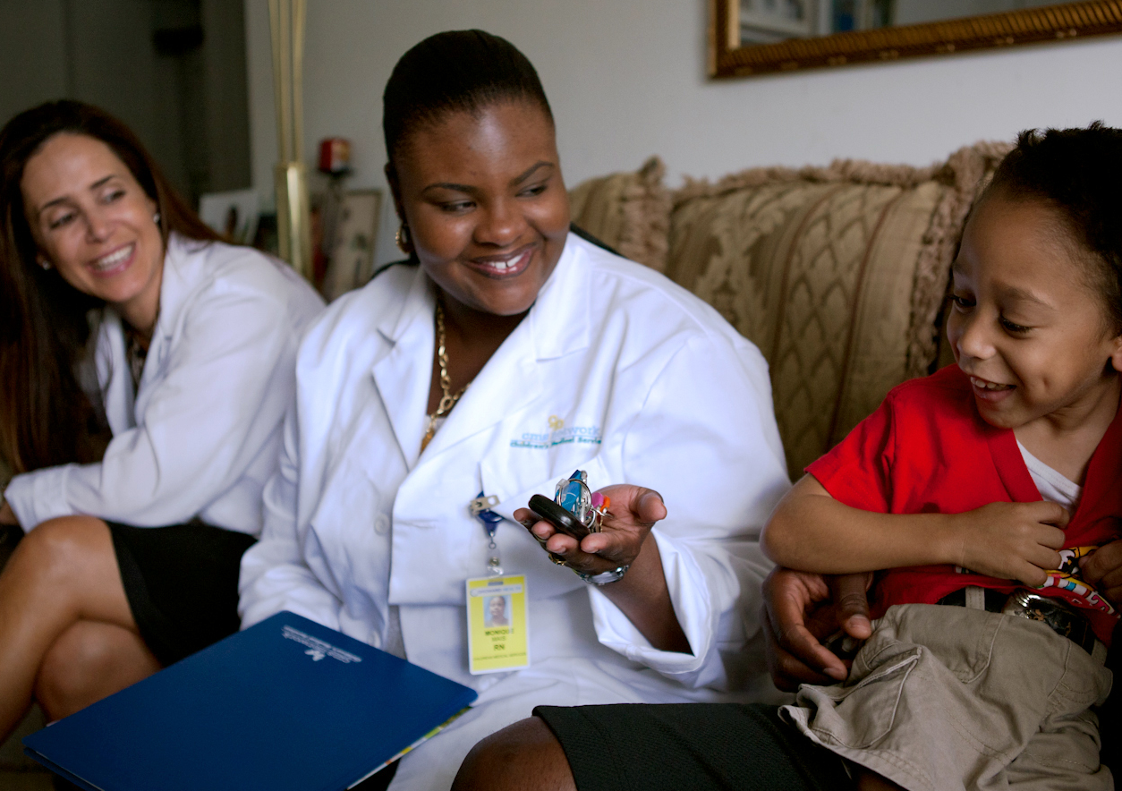

Areas of Focus
Education
Practice & Care
Leadership
Diversity
Interprofessional Collaboration
Notes:
The Campaign focuses on five major areas, or pillars. They are to:
Advance education transformation. We need to prepare our nursing workforce for the future by strengthening education and training.
Remove barriers to practice and care. We need to expand access to care by maximizing the use of nurses and modernizing outdated policies that prevent nurses from practicing to the full level of their education and training.
Leverage nursing leadership. We need to prepare the next generation of nurses to meet the health care needs of people, their families, and the communities where they live and to position nurses to lead system change.
Promote diversity. We need to recruit and prepare the nursing profession to provide culturally competent care in a variety of settings to an aging and more ethnically diverse population with more chronic illnesses.
Foster interprofessional collaboration. We need to promote a team-based approach to education and practice to improve the quality and coordination of health care.
In addition to these areas, we need accurate data to predict workforce needs and competencies, assess quality, and determine what’s working and what’s not. Data can inform all we do, so we are working on data collection across all pillars as well.

Slide 9

Strengthen Nursing Education
IOM: Increase the proportion of nurses with BSN degrees and higher so that nurses can be:
  Better prepared and educated and more adept with complex care and technology
  Prepared to lead and replace retiring leaders and to reduce primary care and faculty shortages
  Able to develop and implement new models of interdisciplinary care
  Able to promote wellness and reduce chronic disease
  Higher educated nurses are linked to lower patient mortality and improved outcomes.
Notes:
We need to make sure that nurses have the competencies required to practice in the community, home, and public health settings. Nurses will need to be more adept with technology to care for an aging population with multiple chronic conditions. They’ll need to work in teams with other health care professionals to coordinate care and manage disease. And they’ll need to assume leadership roles to help transform our health care system to ensure that it delivers integrated, equitable, and cost-effective services for everyone. In addition, nurses are needed to address the primary care shortage and the faculty shortage.
We also need more nurses with doctorates to teach the next generation and design health care delivery innovations. In the 2016-2017 academic year, nursing schools turned away more than 64,000 qualified candidates, primarily because there weren’t enough faculty available to teach them and the schools lacked resources.
Sources:
American Association of Colleges of Nursing. http://www.aacnnursing.org/News-Information/Fact-Sheets/Nursing-Faculty-Shortage.
Kutney-Lee A, Sloane DM, & Aiken LH. 2013. An increase in the number of nurses with baccalaureate degrees is linked to lower rates of postsurgery mortality. Health Affairs, 32(3):579-586.
Aiken LH, Clarke SP, Cheung RB, et al. 2003. Education levels of hospital nurses and surgical patient mortality. Journal of the American Medical Association, 290(12):1617-1623.

Slide 10

Remove Barriers to Practice and Care
Nurses provide an immediate and cost-effective
solution to care shortages.
All clinicians should be able to practice to the full extent of their education and training.
Barriers that limit nurses from expanding access to care must be removed.
Patients deserve the right care by the right clinician, at the right time, in the right place.
APRNs improve care on a wide range of indicators.
Notes:
Primary care in the United States is struggling to meet demand. Staffing shortages are expected to get worse as the population continues to age and people grapple with more chronic disease. This is particularly true in underserved, rural, and minority communities. Nurse practitioners provide an immediate and cost-effective solution to this problem, enabling physicians to direct their energy to caring for people with complex medical conditions.
But outdated barriers are blocking the ability of APRNs and other providers to expand access to care. We need to remove these barriers and use clinicians more efficiently and effectively so that consumers can get the care they need, when and where they need it. We need to ensure that people receive the right care by the right clinician at the right time and the right place.
Source: National Governor’s Association. 2012. The role of nurse practitioners in meeting increased demand for primary care. NGA Paper, www.nga.org/cms/home/nga-center-for-best-practices/center-publications/page-health-publications/col2-content/main-content-list/the-role-of-nurse-practitioners.html.

Slide 11
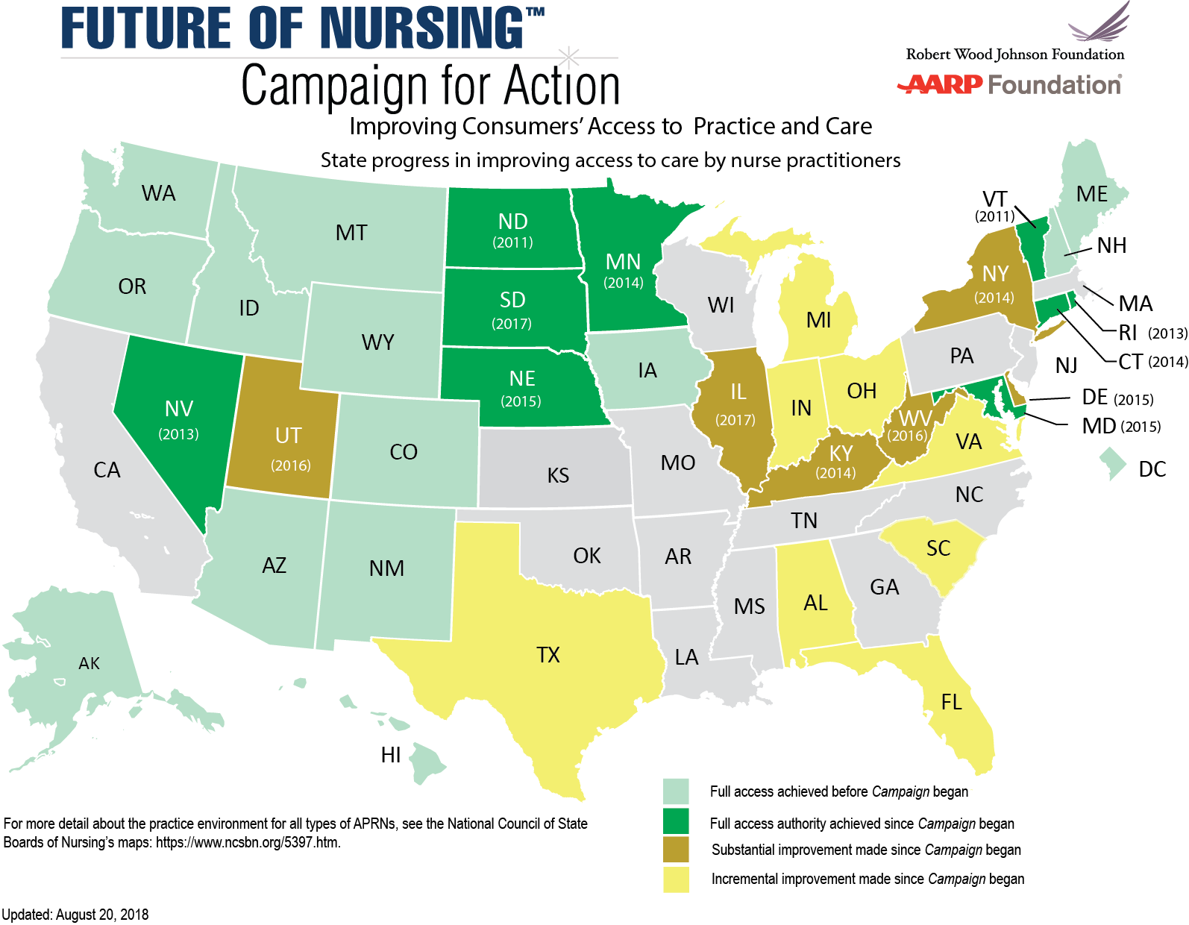
State Progress in Removing Barriers
Notes:
Right now, nurse practitioners in 22 states and the District of Columbia have full practice authority, including Nebraska (where legislation passed in March 2015), Maryland (where legislation passed in May 2015), and South Dakota (where legislation passed in February 2017). This is significantly improved from a few years ago, as you can see by this map, which shows the progress made in removing barriers to practice and care.
The Campaign is working to expand access to care by maximizing the use of nurses and removing outdated laws, regulations, and policies that prevent nurses from practicing to the full extent of their education and training—and we are making steady progress. Public opinion is shifting to support removing barriers to practice, and the Federal Trade Commission has challenged limits to nursing scope in 11 states.
Currently, the majority of Action Coalitions are working to remove barriers to practice and care and we are seeing progress
Since the launch of the Campaign, nine states have fully modernized their practice laws for nurse practitioners to increase consumer’s access to care and more than a dozen states have made improvements, helping to increase consumers’ access to care, and many have made incremental progress.
The nine states are—South Dakota (2017), Maryland (2015), Nebraska (2015), Minnesota (2014), Connecticut (2014), Nevada (2013), Rhode Island (2013), North Dakota (2011), and Vermont (2011).
For more information about practice restrictions for other types of APRNs, visit the National Council of State Boards of Nursing’s website.
Sources:
American Association of Nurse Practitioners. AANP Practice Map. www.aanp.org/legislation-regulation/state-legislation-regulation/state-practice-environment.
Federal Trade Commission. 2014. Policy Perspectives: Competition and the Regulation of Advanced Practice Nurses, www.ftc.gov/system/files/documents/reports/policy-perspectives-competition-regulation-advanced-practice-nurses/140307aprnpolicypaper.pdf.
Bay Area Council Economic Institute. 2014. Full Practice Authority for Nurse Practitioners Increases Access and Controls Cost. Technical Appendix, http://campaignforaction.org/sites/default/files/BACEI_NPs_Tech_Final.pdf.

Slide 12

Promote Nurse Leadership
Nurses bring a unique perspective to management and
policy discussions.
Nurses are the largest segment of the health care work force and spend the most time with people receiving health services.
When nurses are positioned to influence system practice, it leads to improved quality of care and reduced medical errors.
Yet nurses account for only 5 percent of hospital board positions.
Source: American Hospital Association 2011
Notes:
Nurses provide an important and unique point of view in decision-making, from the boardroom to our communities. They are vital to improving quality by supporting the transition of patients from hospital to home or community and reducing re-hospitalizations and medical errors.
Yet, a 2014 survey of 1,000 U.S. hospitals by the American Hospital Association found that nurses account for only 5 percent of clinical professions serving on boards. This contrasts with the number of physicians on boards, which is 20 percent; other clinicians make up about 4 percent. Although we lack data about nursing involvement on local and state boards of health, anecdotal evidence suggests that nurses are underrepresented on those boards as well.
That‘s why the Campaign for Action is working to prepare the next generation of nurses to meet the health care needs of people, their families, and the communities where they live and position nurses to lead system change. We are also working to get more nurses, who represent the largest segment of frontline workers, appointed to hospital and health system boards. We will all benefit when nurses see themselves as leaders and are able to influence health policies and outcomes.
In November 2014, national organizations came together to announce a new, nationwide effort to get 10,000 nurses onto boards of directors by 2020. Members of the “Nurses on Boards Coalition” include AARP, the Robert Wood Johnson Foundation, and 19 national nursing organizations. This effort seeks to ensure that nurses —and their frontline perspectives—have a seat at these decision-making tables.
Source: American Hospital Association. 2014. 2014 National Health Care Governance Survey Report. http://www.americangovernance.com/resources/reports/governance-reports/2014/

Slide 13




Improve Workforce Diversity
Nurses should reflect the population in terms of gender, race, and ethnicity.
All nurses should provide culturally competent services and care.
Greater workforce diversity may help to reduce health disparities and improve health outcomes in diverse communities.
Notes:
The Campaign and our partners also are working to recruit and prepare the nursing profession to provide culturally competent care in a variety of settings to an aging and more ethnically diverse population with more chronic illnesses.
Just over one-third of the U.S. population is part of a racial or ethnic minority according to the 2010 Census, yet nurses from minority backgrounds represent only 28 percent of the registered nurse workforce, and men comprise only 11 percent of all RNs.
We see some progress being made in schools of nursing. The number of minority students enrolled in advanced nursing education is increasing. Some 30 percent of students at the baccalaureate, master’s, doctoral, and doctor of nursing practice program levels represent minority populations. The number of men in nursing is also increasing. In 2016, 13.7% of pre-licensure RN program graduates were male.
By 2043, minority populations will make up a majority of our population. We need to make sure that our profession reflects the people we serve and that all nurses deliver culturally competent services in all settings.
Sources:
U.S. Census Bureau, 2010 Census Shows America's Diversity (press release), https://www.census.gov/newsroom/releases/archives/2010_census/cb11-cn125.html
releases/archives/2010_census/cb11-cn125.html.
Campaign for Action Dashboard, https://campaignforaction.org/issue/increasing-diversity-in-nursing/
Center for Interdisciplinary Health Workforce Studies at Montana State University, http://healthworkforcestudies.com/publications-data/data_brief_update_current_trends_of_men_in_nursing.html
AACN, The Changing Landscape: Nursing Student Diversity on the Rise, http://www.aacnnursing.org/Diversity-Inclusion/Latest-Data
Campaign for Action Dashboard, https://campaignforaction.org/issue/increasing-diversity-in-nursing/
U.S. Census Bureau, https://www.census.gov/newsroom/releases/archives/population/cb12-243.html

Slide 14
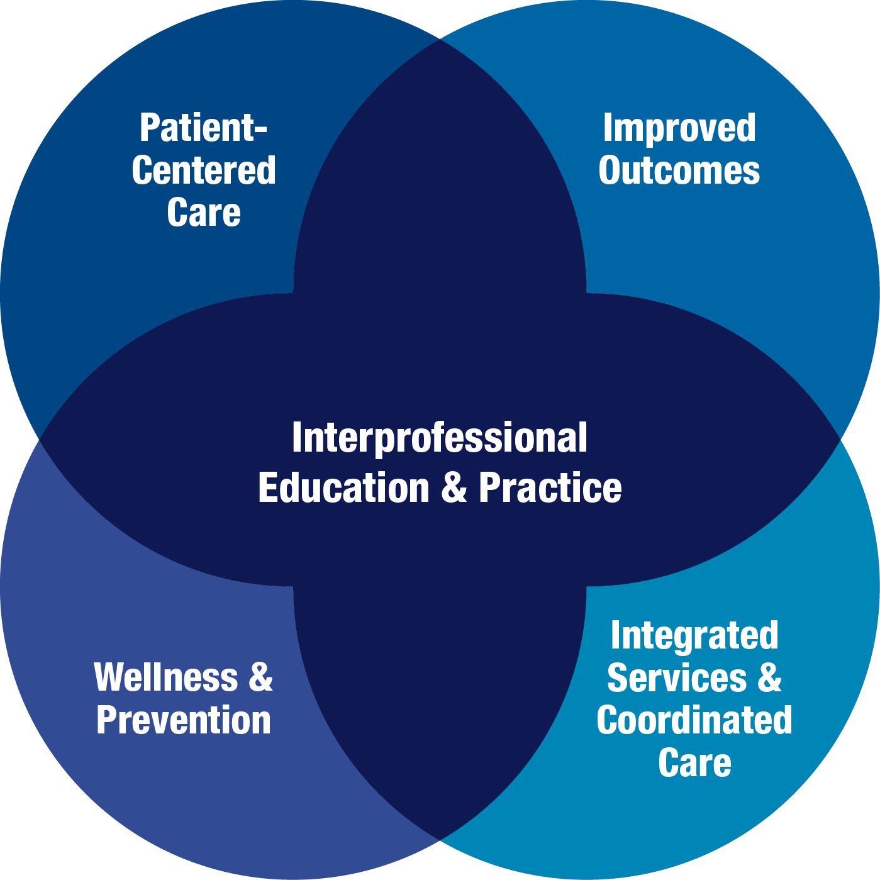
Interprofessional Collaboration
Notes:
Finally, the Campaign also is working on interprofessional collaboration to promote a team-based approach to education and practice to improve the quality and coordination of health care. Studies have demonstrated that effective coordination and communication among health professionals can enhance the quality and safety of patient care.
When health professionals work collaboratively as integrated teams, they draw on individual and collective skills and experience across disciplines. This integration of health service delivery better leverages the assets of health care and public health professionals, allowing each person to practice at a higher level. This results in better health outcomes, including higher levels of satisfaction with services received and improved wellness and preventive care.

Slide 15
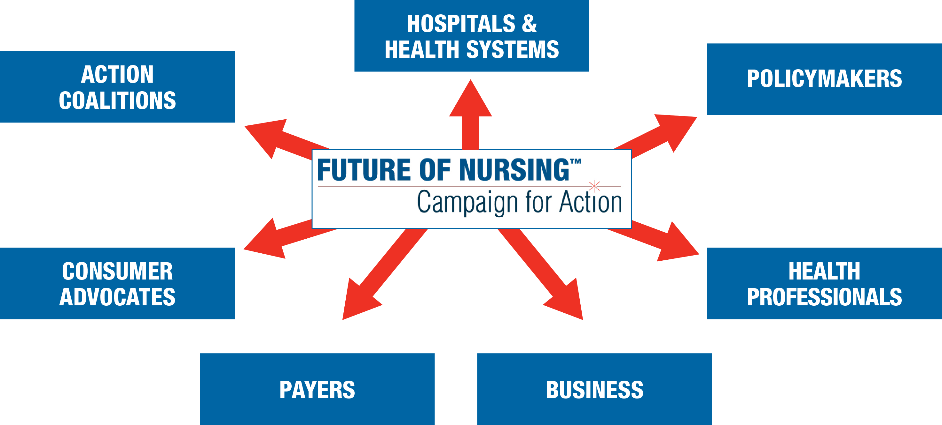
We Need Your Support
Notes:
The Future of Nursing: Campaign for Action is working to transform health through nursing, and we need your help to succeed. It will take all of us—health professionals, hospitals and health systems, policymakers, consumer advocates, payers, consumers, businesses, think tanks, long-term care, foundations, and everyone who cares about health care—to make this work.

Slide 16



Help Shape the Future of Health Care
Join or support an Action Coalition.
Sign up for our email alerts and newsletters.
Visit our website.
Educate your organization about the Campaign.
www.campaignforaction.org
http://facebook.com/campaignforaction www.twitter.com/campaign4action
Notes:
Health care transformation is under way, and the future of nursing is now. We can’t transform health care without transforming nursing. Our health care system can improve only if nurses are better prepared and able to lead and practice to the full extent of their education and training. A few things you can do:
Join or support an Action Coalition.
Sign up for our email alerts and newsletters.
Visit our website and participate in our online community.
Educate your organization about the Campaign.
Together, we can create a health system that provides accessible, affordable, and quality care to everyone in America. Thank you.

