Slide 1

Building a Culture of Health in America
Audience
Date
Speaker
Notes:
Thank you so much. I’m excited to talk to you about building a Culture of Health here in [insert community]– by that I mean enabling everyone to live the healthiest life possible. It’s something that we can do together.
I’m here on behalf of the [insert state Action Coalition]. We were established in [insert year] and are a voluntary organization. I am also [insert professional affiliation].

Slide 2
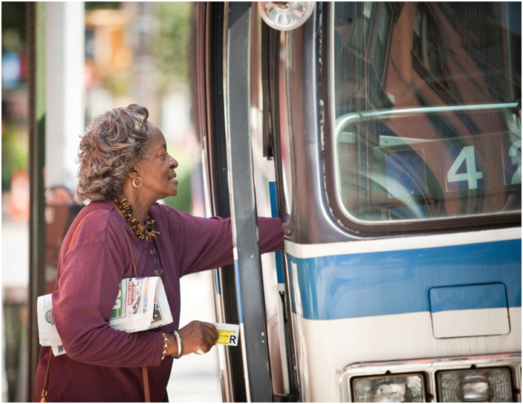
Address All Factors That Affect Health
Health tied to:
How much money people make
How much school they’ve completed
Neighborhoods they live in
Copyright <2009> Rodger Tully
The choices we make are based on the choices we have
Notes:
In today’s America, too many people’s health is tied to how much money they make, how much school they’ve completed, and the neighborhoods they live in. People’s health has a lot to do with the individual decisions they make – that’s for sure. But the choices that we all make are based on the choices we have.

Slide 3
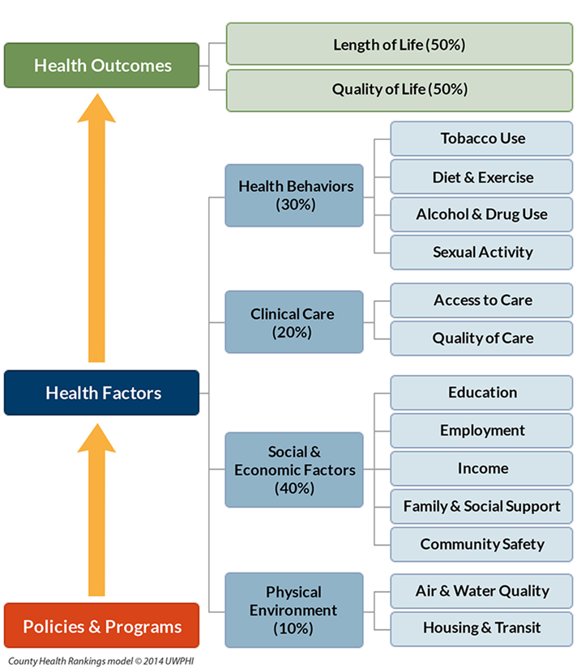
Many Factors Affect Health
Notes:
These social determinants of health, including poverty, inequity, violence, poor housing, lack of a good education, lack of jobs, lack of access to healthy food or safe places to play – are responsible for an estimated 80 percent of all illnesses; only 20 percent can be attributed to biological causes alone.
Source: Braveman, P., & Gottlieb, L. (2014). The social determinants of health: it's time to consider the causes of the causes. Public Health Reports, 129.

Slide 4

Disturbing Facts
1/3 of kids are either overweight or obese
75% of 17- to 24-year-olds are ineligible to serve in the military
One of every two deaths in America is linked to chronic disease
Copyright <2015> Tyrone Turner
Notes:
And as a nation, we’re not as healthy as we think we are. Too many of our children are still overweight or obese. And that means they’re facing the specter of a lifetime of chronic disease.
In fact, right now, a shocking 75 percent of America’s young adults are too fat, too poorly educated or too tied up in the criminal system to serve in the military.*
Research warns that if we don’t do something about our kids’ weight now, they will be the first generation in American history to live shorter and sicker lives than their parents.
One of every two deaths in this country is still linked to chronic diseases like diabetes, heart disease and stroke.**
Source: Mission Readiness. 2014. Retreat Is Not an Option. Washington, D.C. Available at: http://missionreadiness.s3.amazonaws.com/wp-content/uploads/MR-NAT-Retreat-Not-an-Option2.pdf
Source: Woolf SH and Laudan A, eds. U.S. Health in International Perspective: Shorter Lives, Poorer Health. Washington: National
Academies Press; 2013, www.ncbi.nlm.nih.gov/books/NBK154476/

Slide 5
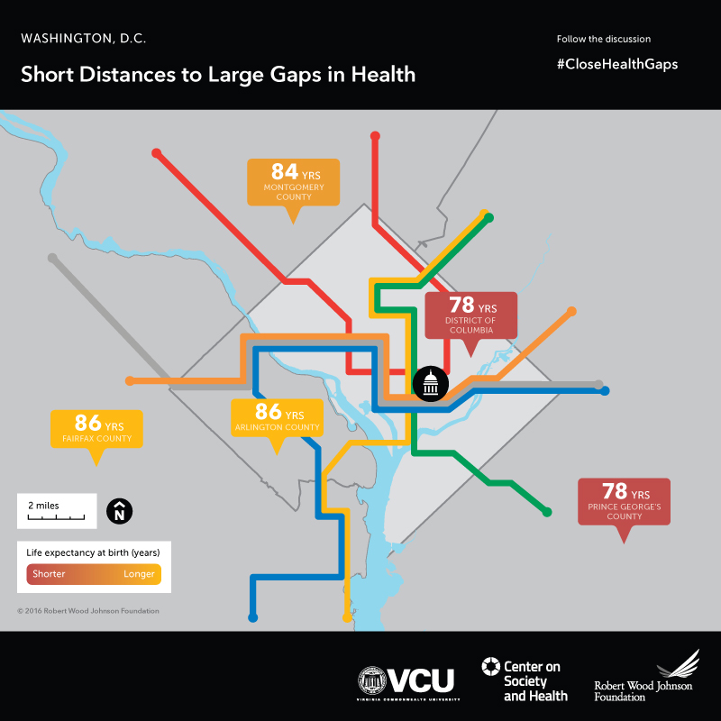
Where You Live Affects Your Health
Notes:
These problems are compounded if you are poor or a member of a minority group. Your zip code may be a better indicator of your health than your genetics. For example, babies born to mothers in Maryland's Montgomery County and Virginia's Arlington and Fairfax Counties can expect to live six to eight years longer than babies born to mothers in Washington, D.C.--just a few subway stops away.
Source: Arkin E, Braveman P, Egerter S, Williams D (eds.) Time to Act: Investing in the Health of Our Children and Communities. Princeton, N.J.: Robert Wood Johnson Foundation Commission to Build a Healthier America; 2014, p. 90.
[You can see maps for other metro areas here: http://www.societyhealth.vcu.edu/work/the-projects/mapping-life-expectancy.html]

Slide 6
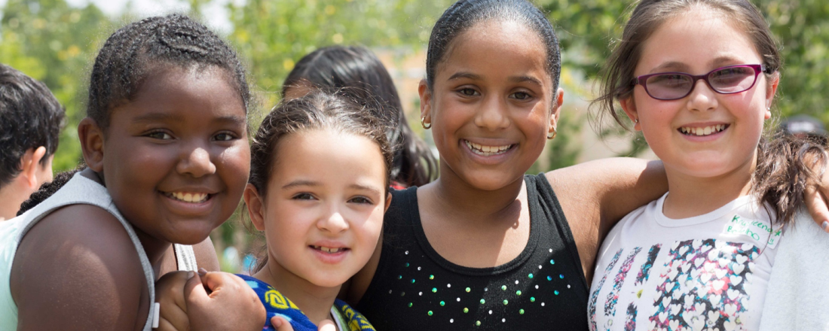
RWJF Vision
We, as a nation, will strive together to build a Culture of Health enabling all in our diverse society to lead healthy lives, now and for generations to come
Copyright <2014> Paul Chouy
Notes:
That’s why we need to build a Culture of Health. Building a Culture of Health is a movement led by the Robert Wood Johnson Foundation and shared with others to take on one of the most pervasive challenges of our time: improving the health and well-being of everyone in America. A Culture of Health places well-being at the center of every aspect of life, so that all communities can flourish and all individuals thrive, regardless of race, creed, income, or location. It’s built on the premise that everyone deserves to live the healthiest life possible.

Slide 7
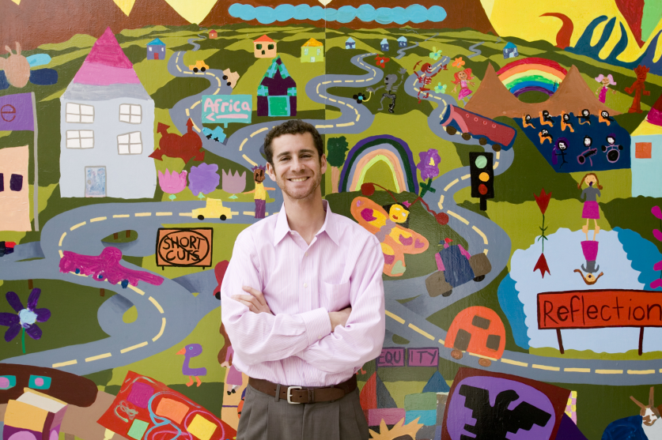
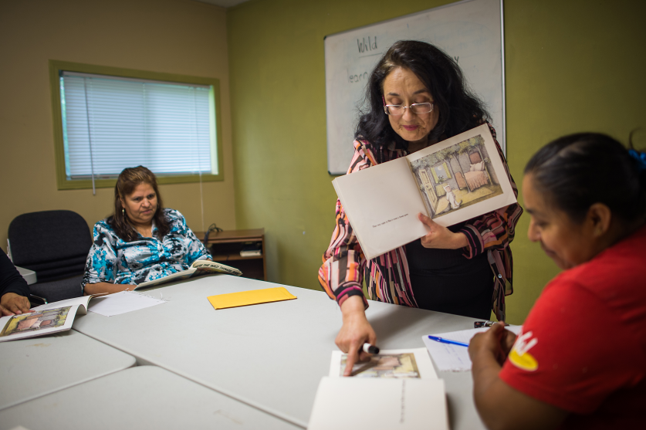
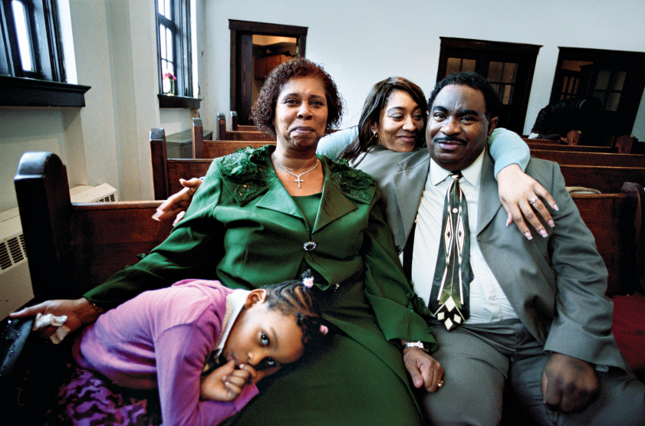
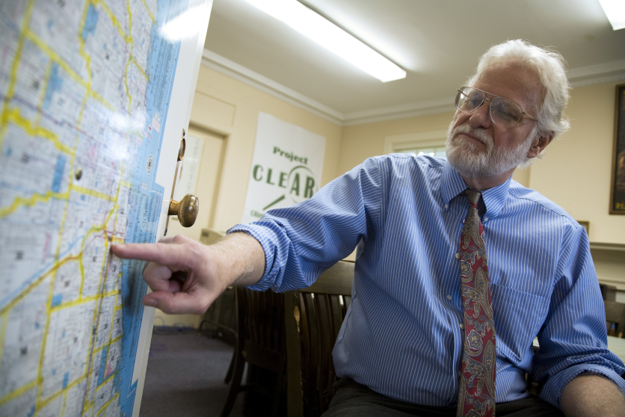
Many Partners…
Copyright <2006> Rodger Tully
Copyright <2014> Mike Belleme
Copyright <2008> Lynn Johnson
Copyright <2008> Ed Kashi
Notes:
If we want everyone in America to be able to lead a healthy life, we need to address all of the factors that affect health.
To do so, we must shift towards a society that places everyone's health and well-being at the center of every aspect of life - including in areas that we may not traditionally associate with healthy living, such as city and urban design, public transportation, and education. That means we need to partner groups like yours, and [give examples of local Action Coalition’s partnerships, or examples of local stakeholders/business that are important to the community]

Slide 8
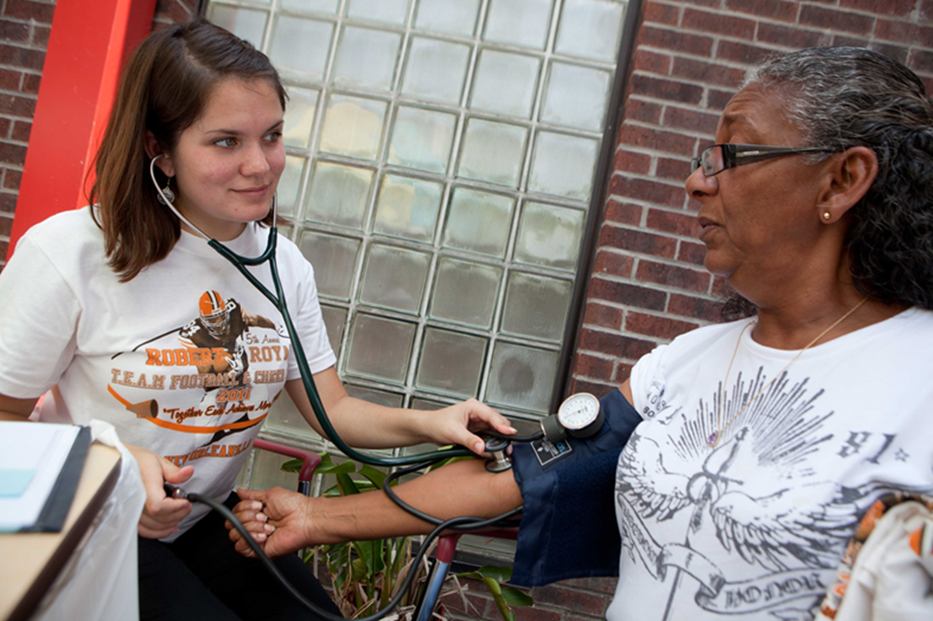
…Including Nurses
Copyright <2011> Tyrone Turner
Notes:
As nurses, we recognize the role we can play in this movement. Nurses are repeatedly ranked the most trusted health professional, and they make up the largest segment of the health and health care workforce. They spend the most time with people, families and communities. Nurses promote prevention and wellness and provide population-focused services to entire communities.
Here in [insert state], nurses in our Action Coalition are [give examples of what nurses are doing. Here it doesn’t have to be specific to Culture of Health].

Slide 9

Nurses Are Transforming Health
The Future of Nursing: Campaign for Action:
Everyone in America can live a healthier life, supported by a system in which nurses are essential partners in providing care and promoting health.
Notes:
In fact, nurses are transforming health and health care through the national Future of Nursing: Campaign for Action, an initiative of AARP Foundation, AARP and the Robert Wood Johnson Foundation.
The goal of the Campaign is to prepare the nursing workforce to provide top-notch care by strengthening nursing education, practice, and leadership.
Action Coalitions are working on these issues in all 50 states, including [enter your state]. The Action Coalitions are made up of nurses and a broad spectrum of partners.
Action Coalitions have raised nearly $20 million in funding. Members include a wide range of health care providers, consumer advocates, policymakers, and business, academic, and philanthropic leaders.
Together, we are working to implement our vision that everyone in America can live a healthier life, supported by a system in which nurses are essential partners in providing care and promoting health.
Our Action Coalition stands ready to work with you to build a Culture of Health.

Slide 10
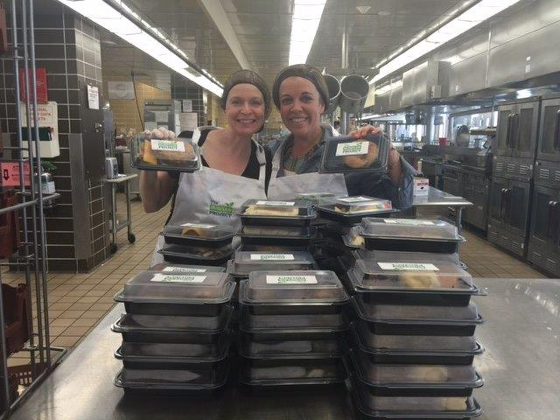
Example: Surplus Food Project
Nurses and other volunteers repackage hospital food bound for landfill to local food pantries
Nurses provide health screenings when meals are served.
Copyright <2016> Jennifer Grenier
Notes:
There are some great examples of how nurses are partnering to build healthier communities. For example, Jennifer Grenier, a nurse in Chicago, started the Surplus Project with community partners to reduce food waste at her hospital, and to make sure the hungry get health screenings as well as meals.
In 2016 alone, 6,000 pounds of food bound for landfills has been turned into 5,600 meals served at food pantries.
Grenier worked with the director of a local food pantry and with volunteer staff at her hospital to repackage sandwiches, vegetables and lasagna for the food pantry. She and other nurse volunteers decided to start delivering, along with the meals, blood pressure screenings, nutritional assessments, and body-mass index calculations. When food is served, RNs on The Surplus Project team stand by, literally, to answer health care questions.
The program was so successful that a local grocery store and a high school also began repackaging food for the food pantry.

Slide 11
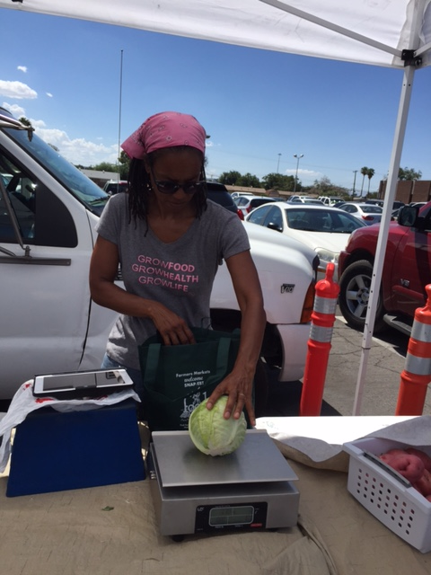
Example: Community Gardens
Garden offers produce to low-income community
Goals: create neighborhood connections and promote healthy bodies and minds
Nurses provide fundraising support and volunteers
Copyright <2016> Vegas Roots
Notes:
In Las Vegas, nurse leaders from the Nevada Action Coalition have partnered with the city’s only urban farm, Vegas Roots Community garden. The garden is located in a low-income part of the city. The garden already offers much now, including a Buck Truck – a farmer’s market on wheels that visits low-income neighborhoods.
The nurses are helping the garden to expand the fresh produce in an area with no large grocery stores and few options for healthy food.
They are visiting local churches to get congregations involved in the garden and pitching the cause to local businesses. They are also organizing a competitive fundraiser with the region’s nursing schools to raise money to build a larger chicken coop and purchase 24 hens. The eggs will be donated to needy families.
[More information is available here: http://campaignforaction.org/roots-success-take-hold-nevada/]

Slide 12

Example: Vote & Vax
Nurses part of Vote & Vax:
Voters are offered a flu shot in neighborhoods that experience health disparities
Many partners involved
Source: Vote & Vax
Notes:
And other nurse leaders are part in Vote & Vax, a program that provides flu vaccine on Election Day. For example, nurses in Omaha will offer people who come to vote a flu shot near four polling places in areas that experience health disparities. Other partners include two Federally Qualified Health Centers, Nebraskans for Civic Reform led by State Senator Adam Morefeld, and the Nebraska Immunization Taskforce.
Vote & Vax is a national program. From the 2004 election through election 2010, close to 40,000 flu shots were administered in 44 states and in DC. About half of those shots went to those who didn’t usually get them.
[More info available here: http://voteandvax.org/]

Slide 13
Your Example Goes Here
Feel free to insert your own example here and delete one or more of the template examples.
What is the project?
Who did it benefit in the community?
Who were the health and non-health stakeholders involved?
What role did nurses or your Action Coalition play?

Slide 14
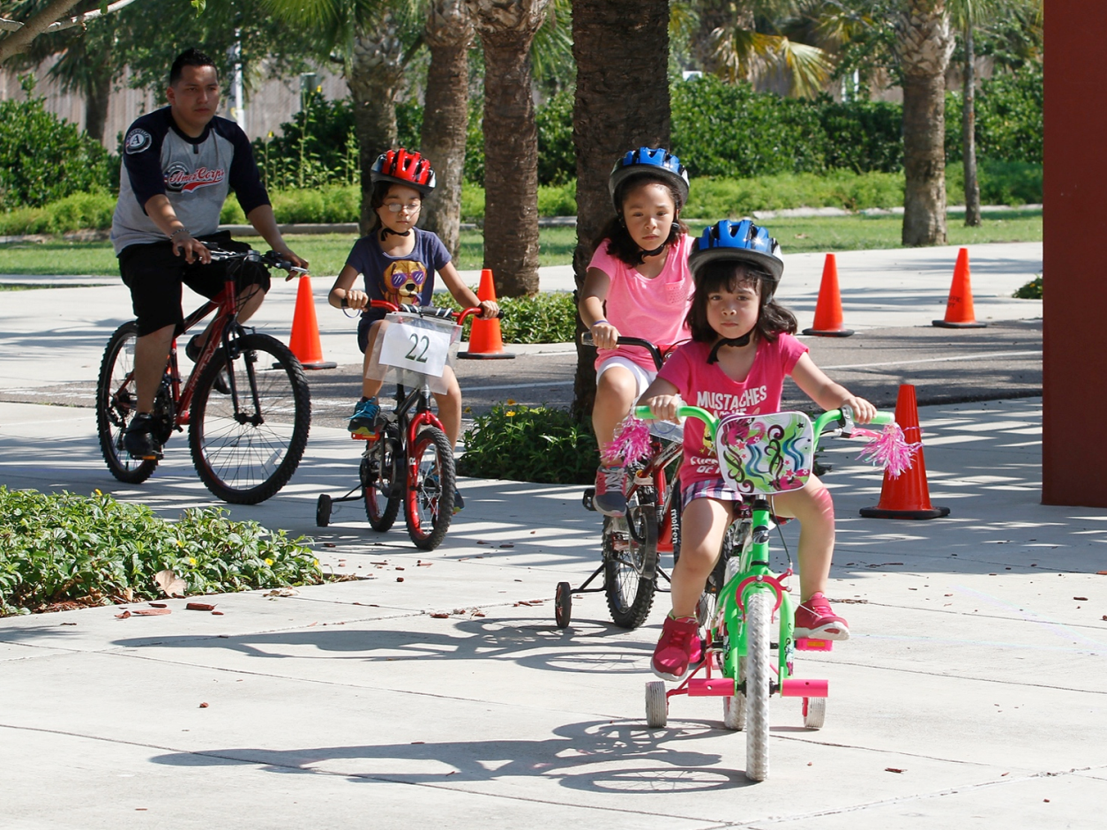
Partnering to Create a Healthier America
Copyright <2015> Flynn Larson
cultureofhealth.org
Notes:
And we’d love to talk to you and hear your ideas of how we can work together to build a Culture of Health. By working together, we can create a healthier place for everyone, and we can leave a lasting legacy to our children and grandchildren. Thank you.
Flynn Larsen 2015

Slide 15
Contact Information
Enter your AC website here
Enter your email address here
Add your Twitter and Facebook info here
Notes:
Action Coalitions can give their website, email address and perhaps Twitter and Facebook

