Slide 1
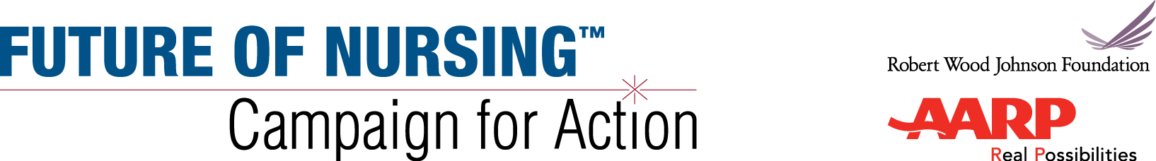

[Venue/Audience]
[Date]
[Speaker name and title]

Slide 2
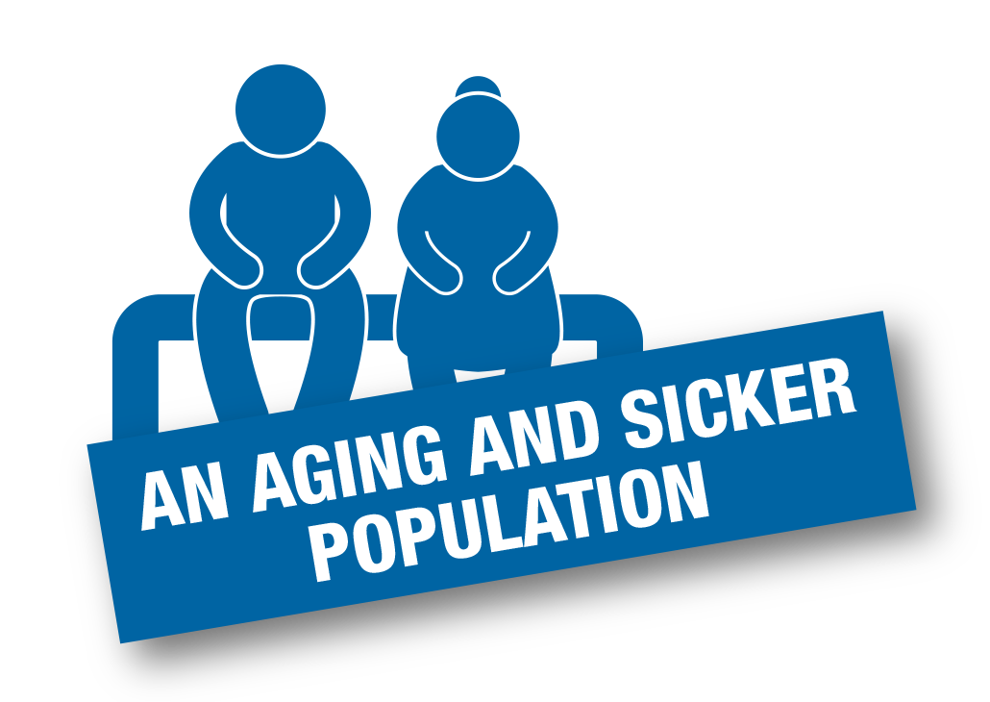
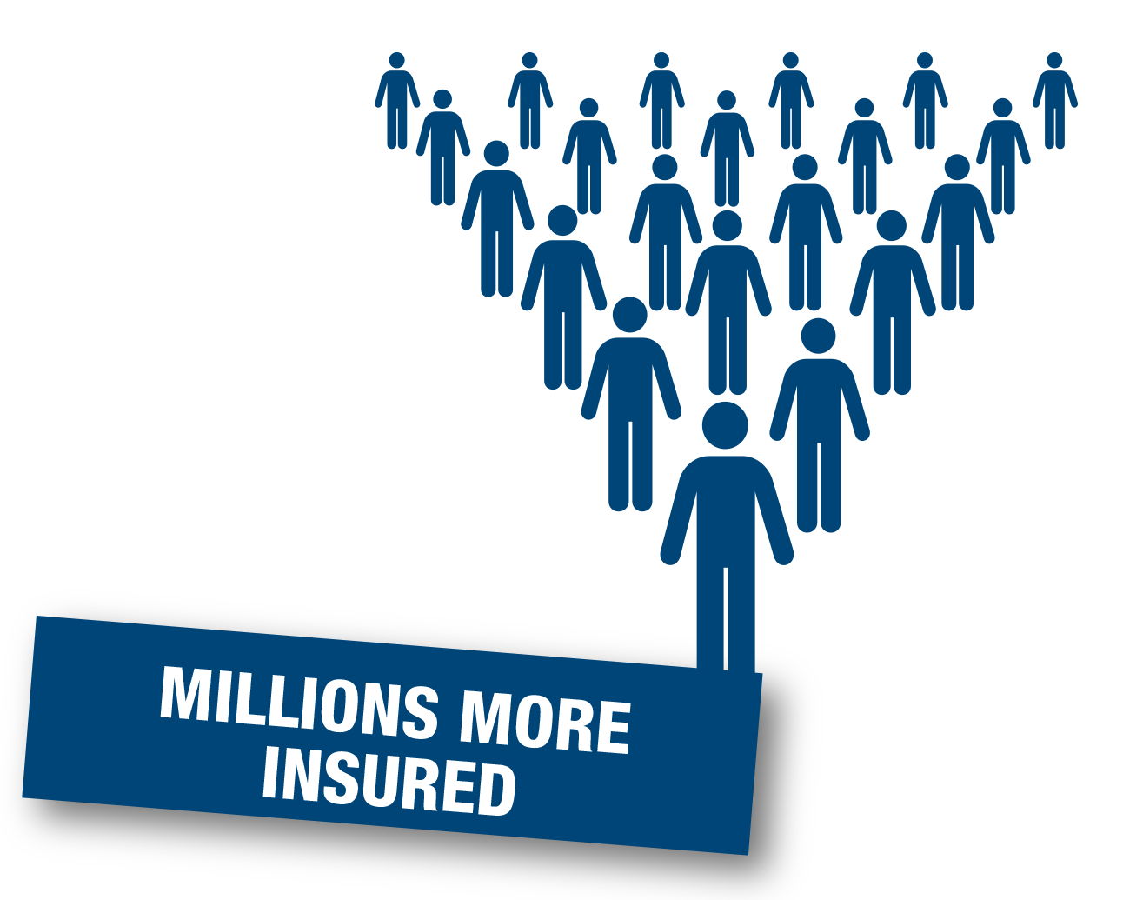

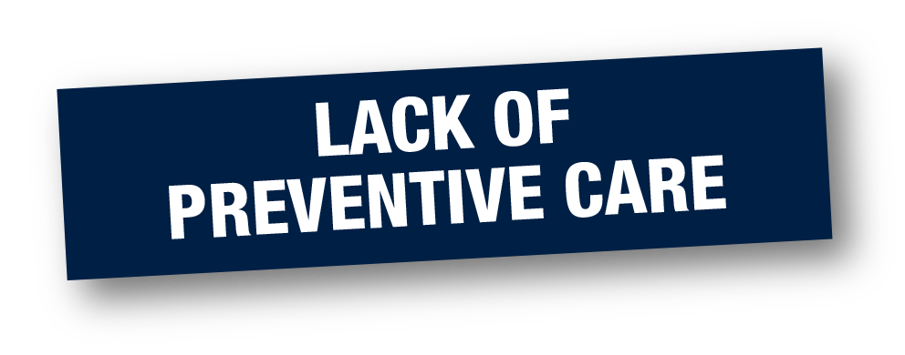

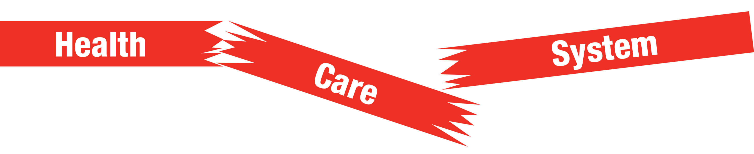
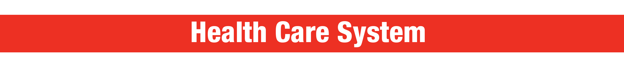
Health System Challenges
Notes:
Our health care system faces enormous challenges: an aging and sicker population, millions more insured, a primary care provider shortage, lack of preventive care, and rising costs. Meanwhile, those of us who work in health care face budget cuts, limited resources, fragmentation, and an emphasis on quantity of tests versus quality of diagnosis, treatment, and prevention. We hear constantly from nurses about the pressure to do more with less.

Slide 3






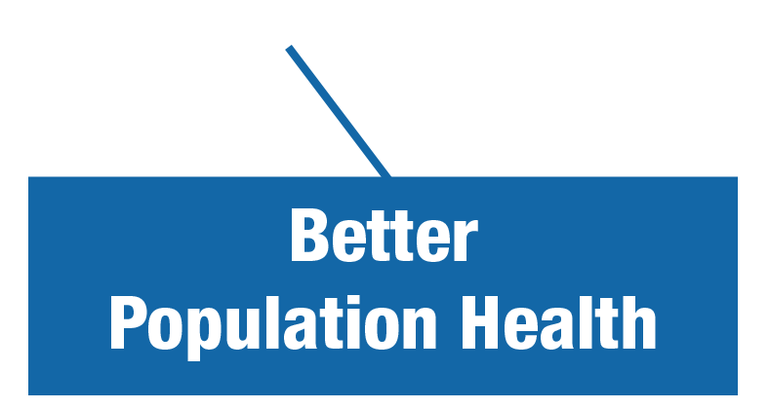
A New Era in Health Care
Person- and Family-Centered Care
Notes:
The good news is that decision-makers are open to change like never before. We need to make many changes to improve the overall quality of health care in our country. For example, we need to move our health care system away from the hospital and into the home and the community—toward person- and family-centered care.
We need to expand our system’s focus and capacity, increase access to care, truly improve quality, and contain costs. And we need to make sure that coordinated health services are provided consistently in all settings, when and where people need it.

Slide 4
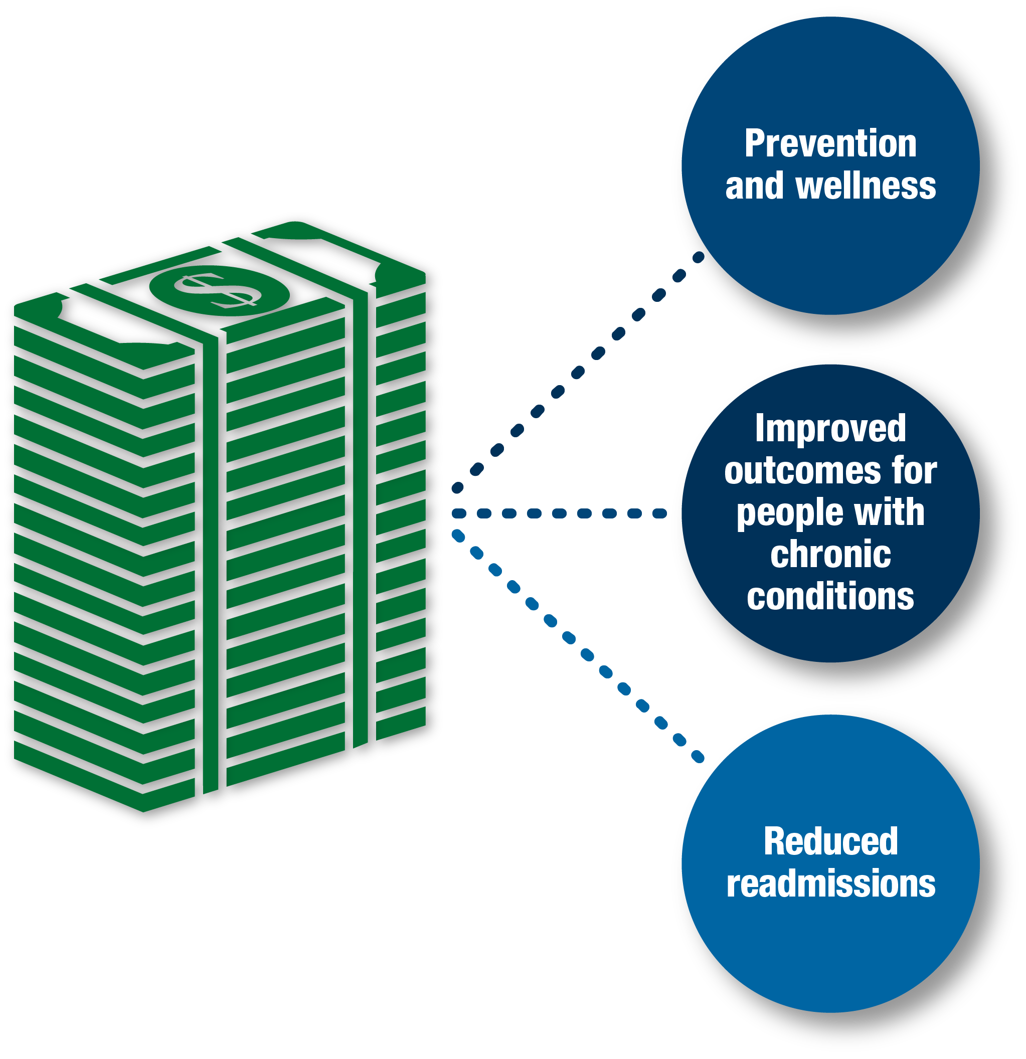
What Does This Mean for Providers?
Payment and Reimbursement Tied to Value-Based Measures
Notes:
A significant change for providers is that payment and reimbursement are being tied to value-based measures: improving outcomes for people with multiple chronic conditions, reducing unnecessary hospitalizations, and focusing on wellness and prevention, so that people can lead healthier lives. For example, through innovative payment models (such as accountable care organizations and bundled payments), Medicare and private health plans are creating substantial new incentives to improve health outcomes by promoting prevention and reducing rates of chronic illness.
As we rethink our new system, we need to reconsider how we use our resources.

Slide 5



A Culture of Health
RWJF Goal: We, as a nation, will strive to create a culture of health enabling all in our society to lead healthy lives, now and for generations to come.
Notes:
As we rethink our health care system, it may be helpful to consider the Robert Wood Johnson Foundation’s ambitious and worthy goal to achieve a culture of health. It means a nation in which being healthier and staying healthy are shared values, and where everyone—regardless of their geographic, demographic, ethnic, racial, or socioeconomic circumstances—has access to high-quality, cost-effective, and affordable health care.
It means encouraging wellness is as high a priority as treating illness:
Where we pay more attention to the social determinants of health, such as food, exercise, and housing.
And where getting healthy and staying healthy are fundamental values, right up there with life, liberty, and the pursuit of happiness.
The Future of Nursing: Campaign for Action, which I am going to discuss in a minute, is a joint initiative of the AARP Foundation, AARP, and the Robert Wood Johnson Foundation that is working to help make this happen.

Slide 6

How Nurses Can Help
Nurses are the largest segment of the health care workforce and spend the most time with individuals and families.
Manage influx of older, sicker, patients with more chronic illness.
Develop and implement new models of care.
Provide transitional and coordinated care.
Reduce medical errors and rehospitalizations.
Improve prevention, wellness, and population health outcomes.
Notes:
As the largest segment of the health care workforce—and the ones who spend the most time with patients and their families across the continuum of care—nurses are vital to the successful transformation of health care.
Nurses are at the center of many of the innovations we rely on to expand access, improve quality of care, and contain costs. And nurses with strong clinical and leadership skills can help to promote wellness, develop new models of care, manage care coordination, and improve population health outcomes.

Slide 7
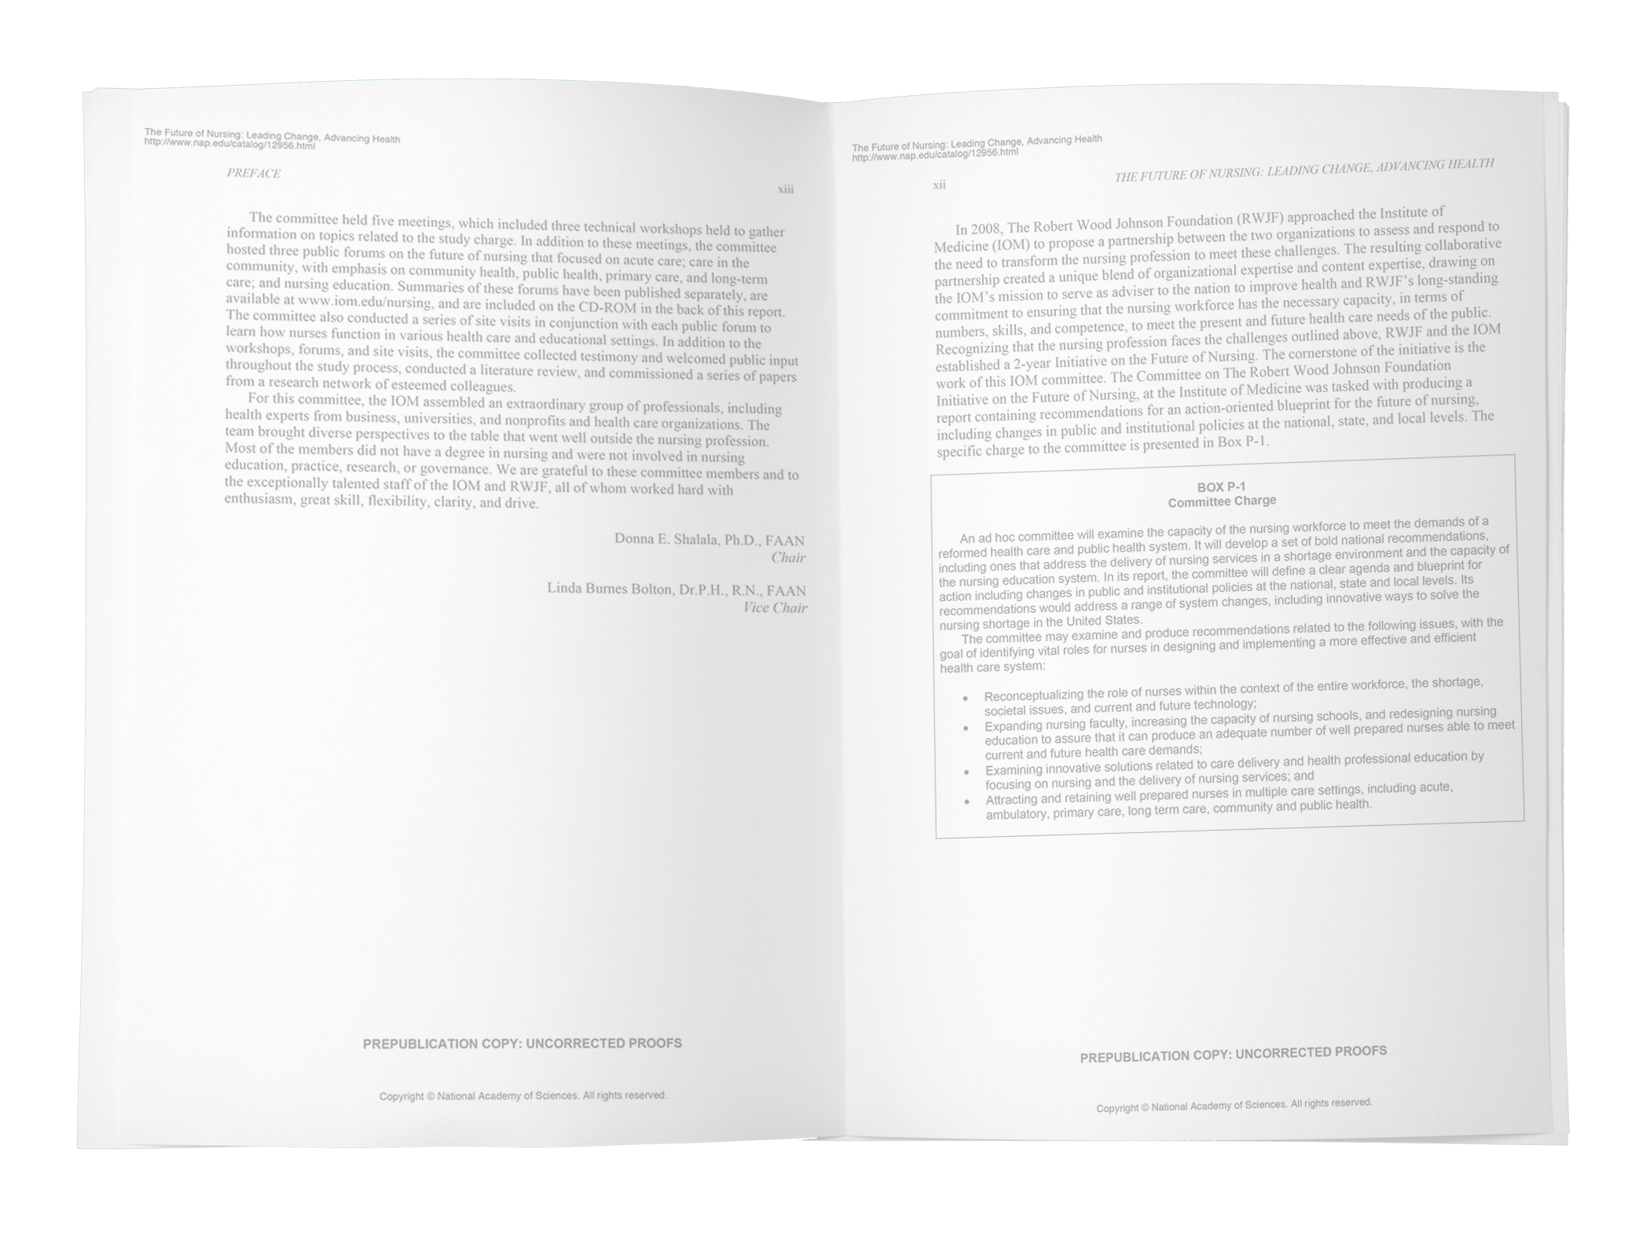

Institute of Medicine Report
High-quality, patient-centered health care for all will require a transformation of the health care delivery system.
Notes:
The Robert Wood Johnson Foundation has long invested in nursing and believes that strengthening the nursing field is crucial to improving health in our country. But the Foundation needed evidence. So, in 2008, they partnered with the Institute of Medicine (IOM) to produce a report on the future of nursing. In 2010, the IOM released The Future of Nursing: Leading Change, Advancing Health, a landmark report that stated that nursing must be prepared for health system transformation—and that nurses must help to lead and shape this change. The report offered recommendations to transform health care through nursing, so all Americans have access to high-quality care, with nurses contributing to the full extent of their capabilities.
Few reports have received as much attention as this one. It is one of the most viewed online reports in the IOM’s history, ranking “most read” in 2011, 2012, 2013, 2014, 2015, and 2016.

Slide 8

Campaign Vision
Everyone in America can live a healthier life, supported by a system in which nurses are essential partners in providing care and promoting health.
Notes:
The Robert Wood Johnson Foundation, the nation’s largest health care philanthropy, and AARP, the nation’s largest consumer organization, believed the recommendations in the IOM report were too important to sit on a shelf, so in 2010, together we launched a nationwide initiative to improve health through nursing called Future of Nursing: Campaign for Action. The Campaign is working both on the national level and in the states, engaging with consumers, nurses, other clinicians, insurers, health care systems, employers, educators, funders, and policymakers—all the stakeholders who need to be involved in system change—to advance the IOM’s recommendations.
We have launched Action Coalitions in all 50 states and the District of Columbia to pave the way for needed changes at the state level. To date, Action Coalitions have raised more than $20 million in funding from hundreds of organizations and individuals. Their members include a wide range of health care providers, consumer advocates, policymakers, and business, academic, and philanthropic leaders.
Together, we are working to implement our vision that everyone in America can live a healthier life, supported by a system in which nurses are essential partners in providing care and promoting health.

Slide 9
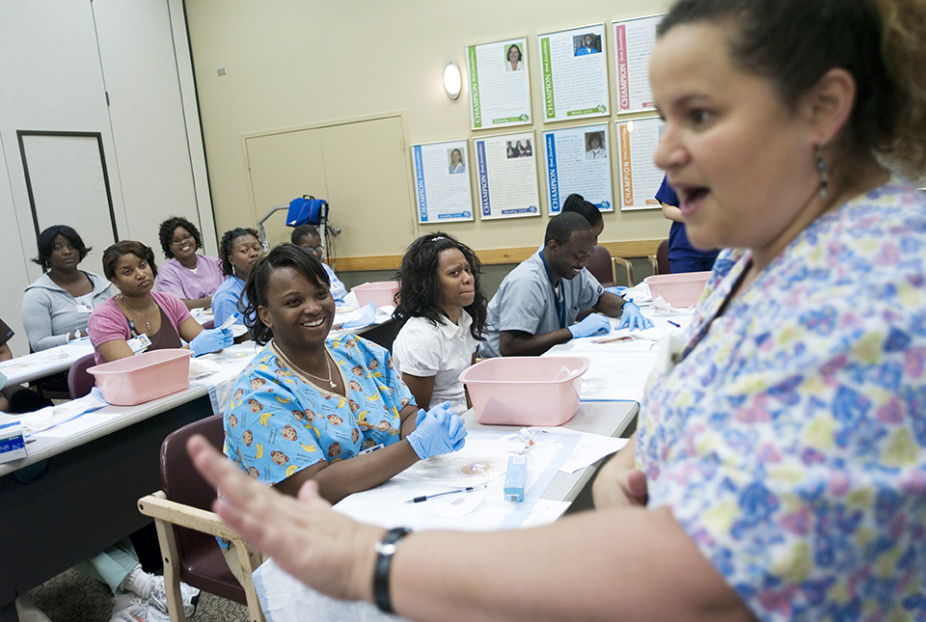


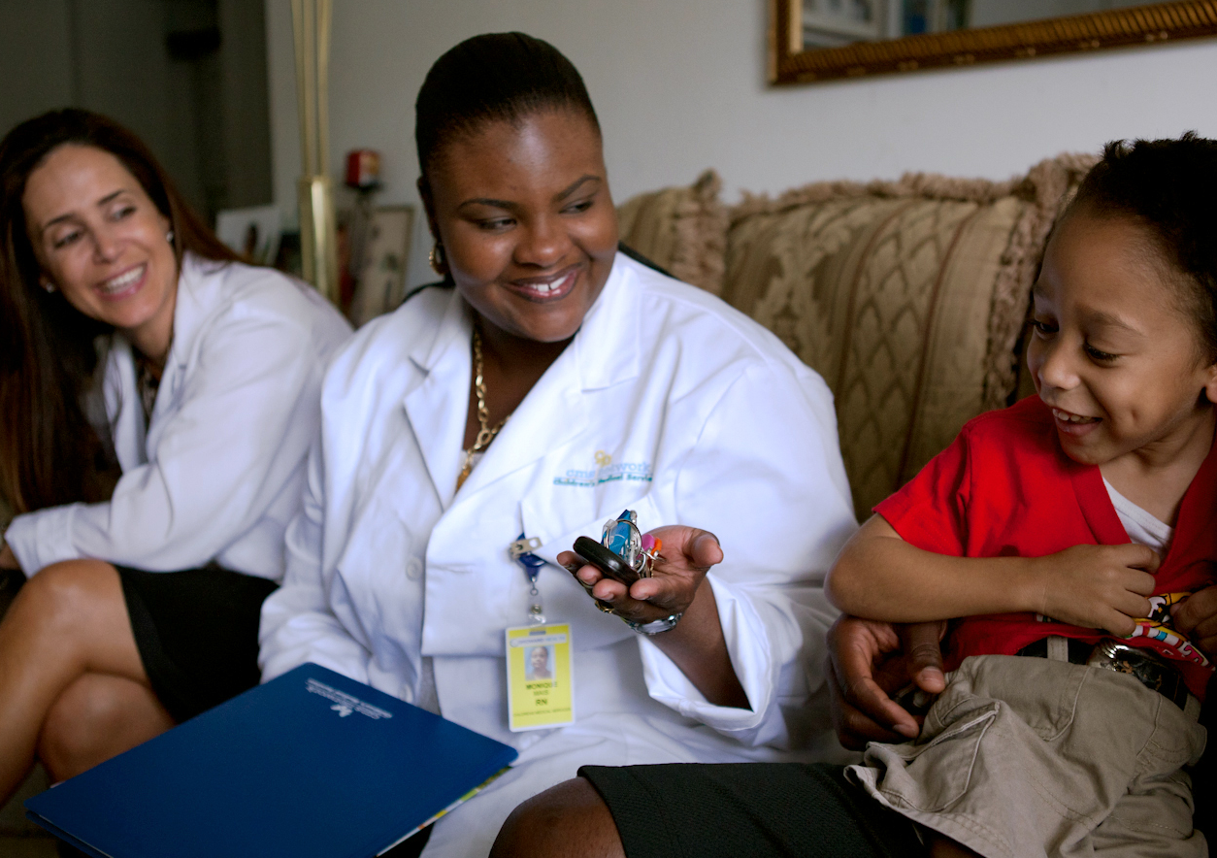

Areas of Focus
Education
Practice & Care
Leadership
Diversity
Interprofessional Collaboration
Notes:
Nurses can improve care in homes and communities, classrooms and emergency rooms. The Campaign focuses on five major areas, or pillars. They are to:
Advance education transformation. We need to prepare our nursing workforce for the future by strengthening education and training.
Remove barriers to practice and care. We need to expand access to care by maximizing the use of nurses and modernizing outdated policies that prevent nurses from practicing to the full level of their education and training.
Leverage nursing leadership. We need to prepare the next generation of nurses to meet the health care needs of people, their families, and the communities where they live and to position nurses to lead system change.
Promote diversity. We need to recruit and prepare the nursing profession to provide culturally competent care in a variety of settings to an aging and more ethnically diverse population with more chronic illnesses.
Foster interprofessional collaboration. We need to promote a team-based approach to education and practice to improve the quality and coordination of health care.
In addition to these areas, we need accurate data to predict workforce needs and competencies, assess quality, and determine what’s working and what’s not. Data can inform all we do, so we are working on that across all pillars as well.

Slide 10

Strengthen Nursing Education
IOM: Increase the proportion of nurses with BSN degrees and higher so that nurses can be:
Better prepared and educated.
Equipped to practice in community, home, and public health settings.
More adept with complex care and technology.
Prepared to lead and replace retiring leaders—reducing primary care and faculty shortages.
Able to develop and implement new models of interdisciplinary care.
Ready to promote wellness and reduce chronic disease.
Notes:
We need to make sure that nurses have the competencies required to practice in community, home, and public health settings. Nurses will need to be more adept with technology to care for an aging population with multiple chronic conditions. They’ll need to work in teams with other health care professionals to coordinate care and manage disease. And they’ll need to assume leadership roles to help transform our health care system to ensure that it delivers integrated, equitable, and cost-effective services for everyone. Nurses also are needed to address the primary care shortage and the faculty shortage. In 2014, the US had more than 12 million newly insured people, and these numbers will increase in the upcoming years. Our workforce is already struggling to provide primary care.
We also need more nurses with doctorates to teach the next generation and to design innovations in health care delivery. In the 2014-2015 academic year, nursing schools turned away more than 68,000 qualified candidates, primarily because there weren’t enough faculty available to teach them and the schools lacked resources.
Sources:
American Association of Colleges of Nursing. 2015. New AACN Data Confirm Enrollment Surge in Schools of Nursing, http://www.aacn.nche.edu/faculty/news/2015/enrollment.

Slide 11
Education Evidence
Education Evidence
Studies show an association between higher nurse education and improved health care outcomes.
Some studies show that higher proportions of BSN-prepared nurses in hospitals are associated with lower rates of medication errors, patient mortality, and failure to rescue.
Research also shows that BSN-prepared nurses have stronger diagnostic skills and are better at evaluating interventions.
A growing body of research shows a connection between baccalaureate education and lower patient mortality rates and improved health outcomes.
Notes:
Studies have shown an association between higher nurse education levels and improved health care outcomes. Some studies show that higher proportions of BSN-prepared nurses are associated with lower rates of medication errors, mortality, and failure to rescue. Research also shows BSN-prepared nurses have stronger diagnostic skills and are better at evaluating interventions, and a growing body of research shows the connection between baccalaureate education and lower mortality rates.
Sources:
Aiken LH, Sloane DM, Bruyneel MS, et al., for the RN4CAST consortium. 2014. Nurse staffing and education and hospital mortality in nine European countries: a retrospective observational study. Lancet, 383(9931):1824-1830.
Kutney-Lee A, Sloane DM, & Aiken LH. 2013. An increase in the number of nurses with baccalaureate degrees is linked to lower rates of postsurgery mortality. Health Affairs, 32(3):579-586.
Aiken LH, Cimiotti JP, Sloane DM, et al. 2011. Effects of nurse staffing and nurse education on patient deaths in hospitals with different nurse work environments. Medical Care, 49(12):1047-1053.
Needleman J & Hassmiller S. 2009. The role of nurses in improving hospital quality and efficiency: real-world results. Health Affairs 2,8(4):w625-w633.
Aiken LH, Clarke SP, Cheung RB, et al. 2003. Education levels of hospital nurses and surgical patient mortality. Journal of the American Medical Association, 290(12):1617-1623.

Slide 12
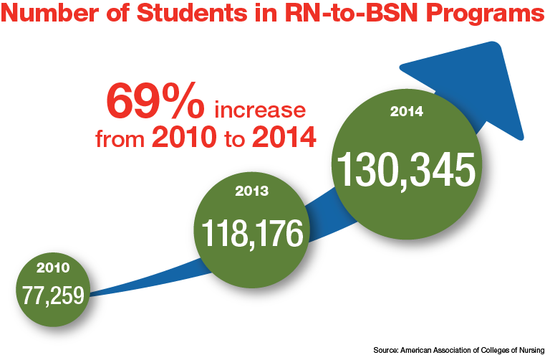
P
Education Progress
Notes:
Right now, 44 Action Coalitions are working on advancing nursing education transformation, and across the country, we are seeing a lot of progress.
The Campaign has identified four promising models to streamline academic progression: RN-to-BSN degree awarded from a community college; state or regionally shared competency- or outcomes-based curriculum; accelerated options (RN-to-MSN); and shared statewide or regional curriculum. Thirty Action Coalitions reported that students are enrolling in one of the four models in their states.
Here are a few examples of state progress:
Minnesota. The Minnesota Alliance for Nursing Education (MANE)—which comprises community colleges, a university, and practice partners—is creating a transformative curriculum to increase the number of baccalaureate-prepared nurses through dual enrollment between MANE community colleges and universities, decreasing existing access barriers to a baccalaureate education. These schools enrolled 840 students in the 2014-2015 academic year.
New Mexico. New Mexico has implemented a common statewide nursing curriculum to ensure that nursing credits will transfer seamlessly between colleges and universities and to enable more students in the state to pursue BSN degrees in their communities. They anticipate this move will help to increase the diversity of the state’s nursing workforce, especially among minority students and in rural areas.
Texas. The University of Texas at Arlington has rapidly increased the capacity of its RN-to-BSN education program by partnering with a proven distance education technology company. Components of its accelerated online program include a 5-week modular course format, a specifically designed content delivery system, and the use of MSN- or PhD-prepared faculty as academic coaches. As a result, enrollment in the RN-to-BSN program has increased from fewer than 200 students in 2008 to nearly 11,000 students today, an increase of 5,400 percent (as of May 2015).
At the national level, we are seeing progress, too. For the first time in its history, Medicare is paying to support the training of nurses with the Graduate Nurse Education Demonstration, a $200 million demonstration project in five hospital systems. And hospitals applying for Magnet status must provide a plan for how they will achieve 80 percent by 2020.
In addition, since 2010, the percentage of employed nurses with a baccalaureate or higher degree has increased from 49 percent to 51 percent, the enrollment in nursing-focused PhD programs has increased from 4,611 in 2010 to 5,286 in 2014, and the enrollment in DNP (doctorate of nursing practice) programs has increased from 7,034 in 2010 to 18,352 in 2014. Furthermore, enrollment in RN-to-BSN programs has increased 69% from 77,259 students in 2010 to 130,345 students in 2014.
Sources:
American Community Survey, Public Use Microdata Sample (series)
American Association of Colleges of Nursing. 2015. Findings from AACN’s Fall 2014 Survey of Nursing Schools (press release), http://www.aacn.nche.edu/news/articles/2015/enrollment#Findings.

Slide 13

Remove Barriers to Practice and Care
Nurses provide an immediate and cost-effective solution to care shortages.
All clinicians should be able to practice to the full extent of their education and training.
Barriers that limit nurses from expanding access to care must be removed.
Patients deserve the right care by the right clinician, at the right time, in the right place.
Notes:
Primary care in the United States is struggling to meet demand. Staffing shortages are expected to get worse as millions of newly insured Americans seek care, the population continues to age, and people grapple with more chronic disease. This is particularly true in underserved, rural, and minority communities. Nurse practitioners provide an immediate and cost-effective solution to this problem, enabling physicians to direct their energy to caring for people with complex medical conditions.
But outdated barriers are blocking the ability of advanced practice registered nurses (APRNs) and other providers to expand access to care. We need to remove these barriers and use clinicians more efficiently and effectively so that people can get the right care by the right clinician, when and where they need it.

Slide 14


Practice and Care Evidence
APRNs improve care on a wide range of indicators:
Patient satisfaction
Length of stay
Nurse practitioners: blood pressure, glucose, lipid control
Certified nurse-midwives: fewer cesarean sections and episiotomies
Preventive care
Notes:
The evidence is clear—APRNs provide effective, high-quality care to consumers and can safely expand access to primary and preventive care. In fact, on a wide range of indicators, APRNs improve care, including patient satisfaction and length of stay. The evidence demonstrates that APRNs provide as high quality care as physicians; there is no evidence that care provided in states that require APRNs to work under a doctor’s authority is better than in states where APRNs have full practice authority.
The American Hospital Association and the National Governor’s Association (NGA) also have released recommendations urging that all clinicians should practice to the top of their education and training, including nurse practitioners.
The NGA report found that nurse practitioners provided care comparable to that of physicians on indicators, including patient satisfaction, time spent with patients, prescribing accuracy, and preventive education. It also reported evidence of improved outcomes on blood pressure and blood sugar and that nurse practitioners are more likely to provide care in underserved urban populations and in rural areas.
Sources:
American Hospital Association. 2013. Workforce roles in a redesigned primary care model, www.aha.org/content/13/13-0110-wf-primary-care.pdf.
National Governor’s Association. 2012. The role of nurse practitioners in meeting increased demand for primary care. NGA Paper, www.nga.org/cms/home/nga-center-for-best-practices/center-publications/page-health-publications/col2-content/main-content-list/the-role-of-nurse-practitioners.html.

Slide 15
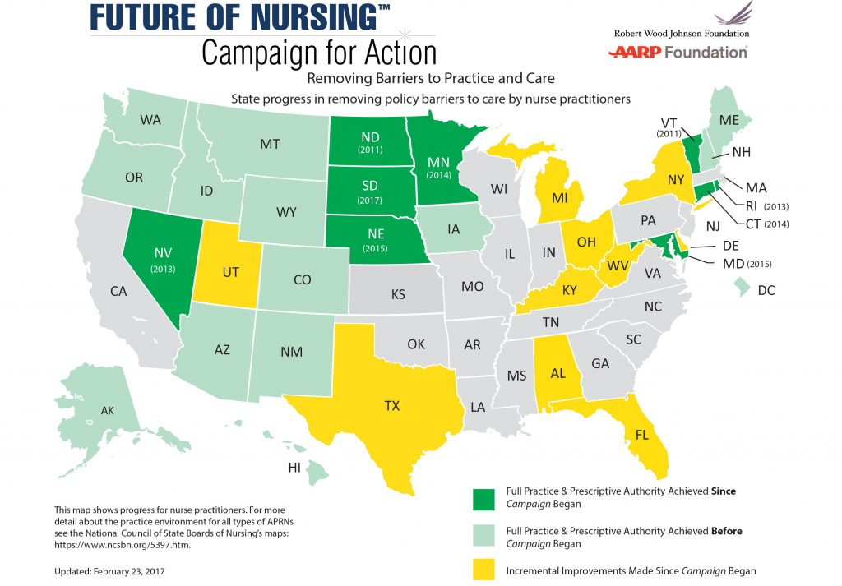
State Progress in Removing Barriers
Notes:
Right now, nurse practitioners in 22 states and the District of Columbia have full practice authority, including South Dakota (where legislation passed in 2017), Nebraska (where legislation passed in March 2015), and Maryland (where legislation passed in May 2015). This is significantly improved from a few years ago, as you can see by this map, which shows the progress made in removing barriers to practice and care. Since the launch of the Campaign, nine states have modernized their practice laws.
For more information about practice restrictions for other types of APRNs, visit the National Council of State Boards of Nursing’s (NCSBN) website.
The Campaign is working to expand access to care by maximizing the use of nurses and removing outdated laws, regulations, and policies that prevent nurses from practicing to the full extent of their education and training—and we are making steady progress.
Currently, 44 Action Coalitions are working to remove barriers to practice and care. And nine states—South Dakota (2017), Maryland (2015), Nebraska (2015), Minnesota (2014), Connecticut (2014), Nevada (2013), Rhode Island (2013), North Dakota (2011), and Vermont (2011)—removed statutory barriers that prevented nurse practitioners from providing care to the full extent of their education and training, helping to increase consumers’ access to care.
Public opinion is also shifting toward support for removing barriers to practice. The turning tide of legislation in the states has coincided with the publication of several high-level reports, journal articles, and mainstream media coverage recommending that states remove outdated barriers to APRN practice and care in publications such as the New York Times, the Wall Street Journal, Politico, Slate, and Bloomberg.
The Federal Trade Commission also has challenged limits to nursing scope of practice in 11 states; in March 2014, the Commission released a policy paper stating that a large body of empirical research strongly suggests that APRNs are safe and effective providers of diverse primary care services. The paper concluded that modernizing APRN scope is “good for competition and American consumers” and urged legislators and policymakers to be mindful when evaluating proposals that limit access to care provided by APRNs.
Furthermore, the Campaign’s leadership is emphasizing the business case for modernizing APRN scope of practice. Campaign leaders have engaged in conversations with employers, insurers, and provider organizations about their bottom lines improving when state policies are modernized.
Additionally, Campaign leaders have engaged with the Bay Area Council Economic Institute, who have designed a model that quantifies the cost savings and consumer access and quality improvements that stem from granting nurse practitioners full practice authority. In California, the Institute found that allowing nurse practitioners to practice to the full extent of their education and training would save $1.8 billion on preventative care visits alone over 10 years, while also increasing the number of preventative care visits by 2 million per year. This model is designed to be replicated in other states and is available for other states to use. If you’d like to learn more, please contact Center to Champion Nursing in America (CCNA) Director Winifred Quinn at wquinn@aarp.org.
Sources:
American Association of Nurse Practitioners. 2017. 2017 Nurse Practitioner State Practice Environment, AANP Practice Map, www.aanp.org/legislation-regulation/state-legislation-regulation/state-practice-environment.
Federal Trade Commission. March 7, 2014. Policy Perspectives: Competition and the Regulation of Advanced Practice Nurses, www.ftc.gov/system/files/documents/reports/policy-perspectives-competition-regulation-advanced-practice-nurses/140307aprnpolicypaper.pdf.
Bay Area Economic Institute. Full practice authority for nurse practitioners increases access and controls cost, http://campaignforaction.org/news/bay-area-council-economic-institute-analysis-finds-granting-full-practice-authority-nurse.

Slide 16

Promote Nurse Leadership
Nurses bring a unique perspective to management and policy discussions.
Nurses are the largest segment of the health care work force and spend the most time with people receiving health services.
Nurses are vital to improving quality.
Yet nurses account for only 6 percent of hospital board positions.
Source: American Hospital Association 2011
Notes:
Nurses provide an important and unique point of view in decision-making, from the boardroom to our communities. They are vital to improving quality by supporting the transition of patients from hospital to home or community and reducing re-hospitalizations and medical errors.
Yet, a 2014 survey of 1,000 U.S. hospitals by the American Hospital Association found that nurses account for only 5 percent of clinical professions serving on boards. This contrasts with the number of physicians on boards, which is 20 percent; other clinicians make up about 4 percent. Although we lack data about nursing involvement on local and state boards of health, anecdotal evidence suggests that nurses are underrepresented on those boards as well.
That‘s why the Campaign for Action is working to prepare the next generation of nurses to meet the health care needs of people, their families, and the communities where they live and to position nurses to lead system change. We also are working to get more nurses, who represent the largest segment of frontline workers, appointed to hospital and health system boards. We will all benefit when nurses see themselves as leaders and are able to influence health policies and outcomes.
In November 2014, national organizations came together to announce a new, nationwide effort to get 10,000 nurses onto boards of directors by 2020. Members of the “Nurses on Boards Coalition” include AARP, the Robert Wood Johnson Foundation, and 19 national nursing organizations. This new effort seeks to ensure that nurses —and their frontline perspectives—have a seat at these decision-making tables.
Source: American Hospital Association’s Center for Healthcare Governance. 2014 National Health Care Governance Survey Report. http://www.americangovernance.com/resources/reports/governance-reports/2014/

Slide 17

Leadership Evidence
Leadership Evidence
When nurses are positioned to influence system practice and policies, it leads to improvements in quality of care, wellness, and reduced medical errors.
Reduced falls with harm
Reduced “code blue” calls
Reduced 30-day re-admissions
Source: Needleman and Hassmiller 2009
Notes:
When nurses are positioned to influence system practice and policies, it leads to improvements in quality of care, wellness, and reduced medical errors. A 2010 Gallup poll of 1,500 health opinion leaders said they wanted nurses to have more influence in a variety of areas, especially in reducing medical errors, increasing quality of care, and promoting wellness. They also believed that nurses should have more input and impact in planning, policy development, and management.
One program called Transforming Care at the Bedside, or TCAB, has been successful at engaging and empowering floor nurses to suggest changes that they think will improve patient care. The changes are tested over a short period, and they’re adopted if they’re proven beneficial. These nurse-led initiatives have reduced falls with harm, code blue calls, and 30-day readmissions. The program also has improved patient outcomes and nursing leadership.
It is also important to point out that nurse leadership will have benefits not only for acute care but in the public health arena as well.
Sources:
Khoury CM, Blizzard R, Wright Moore L, & Hassmiller S. 2011. Nursing leadership from bedside to boardroom: a Gallup national survey of opinion leaders. Journal of Nursing Administration, 41(7/8):299-305, http://www.rwjf.org/en/research-publications/find-rwjf-research/2011/07/nursing-leadership-from-bedside-to-boardroom-.html.
Needleman J, & Hassmiller, S. 2009. The role of nurses in improving hospital quality and efficiency: real-world results. Health Affairs, 28(4):w625-w633, http://content.healthaffairs.org/content/28/4/w625.long.

Slide 18



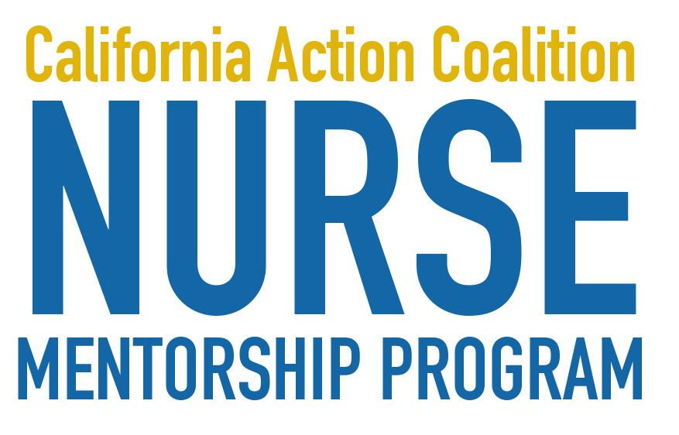
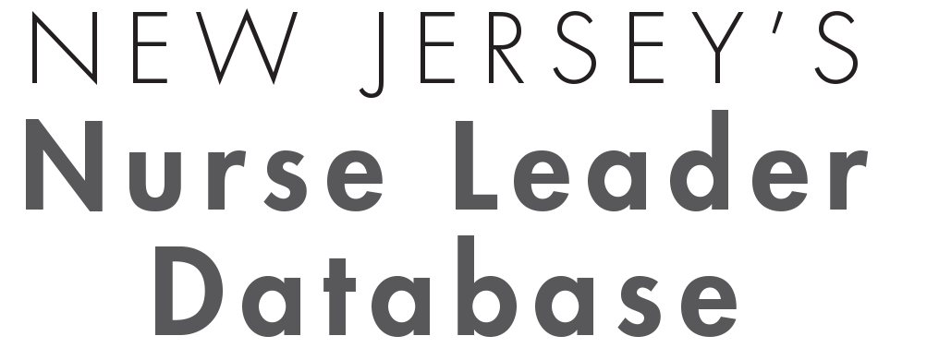

Leadership Progr
Leadership Progress
Notes:
Here are a few examples of what our Action Coalitions are doing across the country to leverage nurse leadership. We’ve made steady progress. The Campaign developed a national nursing leadership strategy after convening nurse leaders and champions at three national meetings. Much of our focus is to get nurses appointed to hospital and health system boards.
Many Action Coalitions are working to get nurses appointed to boards, and 29 Action Coalitions have implemented programs to prepare nurses to lead. For example:
North Carolina and Wyoming have established nursing leadership institutes.
Virginia has implemented an innovative program to identify 40 emerging nurse leaders under the age of 40, and five other states (Arizona, Arkansas, Idaho, Nebraska, and Tennessee) are implementing similar “40 Under 40” programs.
New Jersey has implemented a nurse leader database to increase the number of nurses on boards. To date, 11 nurses have been appointed to boards or task forces as a result of the Action Coalitions’ efforts [as of May 2015].
California has developed a mentorship program pairing up experienced nurse leaders with those who aspire to advance in the nursing profession. To date, more than 200 mentor/mentee pairs have participated in the program [as of May 2016].
Texas has adopted new regulations that promote nurse leadership.
And at the national level, the Leapfrog Group requires nurses to be integrated into governance for hospitals to attain Magnet® status.

Slide 19


Improve Workforce Diversity
Nurses should reflect the population in terms of gender, race, and ethnicity.
All nurses should provide culturally competent services and care.
Greater workforce diversity may help to reduce health disparities and improve health outcomes in diverse communities.
Notes:
The Campaign and our partners also are working to recruit and prepare the nursing profession to provide culturally competent care in a variety of settings to an aging and more ethnically diverse population with more chronic illnesses.
Just over one-third of the U.S. population is part of a racial or ethnic minority according to the 2010 Census, yet nurses from minority backgrounds represent only 19 percent of the registered nurse workforce, and men comprise only 9.6 percent of all RNs.
We see some progress being made in schools of nursing. Nursing students from minority backgrounds represent about 31 percent of students in entry-level baccalaureate programs, 32 percent of students in master’s programs, about 32 percent of students in research-focused doctoral programs, and 29 percent of students in practice-focused doctoral programs. When it comes to college faculty, these percentages are even lower. Only about 14.4% percent of full-time nursing school faculty come from minority backgrounds.
By 2043, minority populations will make up a majority of our population. We need to make sure that our profession reflects the people we serve and that all nurses deliver culturally competent services in all settings.
Sources:
U.S. Census Bureau. March 24, 2011. 2010 Census Shows America's Diversity (press release), www.census.gov/newsroom/ releases/archives/2010_census/cb11-cn125.html.
American Association of Colleges of Nursing. Findings from AACN’s Fall 2014 Survey of Nursing Schools (press release), http://www.aacn.nche.edu/news/articles/2015/enrollment#Findings
American Association of Colleges of Nursing. Fact sheet: Enhancing diversity in the nursing workforce, www.aacn.nche.edu/media-relations/fact-sheets/enhancing-diversity.
American Association of Colleges of Nursing. Nursing Faculty: A Spotlight on Diversity. http://www.aacn.nche.edu/government-affairs/Diversity-Spotlight.pdf
American Association of Colleges of Nursing. Enhancing Diversity in the Workforce. http://www.aacn.nche.edu/media-relations/fact-sheets/enhancing-diversity

Slide 20







P
Diversity Progress
Notes:
To increase diversity among our nursing workforce, the Campaign for Action created a diversity steering committee that is working with all of these groups and more. On the state level, 41 Action Coalitions are working on diversity initiatives within their education and leadership work plans. We have also established a diversity and data learning collaborative with monthly meetings to provide Action Coalitions an opportunity to learn from our diversity consultants, other experts, and each other. Nearly all Action Coalitions participate, and they are working together to move forward the diversity agenda.
A few examples of diversity progress in the states include:
Arizona. The Center to Champion Nursing in America collaborated with AARP Arizona, the National Association of Hispanic Nurses (NAHN) Phoenix Chapter, and Arizona’s National Black Nurses Association (NBNA) and Philippine Nurses Association to educate Hispanic communities about the Affordable Care Act by providing diverse nurses with opportunities to develop skills in leadership, community engagement, and public speaking.
Texas. The Texas Action Coalition is using funding from the Academic Progression in Nursing grant to increase diverse nursing student enrollment in RN-to-BSN programs. They partnered with the University of Texas and other local stakeholders to provide scholarships, increase enrollment opportunities, and provide mentoring to minority nursing students in eight regions of Texas.
Rhode Island. Rhode Island has established the only (new) charter school completely devoted to graduating students devoted to a career in nursing. The school has an 85 percent diversity rate and has graduated students from families that themselves never finished high school, much less college.
Together with NAHN, the Center to Champion Nursing in America trained more than 20 nurses on the Affordable Care Act, and those nurses held more than 50 town halls, informing more than 1,200 individuals about relevant health care provisions. Nurses in three other states—Washington, Illinois, and California—engaged in similar efforts.

Slide 21
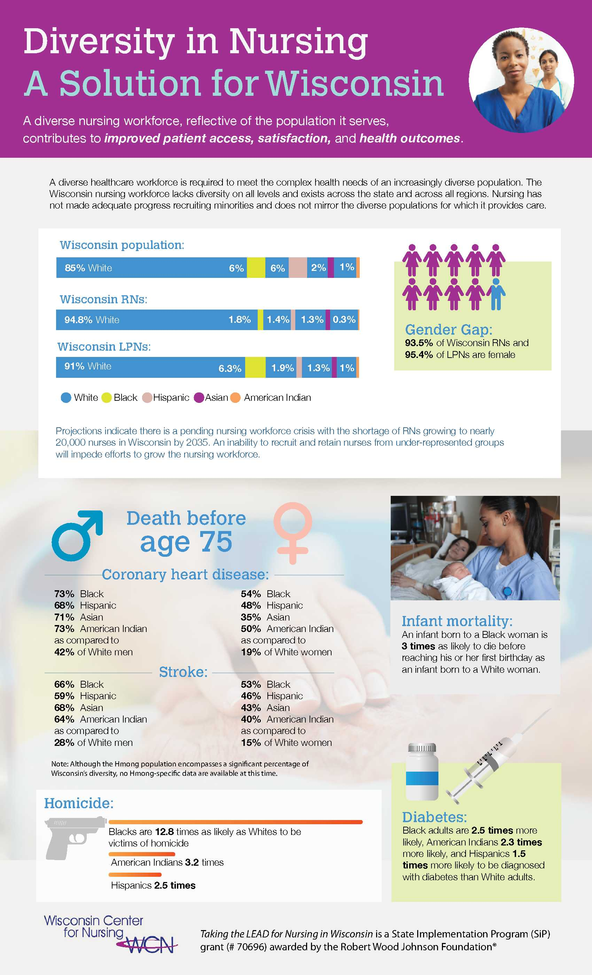
P
Action Coalition Diversity Efforts
A majority of Action Coalitions already have or plan to:
Partner with minority nursing organizations.
Create a diversity manual of best or promising practices.
Develop a toolkit for ethnic minority recruitment of faculty and students.
Notes:
In addition, a majority of the Action Coalitions already have or plan to:
Partner with minority nursing organizations and associations.
Create a diversity manual of best or promising practices.
Develop a toolkit for ethnic minority recruitment of faculty and students.
And 11 states—Alaska, Arizona, Florida, Georgia, Illinois, Indiana, Mississippi, Nebraska, North Dakota, Oklahoma, and Wisconsin—have held or are planning to hold a statewide diversity conference.
Here you will see an example of an infographic created by Wisconsin showcasing the diversity of Wisconsin’s population and workforce.

Slide 22
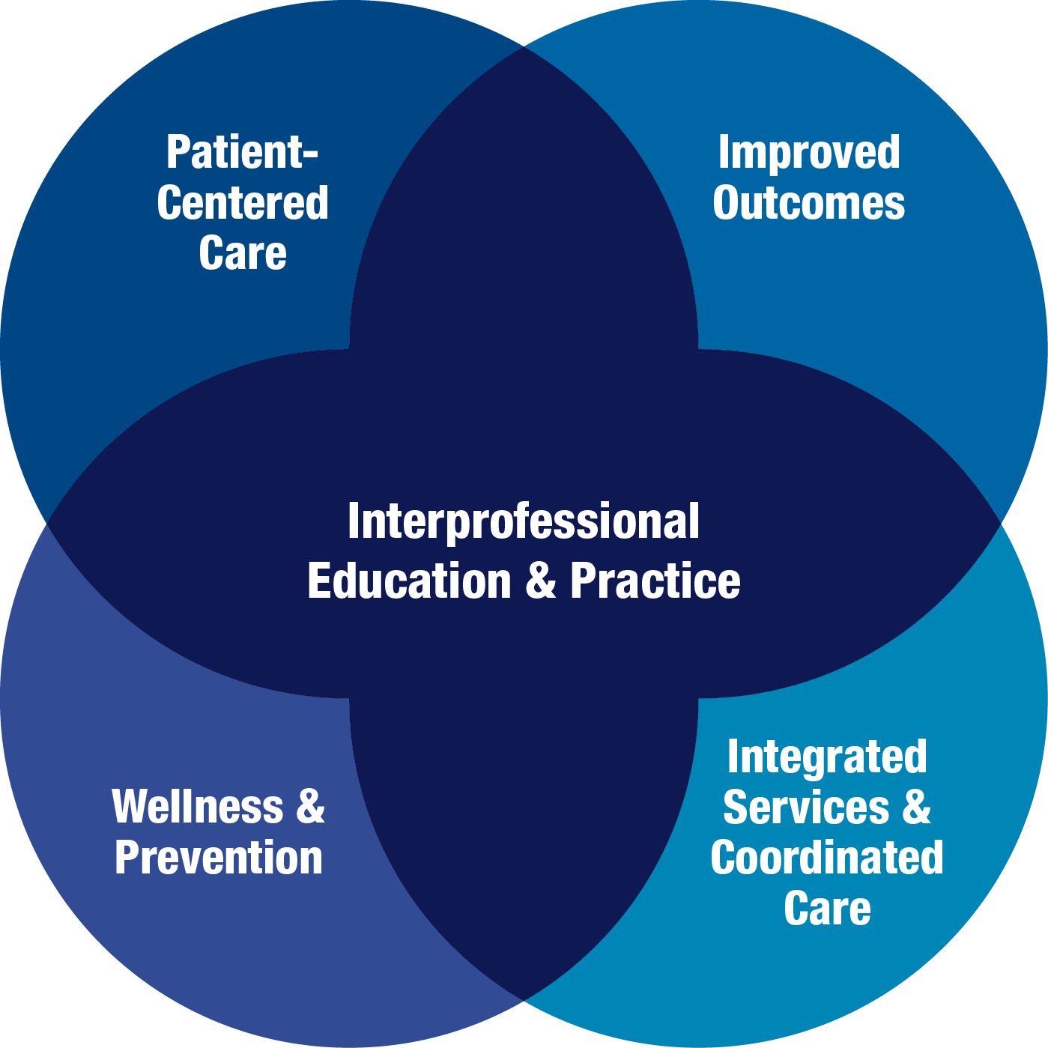
Interprofessional Collaboration
Notes:
Finally, the Campaign also is working on interprofessional collaboration to promote a team-based approach to education and practice to improve the quality and coordination of health care. Studies have demonstrated that effective coordination and communication among health professionals can enhance the quality and safety of patient care.
When health professionals work collaboratively as integrated teams, they draw on individual and collective skills and experience across disciplines. This integration of health service delivery better leverages the assets of health care and public health professionals, allowing each person to practice at a higher level. This results in better health outcomes, including higher levels of satisfaction of services received and improved wellness and preventive care.

Slide 23




New Collaborations
Notes:
Right now, 25 Action Coalitions are working on interprofessional collaboration. A few examples of progress include:
Colorado’s Center for Nursing Excellence received a grant from the Health Resources and Services Administration (HRSA) in collaboration with Colorado’s Community Health Centers to support the implementation of Interprofessional Collaborative Practice Teams at Community Health Centers across the state through June 2016.
Hawaii was awarded a grant from the National Governor’s Association to build an interprofessional workforce database.
Virginia continued a partnership with the Medical Society of Virginia Foundation on the development and implementation of Evolve, a pilot clinical leadership program that encourages pairings between physicians, nurses, nurse practitioners, and other providers.
At the national level, three major foundations—the Robert Wood Johnson Foundation, the Gordon and Betty Moore Foundation, and the Josiah Macy Jr. Foundation—collaborated to support the Health Resources and Services Administration’s National Center for Interprofessional Practice and Education at the University of Minnesota. The Center is working to provide leadership, scholarship, evidence, coordination, and national visibility to advance interprofessional education and practice as a viable and efficient health care delivery mode.

Slide 24
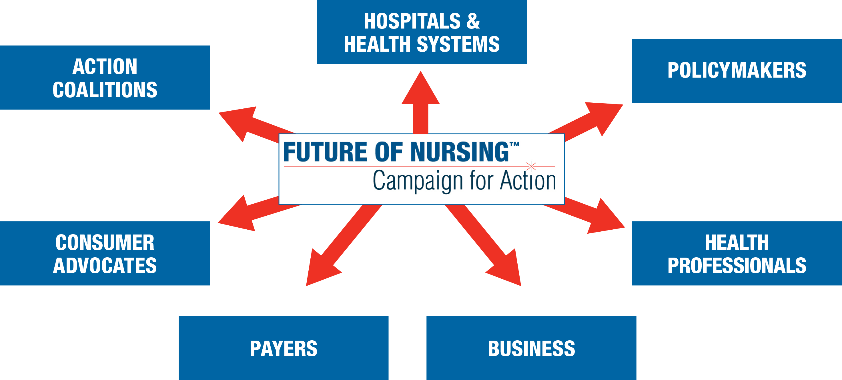
We Need Your Support
Notes:
The Future of Nursing: Campaign for Action is working to transform health through nursing, and we need your help to succeed. It will take all of us—health professionals, hospitals and health systems, policymakers, consumer advocates, payers, consumers, businesses, think tanks, long-term care, foundations, and everyone who cares about health care—to make this work.

Slide 25



Help Shape the Future of Health Care
Join or support an Action Coalition.
Sign up for our email alerts and newsletters.
Visit our website.
Educate your organization about the Campaign.
www.campaignforaction.org
http://facebook.com/campaignforaction www.twitter.com/campaign4action
Notes:
Health care transformation is under way, and the future of nursing is now. We can’t transform health care without transforming nursing. Our health care system can improve only if nurses are better prepared and able to lead and practice to the full extent of their education and training. A few things you can do:
Join or support an Action Coalition.
Sign up for our email alerts and newsletters.
Visit our website and participate in our online community.
Educate your organization about the Campaign.
Together, we can create a health system that provides accessible, affordable, and quality care to everyone in America. Thank you.

