Slide 1

Progress on the Institute of Medicine Recommendations: Perspectives on the Evidence
WORKFORCE PLANNING

Slide 2

Moderator
Joanne Spetz, PhD, FAAN
Professor
Institute for Health Policy Studies,
University of California at San Francisco

Slide 3
Behind the Research
Research on progress in achieving Institute of Medicine recommendations was made possible by the Robert Wood Johnson Foundation.

Slide 4
Four Key Research Areas
Scope of Practice
Nursing Education
Partners in
Redesigning Health Care
Workforce Planning
ADVANCING HEALTH

Slide 5

Presenter
Erin Fraher, PhD, MPP
Assistant Professor, Departments of Family Medicine and Surgery, School of Medicine
Director, Program on Health Workforce Research and Policy at Cecil G. Sheps Center for Health Services Research
University of North Carolina at Chapel Hill

Slide 6

Featured Speaker
Michelle Washko, PhD
Deputy Director
National Center for
Health Workforce Analysis,
Health Resources and
Services Administration

Slide 7

Featured Speaker
Carey McCarthy, PhD, MPH, RN
Director of Research
National Council of State Boards of Nursing

Slide 8
Workforce planning
Erin Fraher, PhD, MPP

Slide 9

Recommendation
Effective workforce planning and
policymaking require better data collection and an improved information infrastructure.

Slide 10
Recommendations
More coordination is needed among organizations that collect nursing
workforce data.
The Health Resources and Services Administration needs to retain and bolster National Sample Survey of Registered Nurses.
System should be established to monitor supply and demand, roles, mix of skills,
and demographics.

Slide 11
Webinar Overview
Data are critical to be able to:
  Track education mobility
  Monitor workforce supply and demand
  Galvanize action to increase workforce diversity
Progress and challenges:
  Federal level
  State level
Action steps will be outlined at the end of this presentation.

Slide 12
Why Data Are Critical
Support and measure progress made on
Institute of Medicine recommendations
Counter turf-based arguments
Engage stakeholders outside of nursing
Forecast employment needs
Assess future nursing workforce needs —
not just numbers but content of care

Slide 13
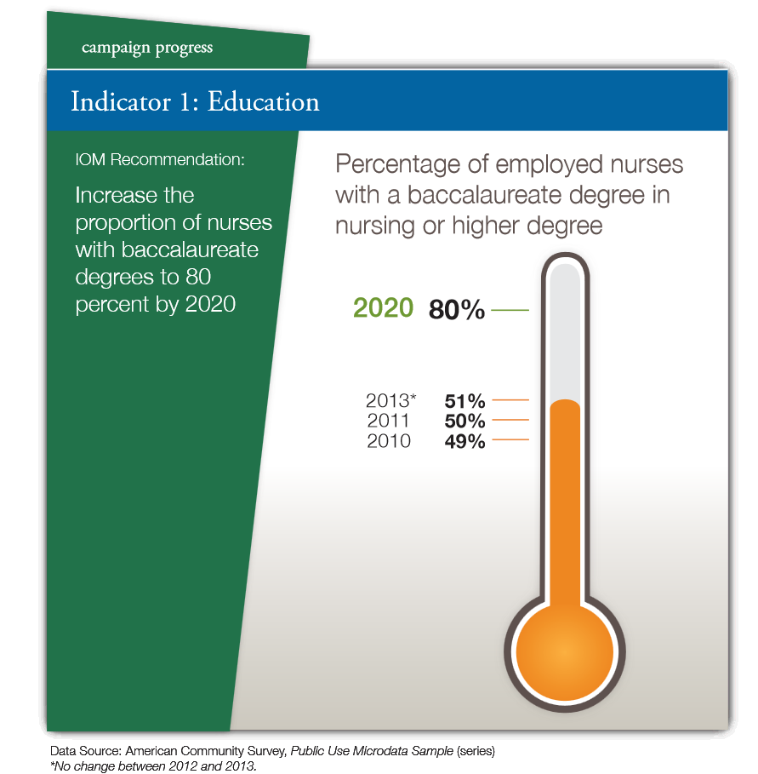
Tracking Educational Mobility
The Campaign Dashboard provides data on progress, using data from American Community Survey (ACS)
ACS data can be a problem for smaller states
State licensure data provide more precise estimates

Slide 14
Tracking Education Mobility: A Case Study
North Carolina Nursing Workforce by Highest Degree, 1982-2013
Note: Data include RNs who were actively practicing in North Carolina as of October 31 of the respective year. Source: North Carolina Health Professions Data System, with data
derived from the NC Board of Nursing, 2016. Produced by: Program on Health Workforce Research and Policy, Cecil G. Sheps Center for Health Services Research, UNC-CH.

Slide 15
Tracking Education Mobility: A Case Study
Number of North Carolina Nurses Entering With ADN as Entry
Degree Who Have Baccalaureate or Higher Degree, 1982-2013
Note: Data include RNs who were actively practicing in North Carolina as of October 31 of the respective year. Source: North Carolina Health Professions Data System, with data
derived from the NC Board of Nursing, 2016. Produced by: Program on Health Workforce Research and Policy, Cecil G. Sheps Center for Health Services Research, UNC-CH.

Slide 16
  Monitoring Workforce Supply
Nursing workforce has lurched from oversupply to shortage. Need better data to anticipate how supply and demand will change due to shifts in the workforce and the health care system.
Retirements: Researchers have developed better understanding of how nurse retirement rates vary by cohort and how these variations may affect future supply. (Auerbach, Buerhaus, & Staiger, 2014)
Enrollments: On other end of career span, dramatic increase in nursing enrollments has caused nursing workforce to grow faster than previous models had forecast. (Auerbach, Buerhaus, & Staiger, 2011)
But will those nurses stay in the workforce?

Slide 17
  Galvanize Action to Increase Diversity
In the United States:
African Americans make up 13.6% of population ages 20 to 40 but only 10.7% of nursing workforce
Latinos make up 20.3% of U.S. population ages 20 to 40 but only 5.6% of nursing workforce
The Campaign has charged Action Coalitions to examine workforce diversity, saying efforts “should be data-based and data-driven. The Diversity Steering Committee recommends an Action Coalition’s plans begin by determining baseline data regarding the state’s population and workforce”

Slide 18
Case Study
Tracking Diversity in NC
Diversity Overview of Population and Select Health Professions, NC, 2014
Note: Data include all active, in-state nurses licensed in North Carolina as of October 31, 2014. Source: NC Health Professions Data System, with data derived from the North Carolina Board of Nursing, 2015. Produced by: Program on Health Workforce Research and Policy, Sheps Center for Health Services Research, UNC-CH.

Slide 19
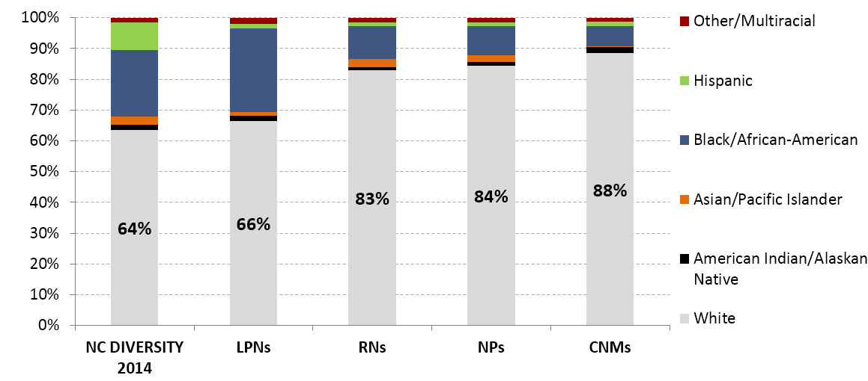
Case Study
Tracking Diversity in NC
Percent of Nursing Workforce and NC Population by Race/Ethnicity,
North Carolina, 2014
Note: Data include all active, in-state nurses licensed in North Carolina as of October 31, 2014. Source: NC Health Professions Data System, with data derived from the North Carolina Board of Nursing, 2015. Produced by: Program on Health Workforce Research and Policy, Sheps Center for Health Services Research, UNC-CH.

Slide 20
Progress Update: Federal Efforts (1)
HRSA has not administered the National Sample Survey of Registered Nurses (NSSRN) since 2008
2012 — administered first National Sample Survey of Nurse Practitioners
2013 — released “The U.S. Nursing Workforce:
Trends in the Supply and Education”
2014 — published “The Future of the Nursing Workforce: National- and State-Level Projections, 2012-2025”
2016 — released online version of nursing supply and demand model

Slide 21
Progress Update: Federal Efforts (2)
Federal datasets revised to include more data elements to help determine how advanced practice registered nurses (APRNs) are being deployed
HRSA-funded Health Workforce Research Centers exploring nurse education trajectories and roles and skill mix of nurses in different settings
Health Workforce Technical Assistance Center providing assistance in using HRSA’s nursing model

Slide 22
Federal-State Partnerships
The National Council of State Boards of Nursing and National Forum of State Nursing Workforce Centers in 2015 partnered to fill void created by end of NSSRN; ~46,000 RNs and 32,000 licensed practical nurses responded.
Key findings (Budden 2016):
  Workforce becoming younger, more diverse, more educated
  Newly licensed nurses more likely to be in hospital settings than experienced nurses
  Data do not suggest impending shortage due to retirements
Notes:
Budden Jill. (2016). Findings from the 2015 National Nursing Workforce Study. Presented at the National Forum of State Nursing Workforce Centers Conference. April 27, 2016. http://www.ndcenterfornursing.org/wp-content/uploads/2016/04/Budden-Presentation.pdf

Slide 23
Progress: State Efforts
National Forum of State Nursing Workforce Centers has developed set of recommended questions states should collect about supply, demand, and nursing education
National Council of State Boards of Nursing has created infrastructure to collect those supply, demand and education data elements for all states
34 states have nursing workforce centers
  30 collect supply data
  20 collect demand data
  31 collect education data
Campaign Dashboard shows in 2014, 45 states collected race/ethnicity data, up from 34 states in 2011

Slide 24
Good Start, Action Still Needed
Reinstate and bolster NSSRN
Create national sampling frame
Collect data on content of nursing care, not just numbers
Enhance ability to use EHRs to measure content and value of nursing care
Develop interprofessional datasets
Create better demand measures—engage employers!
Celebrate wins—collect evidence on policy impact of having data. Use to leverage resources
Develop data use agreements

Slide 25
Take-Away Message
Take home message:
Data are critical in shaping the future of nursing in a transformed health care system

Slide 26
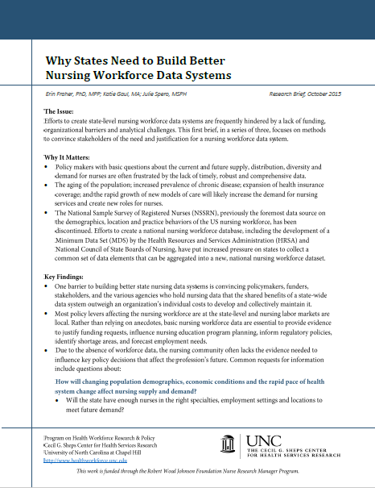
So Now You’re Ready To Do This…
See our briefs
Why States Need to Build Better Nursing Workforce Data Systems
How States Can Develop Better
Nursing Workforce Data Systems
What Data States Can Collect to Build Better Nursing Workforce
Data Systems
http://www.shepscenter.unc.edu/
workforce_product/nursing-data-
system-briefs-inqri-2/

Slide 27
Featured Speaker
Michelle Washko, PhD
Deputy Director
National Center for
Health Workforce Analysis,
Health Resources and
Services Administration

Slide 28
HRSA’s Health Workforce
Microsimulation Model
  Tracks RNs, LPNs: NPs are modeled with physicians and PAs
Measures characteristics of: current nursing workforce, new entrants
Equations predict: workforce participation, workforce attrition
Minimum requirements in:
  Individual-level database
  Age, gender
  Highest nursing education level
For more, visit National Center for Health Workforce Analysis website:
  http://bhw.hrsa.gov/healthworkforce/index.html

Slide 29
Revised National Sample Survey
Registered Nurses
HRSA is bringing back the NSSRN!
Data will be collected by the Census Bureau
Plan to increase sample size
Plan to oversample:
  Diverse populations
  Nurses under 30
  Nurse practitioners

Slide 30
Featured Speaker
Carey McCarthy, PhD, MPH, RN
Director of Research
National Council of State Boards of Nursing

Slide 31
NCSBN Research Sources
The National Nursing Database
A Profile of Nursing Licensure in the United States
https://www.ncsbn.org/national-nursing-database.htm
National Nursing Workforce Survey
https://www.ncsbn.org/workforce.htm

Slide 32

Questions or Comments?
Press *1 on your telephone keypad to ask a question
OR
Use the “chat” feature to send “everyone” a question
You can find the recording, webinar summary, and additional resources by going to: CampaignforAction.org/webinars.
32

Slide 33

Resources
http://campaignforaction.org/resources/#133,p=1

Slide 34
Research Winter-Spring Webinars
2016 | Topic | Research Manager
​February 23 3 to 4 p.m. ET | ​Scope of Practice | ​Joanne Spetz
March 22 3 to 4 p.m. ET | ​Nursing Education | ​Linda Aiken
April 25 3 to 4 p.m. ET | ​Partners in Redesigning Health Care | ​Olga Yakusheva
May 23 3 to 4 p.m. ET | ​Workforce Planning | ​Erin Fraher
See What You Missed: Archived Webinars

